Slide 1
KUALI
CAPITAL ASSET
MANAGEMENT (CAM)
FINANCIAL DOCUMENTS:
GENERAL LEDGER TRANSFER (GLT)
Business and Financial Services, Property Management
Presenter: Debra Ellison

Slide 2
General Ledger Transfer (GLT) document
Things to know:
Only Actuals (AC) balance types are allowed
Adjustment/Accrual (AV) documents are restricted from being corrected using the GLT document. Search results will omit this document type from selection.
Only accounts within project to date sub-funds can be corrected on the GLT in prior fiscal years.
The GLT document has a tab called Late Adjustment Certification. There are five (5) questions that will need to be answered via text fields. The questions are hardcoded and cannot be changed. This tab will help with justifications as to why the entries are being moved. The tab will be required when a user is moving entries that exceed 365 days and controlled by Business and Financial Services. Office of Sponsored Programs will set sub-fund SPONPR, SPWIP, and 1SPONR at 0 days, so this tab will be required on every GLT document with accounts in these sub-funds.
The Kuali GLT document does not use the terms credit or debit. It uses “FROM/SOURCE” and “TO/TARGET”.

Slide 3
INFORMATION NEEDED
It is important to know why you are submitting the General Ledger Transfer document to know what information is needed.
Will you be creating an asset (capitalizing an asset that was originally expensed).
  “FROM” (source) will use an expense object code and “TO” (target) lines will use a capital object code.
Will you be modifying an existing asset (capitalizing a cost that was originally expensed).
  “FROM” (source) will use an expense object code and “TO” (target) lines will use a capital object code.
Will you be modifying an existing asset (changing funding on an asset already created)
  “FROM” (source) will use a capital object code and “TO” (target) will use a capital object code.
Will you be modifying an asset that was created in error (asset was mistakenly capitalized instead of expensed)
  “FROM” (source) will use a capital object code and “TO” (target) will use an expense object code.
Will you be modifying an existing asset (posting a credit)
  “FROM” (source) may use a capital or expense object code and “TO” (target) will use a capital object code.

Slide 4
other INFORMATION NEEDED
The following information should be considered or may be required when submitting a GLT using capital asset object codes:
Correct Object Codes (Correct capital object code and correct non-capital object code)
Existing Asset Numbers (Required when modifying assets. Any existing asset numbers may be found on the PO in the Notes and Attachments tab if the payment was made using a Payment Request “PREQ” or by doing an Asset Payment lookup using the account number the asset was purchased on)
Amount Paid (The amount in the General Ledger. This information may also be found on the PREQ or on multiple PREQs if more than one PREQ was used)
Vendor (Required to create an asset. Must match the vendor listed on the Purchase Order or PREQ)
Asset Information (Required to create an asset. e.g.; the manufacturer, model, asset description, etc. This information may be found on the PO, quote, or invoice. The Asset Type Code can be looked up in Kuali)
Asset Location (Required to create an asset. e.g.; main campus “MC”, building number, and room number)
Number of Assets to be Created (Are they identical or different)
Cost of Each Asset (Are they the same amount, e.g.; identical, or are they different amounts)
Funding (If multiple accounts and/or assets, which accounts apply to each asset)

Slide 5
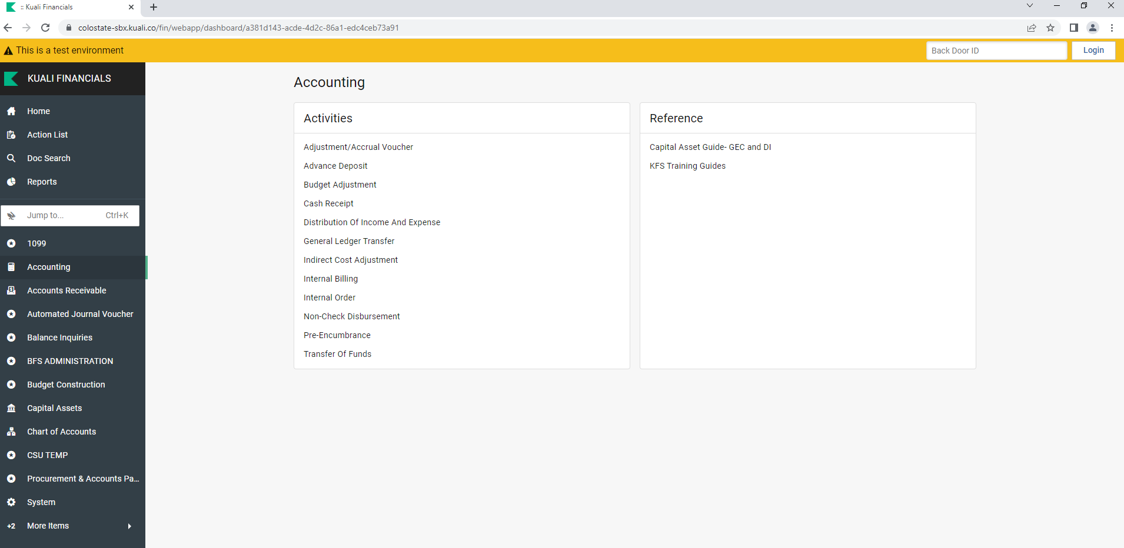
General Ledger Transfer document
Click on: Accounting
Click on: General Ledger Transfer

Slide 6
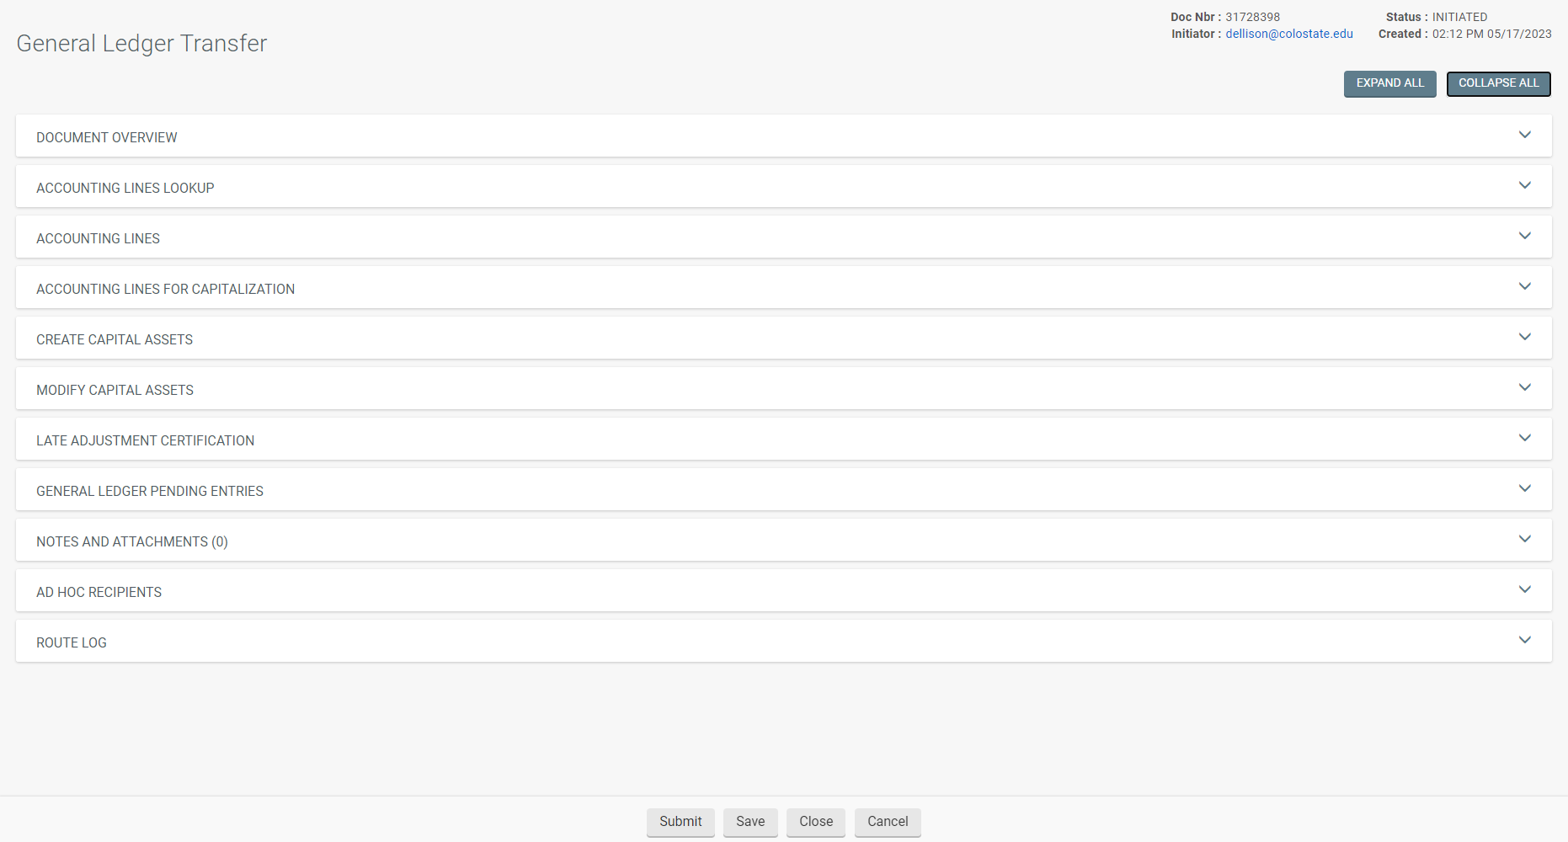
General Ledger Transfer document
A GLT document will open. You will need to complete specific tabs depending upon what you are needing to do.

Slide 7
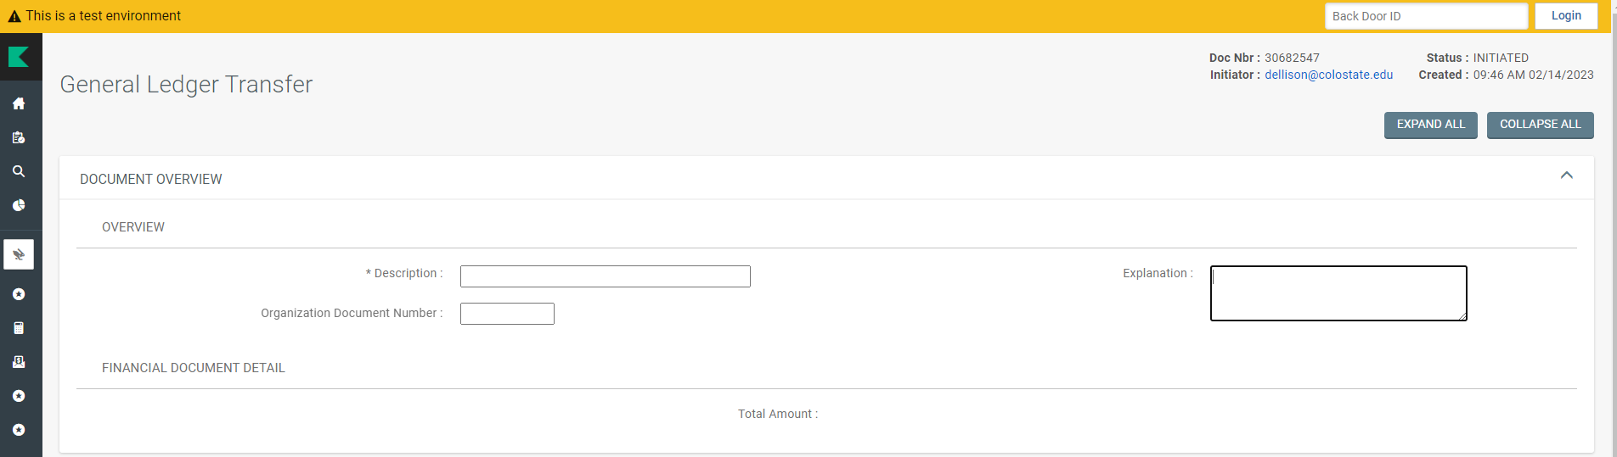
Document Overview tab
The Document Overview Tab
Enter a description
Brief explanation (reason for the document)
The organization document number (usually the PO number).

Slide 8
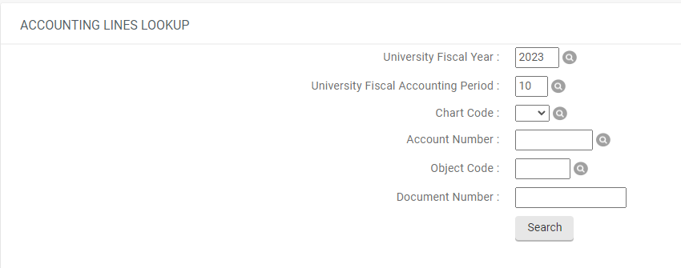
ACCOUNTING LINES LOOKUP TAB
The Accounting Lines Lookup Tab is where you enter any known general ledger information to find the transaction you want to change.

Slide 9
ACCOUNTING LINES LOOKUP TAB
You need to lookup the GL posting(s). Enter any of the following known information:
University Fiscal Year
University Fiscal Accounting Period
Chart Code
Account Number
Object Code
Document Number
Once information is entered, click on “Search” (repeat for additional GL postings).

Slide 10
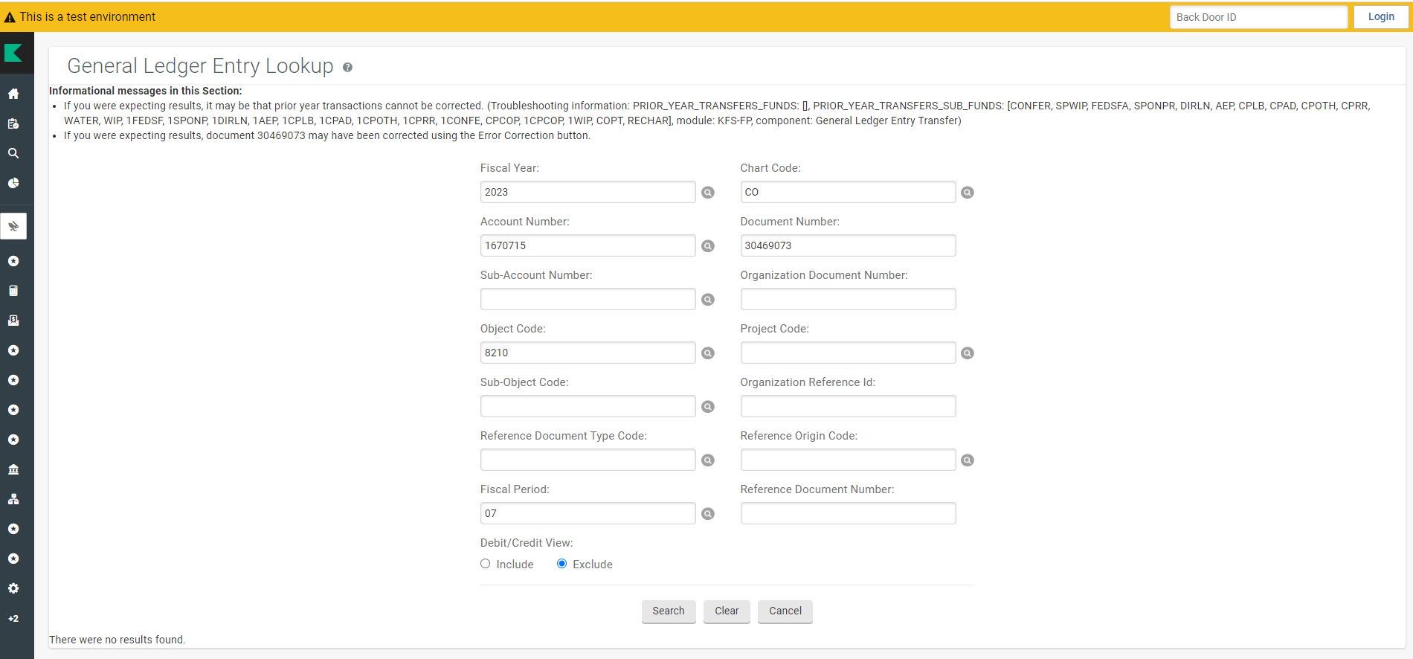
Accounting Lines LOOKUP TAB
If there are no results found, it may be necessary to alter your search data.

Slide 11
Accounting Lines LOOKUP TAB
Use wild card searches by entering “**” in the Fiscal Period.
Then click on “Search”

Slide 12
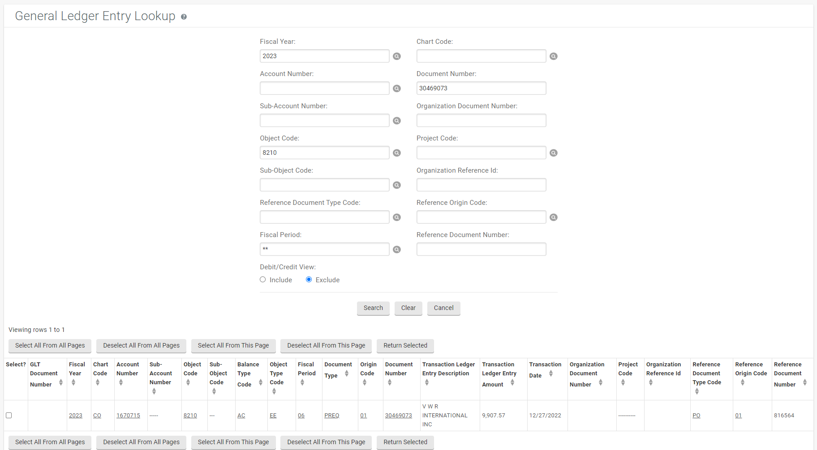
Accounting Lines LOOKUP TAB
All entries meeting the search criteria will be shown.
Verify the information then select the entry or entries you are needing to change (click in the box).
Click on “Return Selected”

Slide 13
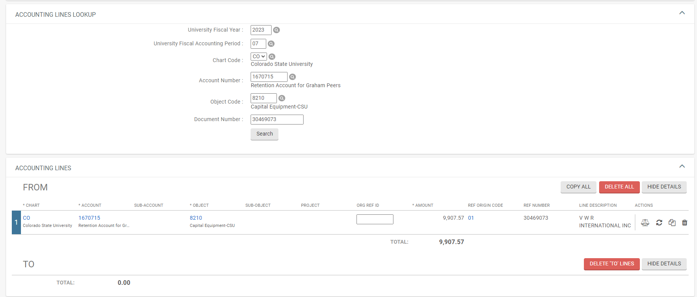
Accounting Lines TAB
The Accounting Lines tab “FROM” Line will now be populated (This is the original entry you want to change).
This is also known as the “SOURCE” and will post a credit entry on the asset*
*Depending upon the type of entry, a debit may be posted (e.g., reversing a credit posting).

Slide 14


Accounting Lines TAB
The Copy All button will copy all lines at once
The Delete All button will delete all lines at once
The Hide Details button will hide descriptions
Actions in the “FROM” lines will allow you to do the following:
The Scale will allow you to perform a balance inquiry for the line
The Circular Arrows will allow you to refresh the line
The Documents will allow you to copy the line
The Garbage Can will allow you to delete the line

Slide 15
Accounting Lines TAB
In order to populate the Accounting Lines tab “TO” Line, click on the “COPY ALL” button.

Slide 16
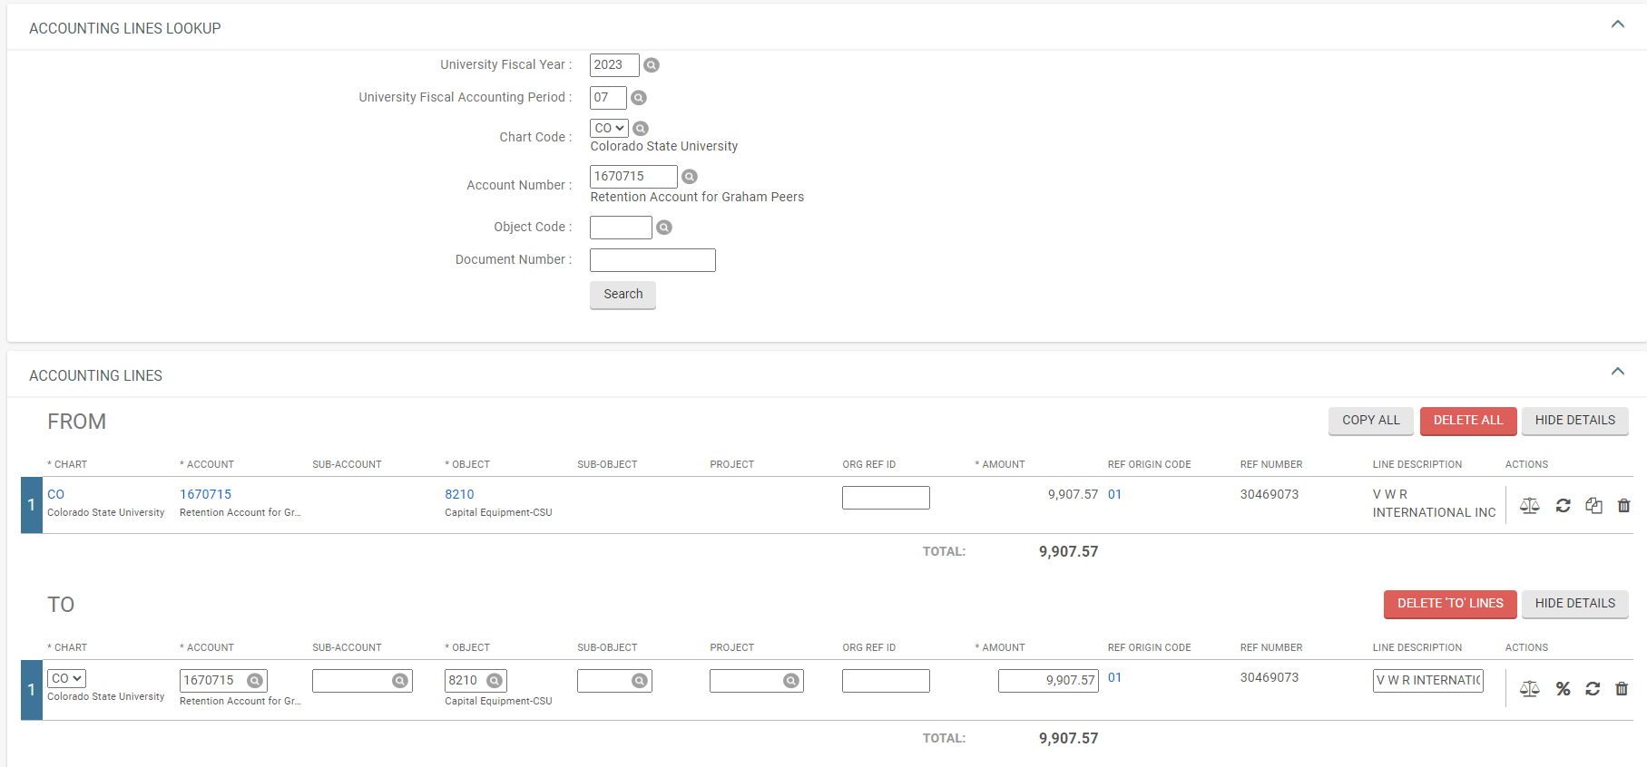
Accounting Lines TAB
The Accounting Lines tab “TO” Line will now be populated.
This is also known as the “TARGET” and will post a debit entry on the asset*.
*Depending upon the type of entry, a credit may be posted (e.g., reversing a credit posting).

Slide 17

Accounting Lines TAB
Actions in the “TO” lines will allow you to do the following:
The Scale will allow you to perform a balance inquiry for the line
The Percent Sign will allow you to split the amount into different amounts
The Circular Arrows will allow you to refresh the line
The Garbage Can will allow you to delete the line

Slide 18
Accounting Lines TAB
NOTE: Splitting line amounts may be necessary to achieve what you are wanting to do and keep the lines in balance and post the correct amounts to each asset.
Some reasons to split line amounts:
  Only moving a partial amount
  Multiple assets involved
  Multiple asset values involved
  Multiple accounts involved
  Multiple Payment Requests (PREQ) involved

Slide 19
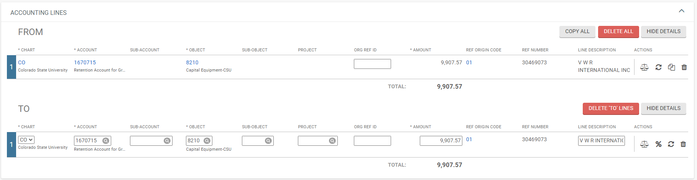
Accounting Lines TAB
NOTE: If lines have identical account information, you will get the following error message when trying to process your document.
This means you will need to enter or edit information in one or more of the following fields to make the lines different (you can usually put different numbers in each of the ORG REF ID fields to make the lines different):

Slide 20
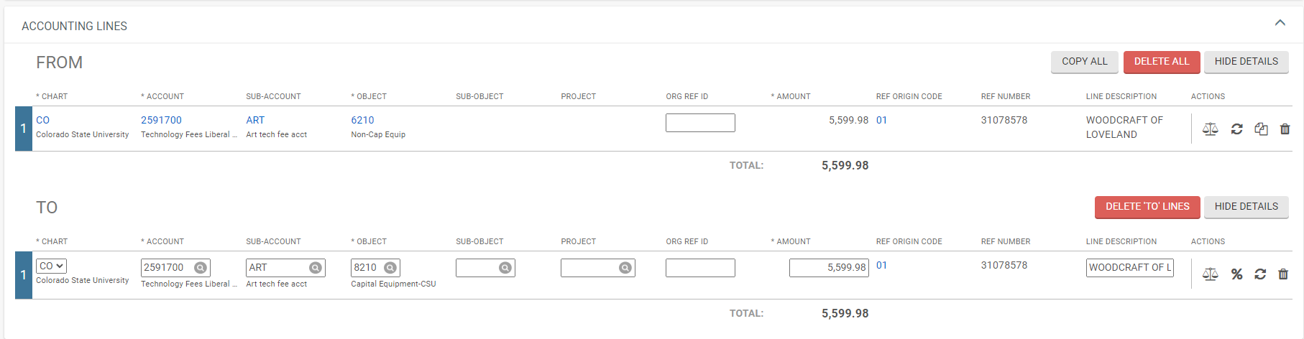
Accounting Lines TAB
Once you made your changes, you may need to click on the “refresh” icon to open the Accounting Lines For Capitalization tab.

Slide 21
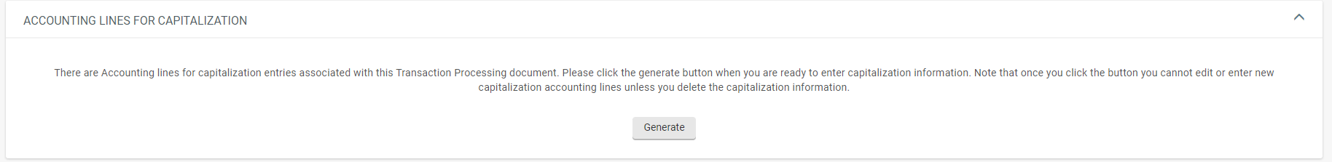
Accounting Lines for capitalization tab
Once the Accounting Lines For Capitalization Tab is open, click on “Generate” to start processing.

Slide 22
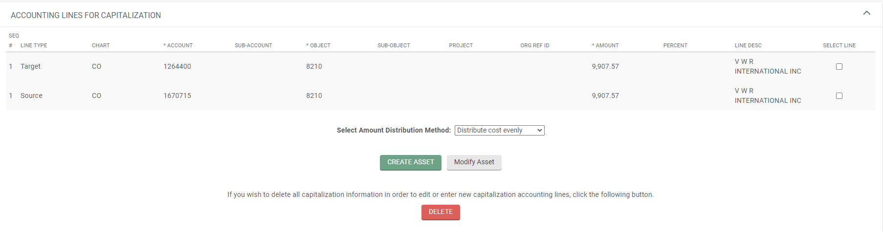
Accounting Lines for capitalization tab
Only lines that used a capital object code will be available for processing.
Each line will be labeled as either a Target or Source.
The Target (TO) line is the accounting line you are putting the amount to.
The Source (FROM) line is the accounting line you are removing the amount from.

Slide 23
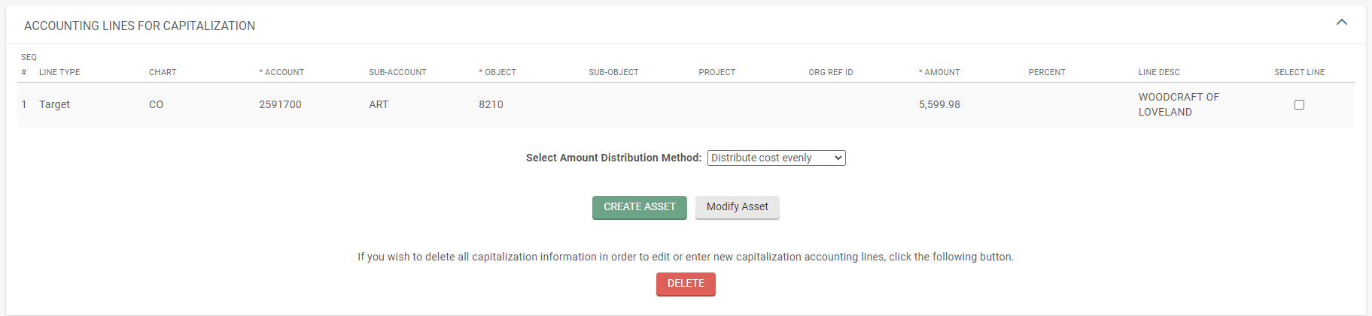
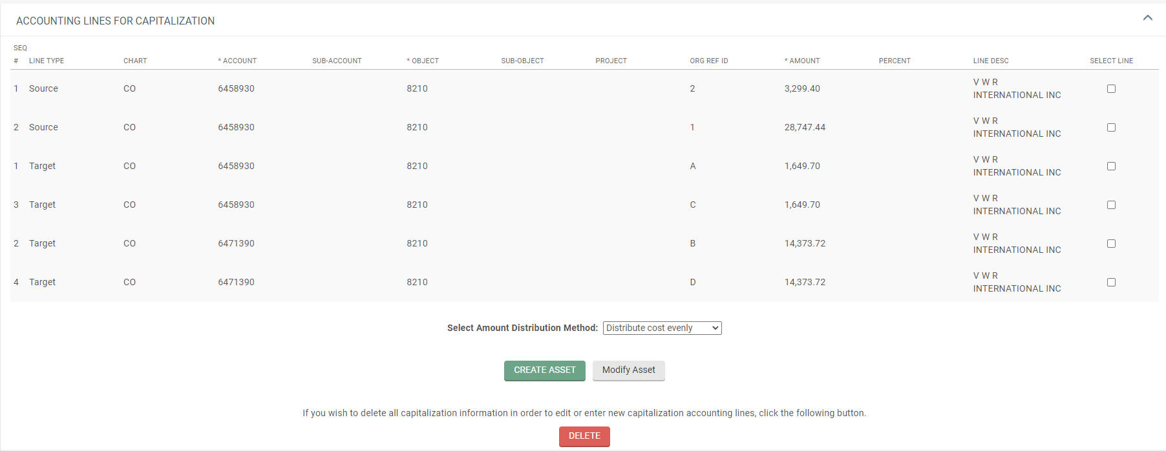
Accounting Lines for capitalization tab
There may be a single line (either a Target or Source) or multiple lines (either Targets, Sources, or any combination of Targets and Sources.

Slide 24
Accounting Lines for capitalization tab
The following choices are all tied together depending upon what you are needing to do:
  Selecting the line or lines to process
  Selecting the Amount Distribution Method
  Selecting whether to Create an asset or Modify an asset.

Slide 25
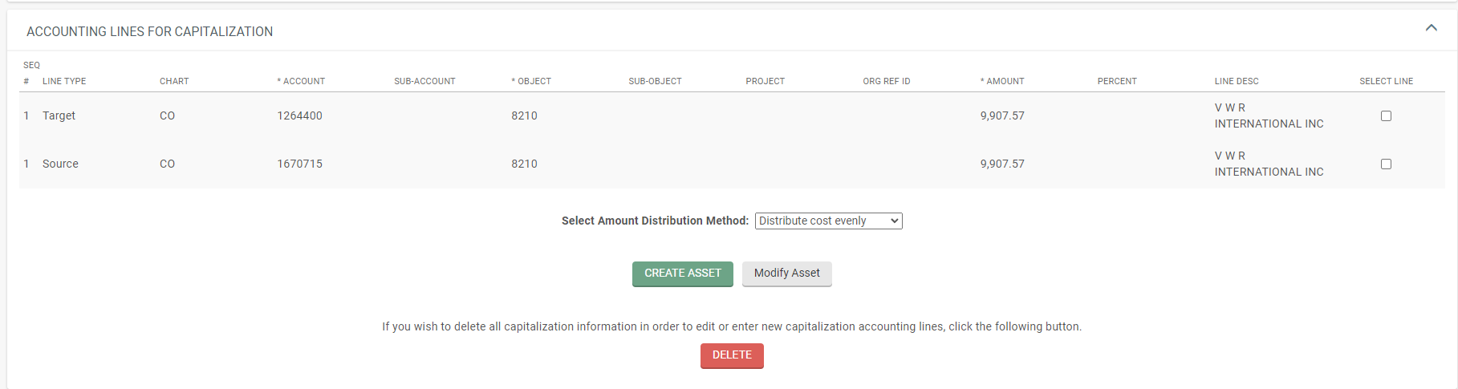
Accounting Lines for capitalization tab
You may select one or any combination of lines for processing.
NOTE: In most cases, when modifying an existing asset and only one asset is involved, you will have both a Target and Source line, you would select both line items to post to the asset.

Slide 26
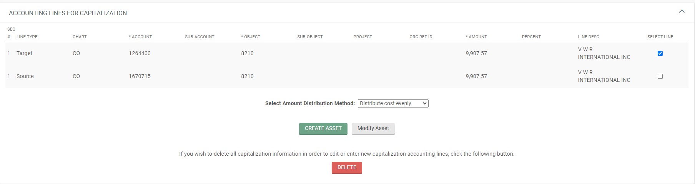
Accounting Lines for capitalization tab
Remaining unselected lines will need to be selected and processed based upon your next set of choices, until all lines have been selected and processed.

Slide 27
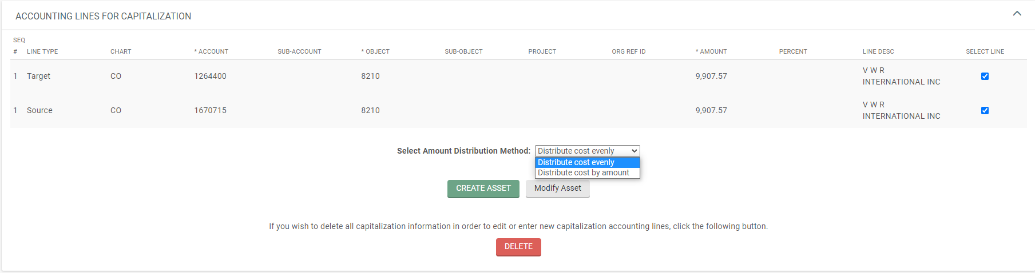
Accounting Lines for capitalization tab
The Select Amount Distribution Method allows for custom postings if multiple accounts and/or assets are involved and will be tied to the lines that were selected.
Selecting “Distribute cost evenly” will distribute identical amounts over one or more assets using the Target and/or Source lines that were selected. (Primarily used for one asset or identical assets costing the same amount)
Selecting “Distribute cost by amount” will distribute the amount that is manually entered over multiple assets using the Target and/or Source lines that were selected. (Primarily used for multiple unique assets with different costs)

Slide 28
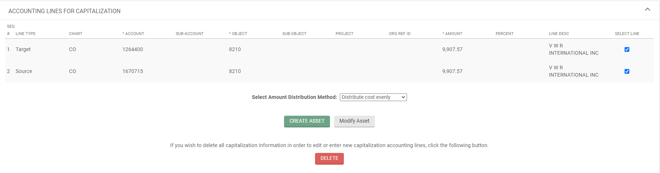
Accounting Lines for capitalization tab
You need to select if you are creating an asset or assets or modifying an asset or assets.
Selecting Create Asset will require you to complete the Create Capital Assets Tab and you will need information from the PO.
Selecting Modify Asset will require you to complete the Modify Assets Tab and you will need the asset number or numbers.
If the “Target/To” line uses a capital object code, and the “Source/From” line uses a non-cap object code you will either be creating an asset or assets or modifying an existing asset or assets.
If the “Target/To” and the “Source/From” line both use a capital object code, you are modifying an existing asset.

Slide 29
Accounting Lines for capitalization tab
You can create assets individually or in groups of identical assets. To create additional assets or groups of identical assets, repeat clicking on “Create Asset” for each unique asset you wish to create or each group of identical assets you wish to create.
If you are modifying more than one asset, repeat clicking on “Modify Asset” for each individual asset you want to modify.
Your selected line item(s) total must amount to the total value of your asset or assets. If creating multiple groups of identical assets, split your line items into the correct amount of the group totals before processing.
If distributing cost evenly, all assets will have the same amount applied. Otherwise, for assets that have different values, use distribute cost by amount.

Slide 30
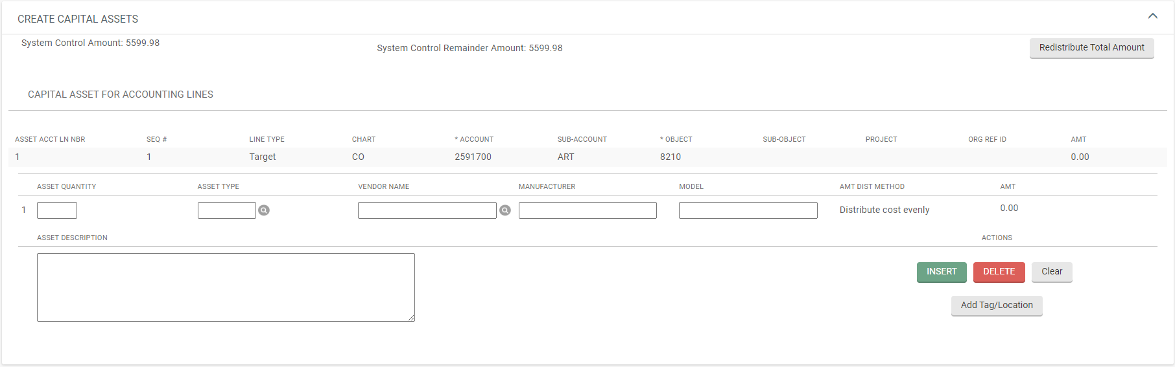
Create capital assets tab
If “Create Asset” was selected, you must complete the Create Capital Assets Tab.
NOTE: Only selected line items will show in the tab.

Slide 31
Create capital assets tab
Enter the Asset Quantity to create (if entering more than “1”, the assets must be identical)
Click on the Magnifying Glass or Enter the Asset Type.
Click on the Magnifying Glass to enter the Vendor Name (must match the vendor’s name used on the PO or PREQ).
Enter the Manufacturer.
Enter the Model.
Enter the Asset Description.
Click on: “Add Tag/Location”

Slide 32
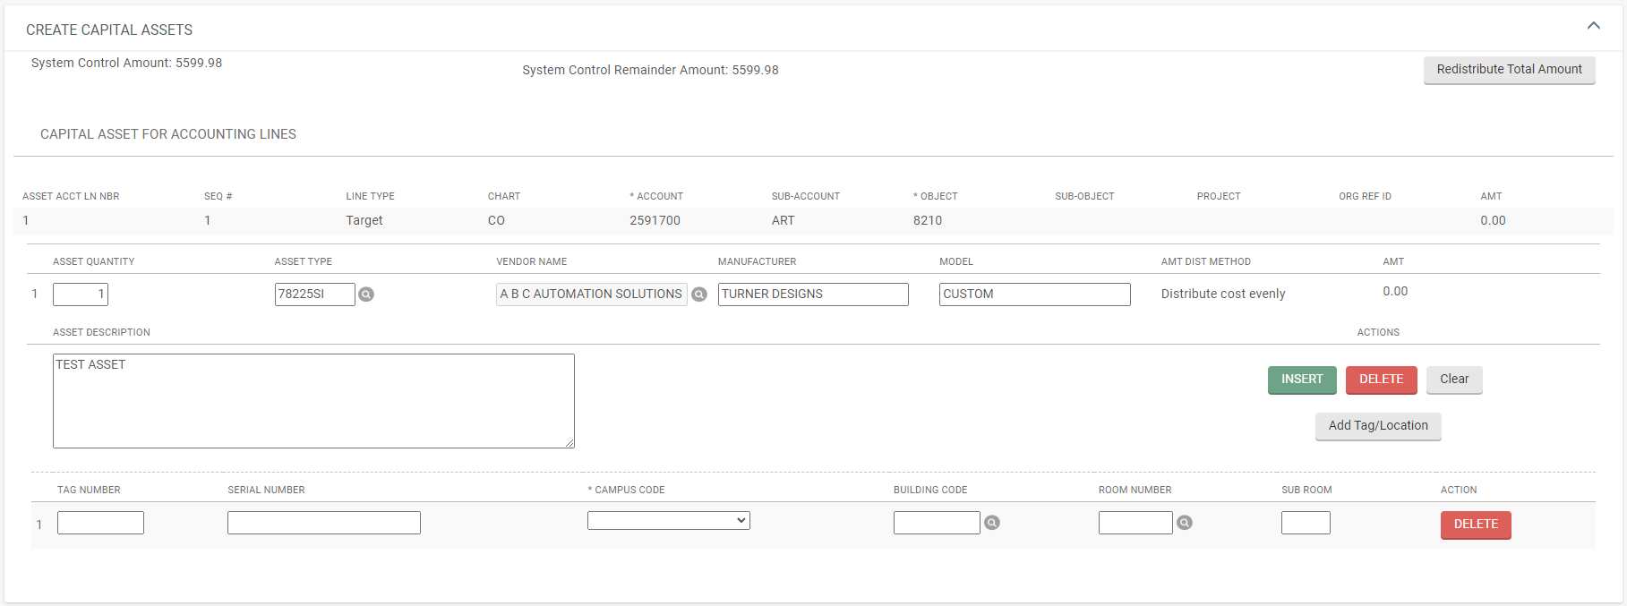
Create capital ASSETs tab
After clicking on Add Tag/Location, a Tag/Location line will show for each asset quantity entered.
NOTE: Unless obtained from Property prior to submitting, leave any decal (tag) number fields blank when creating an asset or assets. These will be assigned (entered) when the document is routed to Property Management.
Enter the Campus Code, Building Code, and Room Number for the asset.

Slide 33
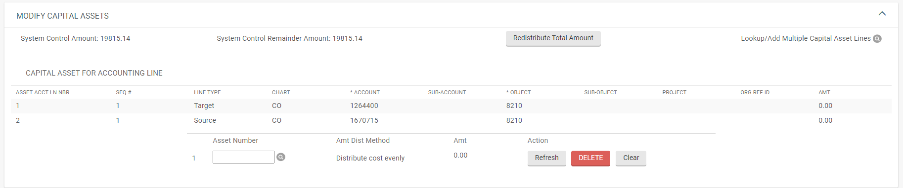
Modify capital assets tab
If “Modify Asset” was selected, you must complete the Modify Capital Assets Tab.
NOTE: Only selected line items will show in the tab.

Slide 34
MODIFY capital assets tab
Enter, or lookup, the Asset Number of the asset you are wanting to post the entry or entries to. (NOTE: The Asset Number is NOT the Decal Number).

Slide 35
SYSTEM CONTROL AMOUNT
Once your information is entered (either completing the Create Capital Assets tab or Modify Capital Assets tab), you must clear the System Control Amount to show zero.
Click on the “Redistribute Total Amount” button.
NOTE: Kuali does not distinguish between debits and credits, your System Control Amount should be doubled if processing a debit and credit amount on an asset.

Slide 36
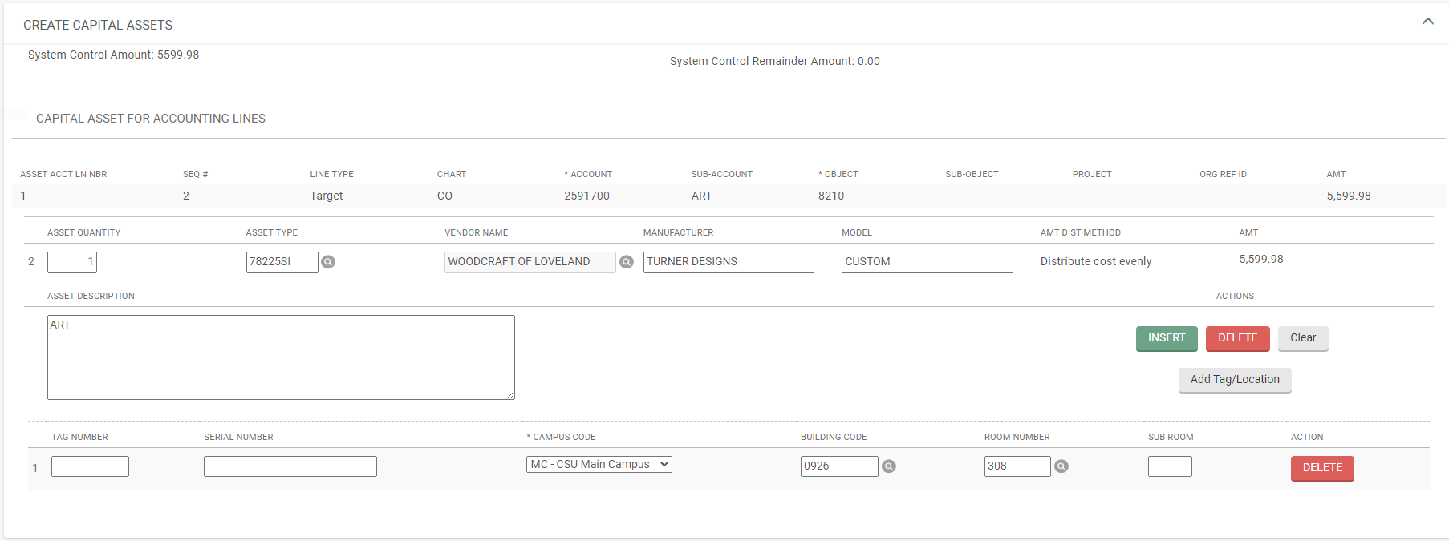
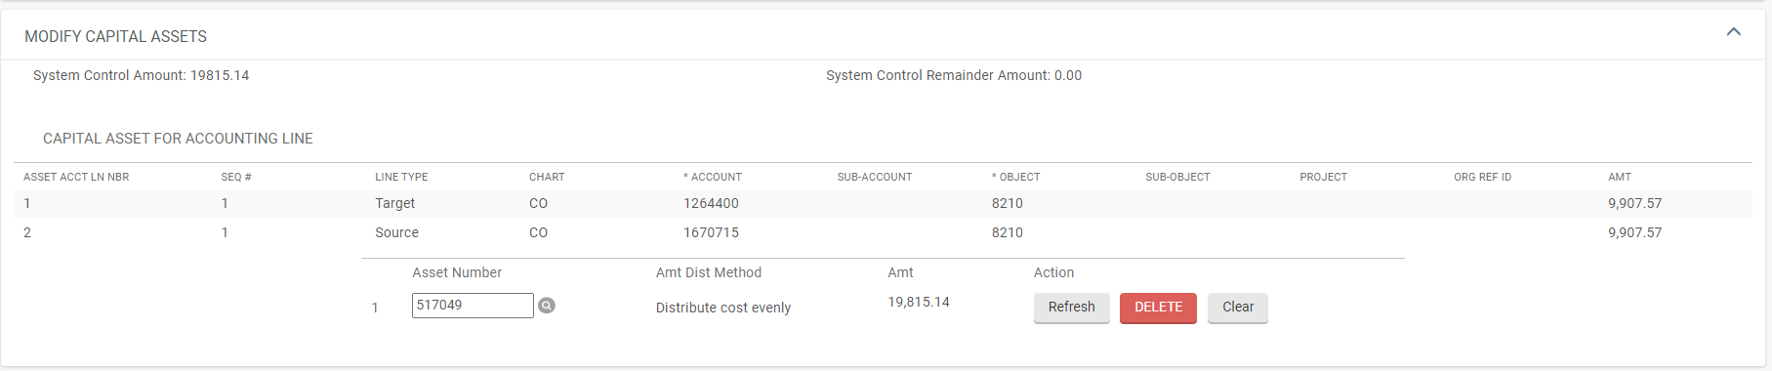
SYSTEM CONTROL AMOUNT
The values processed should now show in your Capital Asset tab (either Create Capital Assets or Modify Capital Assets).

Slide 37
SYSTEM CONTROL AMOUNT
Repeat any additional processing with remaining line items to select or assets to create or modify.
Once you have processed all Accounting Lines for Capitalization, the System Control Remainder Amount should show zero.

Slide 38
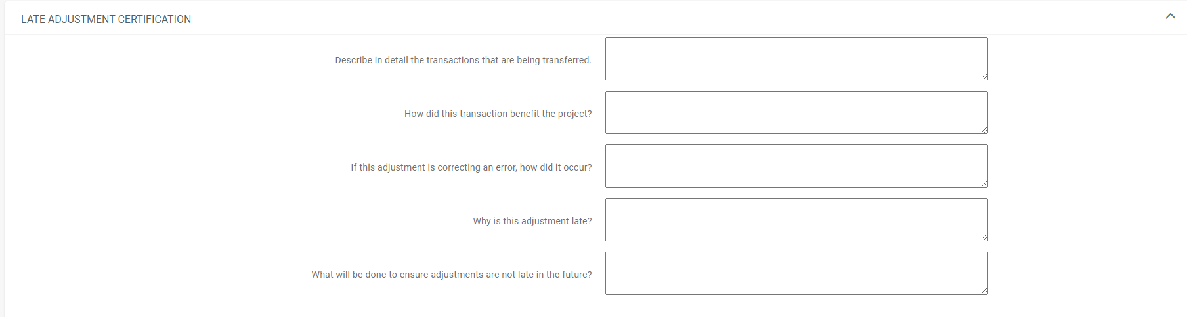
LATE ADJUSTMENT CERTIFICATION TAB
When required, you must complete each box.

Slide 39
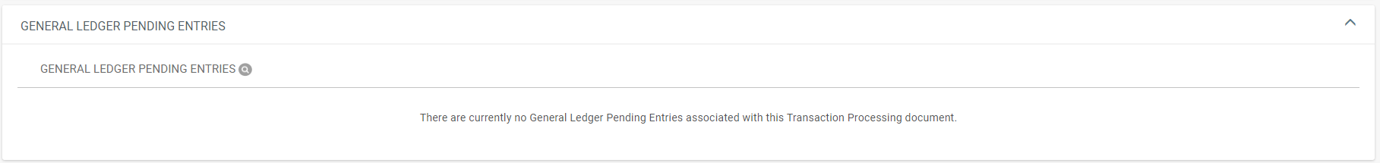
GENERAL LEDGER PENDING ENTRIES TAB
Always check to see if the entries are what you are wanting.

Slide 40
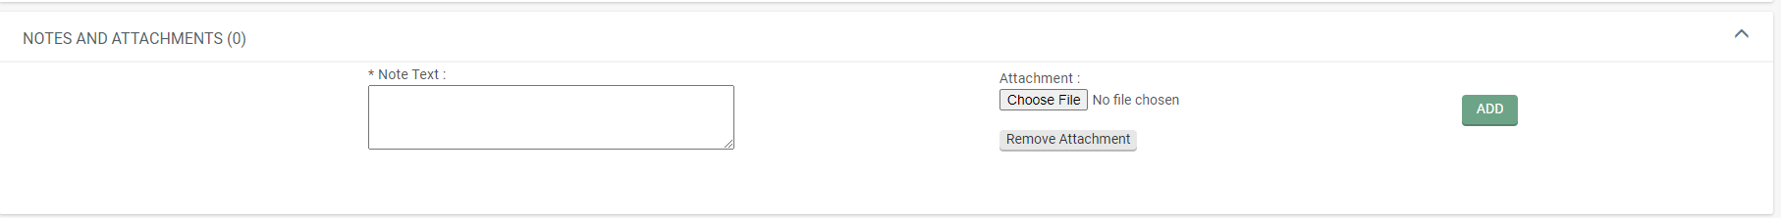
NOTES AND ATTACHMENTS TAB
Attach any backup in the Notes and Attachments Tab and click on “add”.

Slide 41

Document options
Submit, Save, Close, or Cancel document are available options.
Click on: “submit”.

Slide 42
General Ledger Transfer document
EXAMPLE: OBJECT CODE CHANGE-CREATE ASSET
(non-cap to cap, single asset)

Slide 43
General Ledger Transfer document
Bring up a GLT document

Slide 44
Document Overview tab
Description: Enter a brief description.
Explanation: Enter any necessary information (e.g., Object Code Change)
Organization Document Number: Enter the PO number (In this example, information from PO 822429 was used).

Slide 45
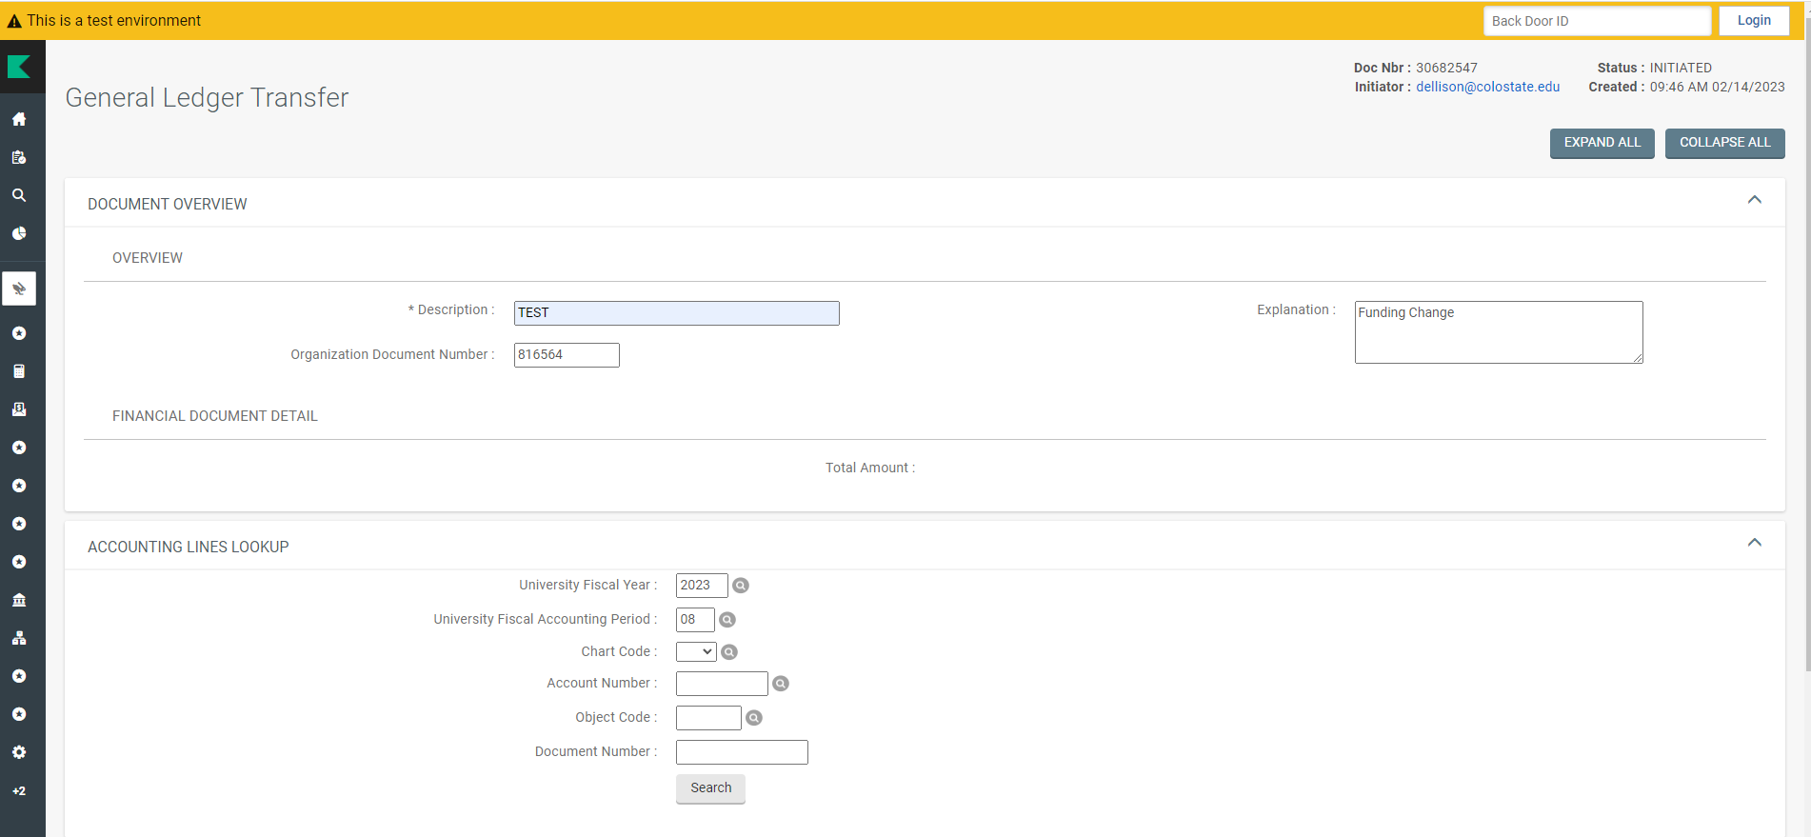
Accounting Lines LOOKUP TAB
Doing a PREQ lookup beforehand will help find required information. The PREQ’s can be found on the PO in the “View Related Documents” tab.
Confirm, enter, change, or leave blank any of the following information per the asset payment lookup information.
University Fiscal Year: 2023 (confirm)
University Fiscal Accounting Period: (enter “**”, this is a wildcard search to check multiple Fiscal Periods)
The Chart Code: (Enter CO)
The Account Number: (Enter 2591700)
Object Code: (Enter 6210)
Document Number: (31078578)
Then click on “Search”

Slide 46
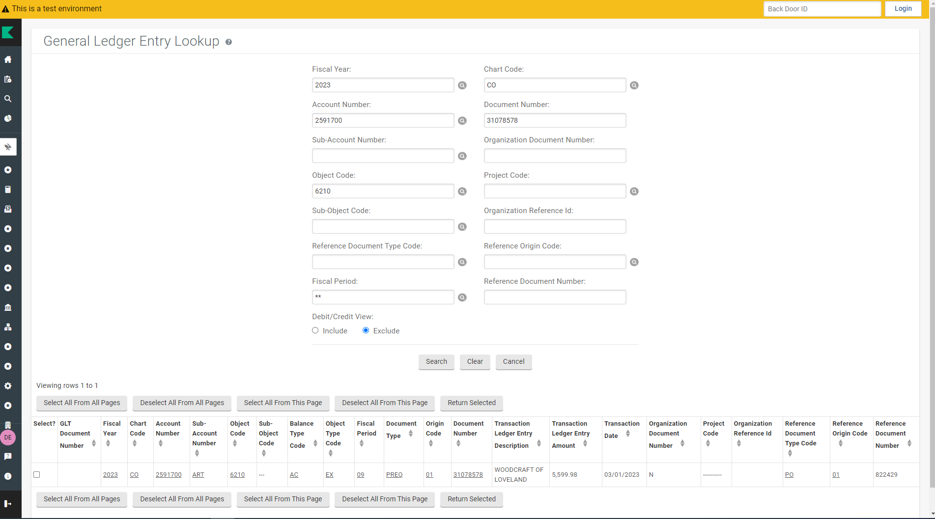
Accounting Lines LOOKUP TAB
The following search results are retrieved.
Confirm the information you were expecting to see is correct (e.g., double check the account number, object code, and amount).
Select the line to retrieve.
Click on “Return Selected”

Slide 47
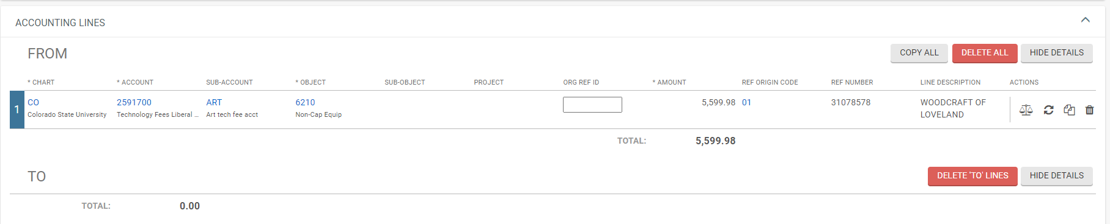
Accounting Lines TAB
You will be returned to the document and the Accounting Lines tab “FROM” Line will be populated with the entered account, object code and amount.
Click on “COPY ALL”

Slide 48
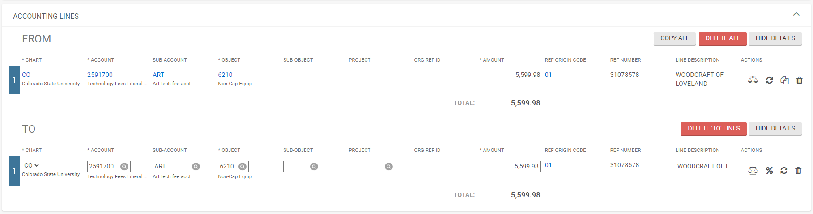
Accounting Lines TAB
The Accounting Lines tab “TO” Line will be populated with the “FROM” line information.

Slide 49
Accounting Lines TAB
Change the information in the “TO” line to what you need it to reflect (e.g., new account number, new object code, amount, etc.).

Slide 50
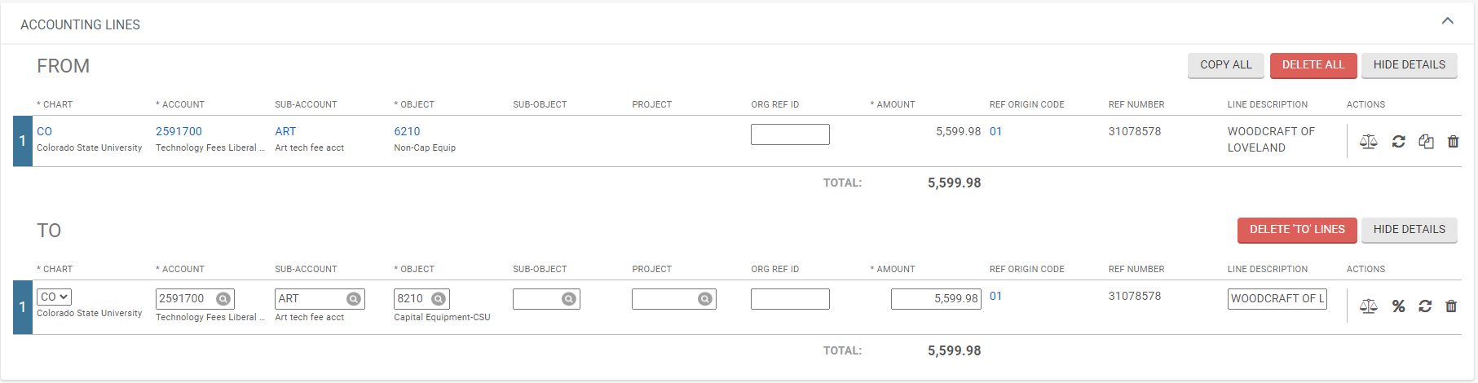
Accounting Lines TAB
Account: “Keep the same”.
Object Code: Change to 8210
Amount: Keep the same
Click On: Refresh Account Summary Symbol

Slide 51
Accounting Lines for capitalization tab
When capital object codes are used, the Accounting Lines For Capitalization tab will open.
You will receive a message showing instructions regarding making changes after you click on the Generate button.
Click on: Generate

Slide 52
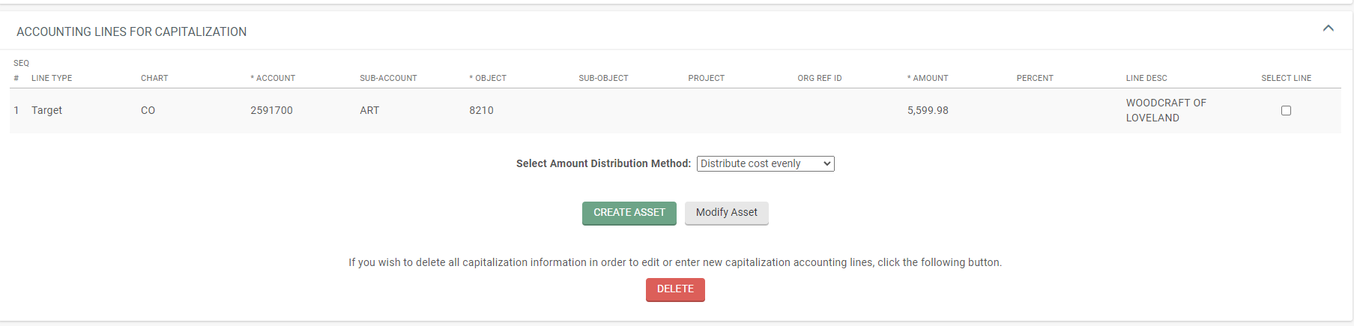
Accounting Lines for capitalization tab
The tab will expand and populate with all lines that used a capital object code.
The Target (TO) line is the accounting line you are putting the amount to (debit).
Select the line to process by clicking on the “box”.

Slide 53
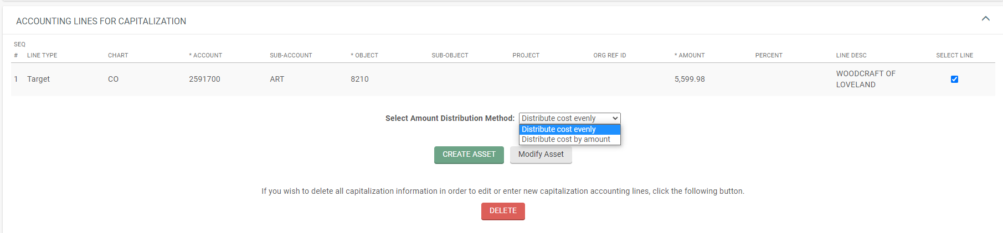
Accounting Lines for capitalization tab
You need to select either “Distribute cost evenly” or “Distribute cost by amount”.
NOTE: This example does not have multiple assets involved, so “Distribute cost by amount” is not necessary.
Select: Distribute cost evenly

Slide 54
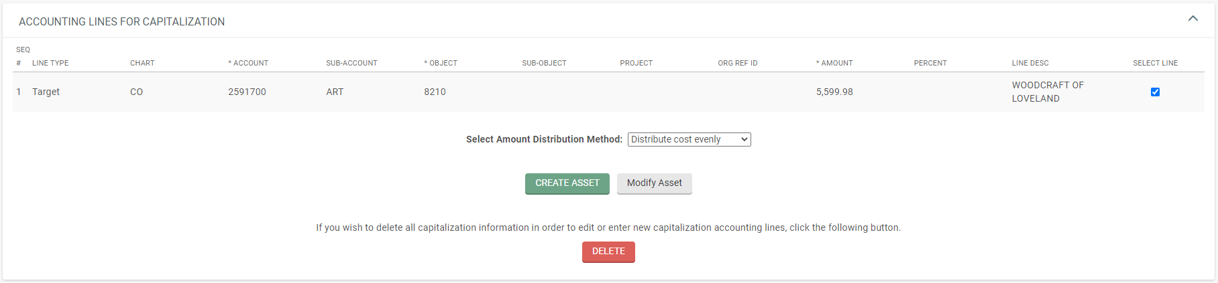
Accounting Lines for capitalization tab
You need to select if you are creating an asset or assets or modifying an asset or assets.
There is only a “Target/To” line, meaning you are either creating an asset or modifying an asset.
Click on: Create Asset

Slide 55
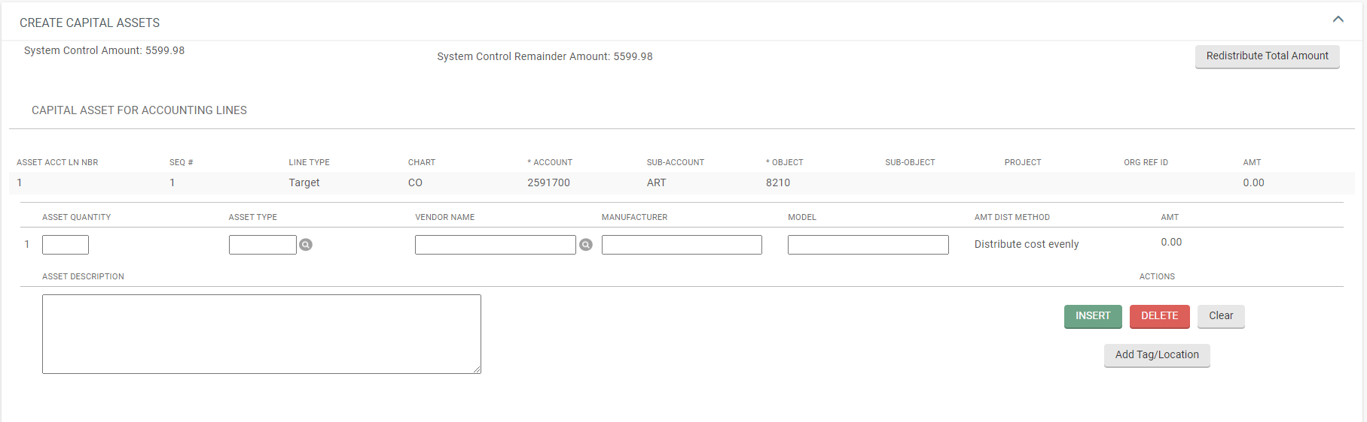
Create capital assets tab
You must complete the Create Capital Assets Tab.
Enter the Asset Quantity you wish to create: “1”
Click on the Magnifying Glass or Enter the Asset Type: “00032ME” (SHOP + MAINTENANCE EQUIPMENT)
Click on the Magnifying Glass to enter the Vendor Name (must match the vendor’s name used on the PO or PREQ): Lookup “WOODCRAFT OF LOVELAND” and return it.
Enter the Manufacturer: “JWBS”
Enter the Model: “15”
Enter the Asset Description: “BANDSAW”
Click on: “Add Tag/Location”

Slide 56
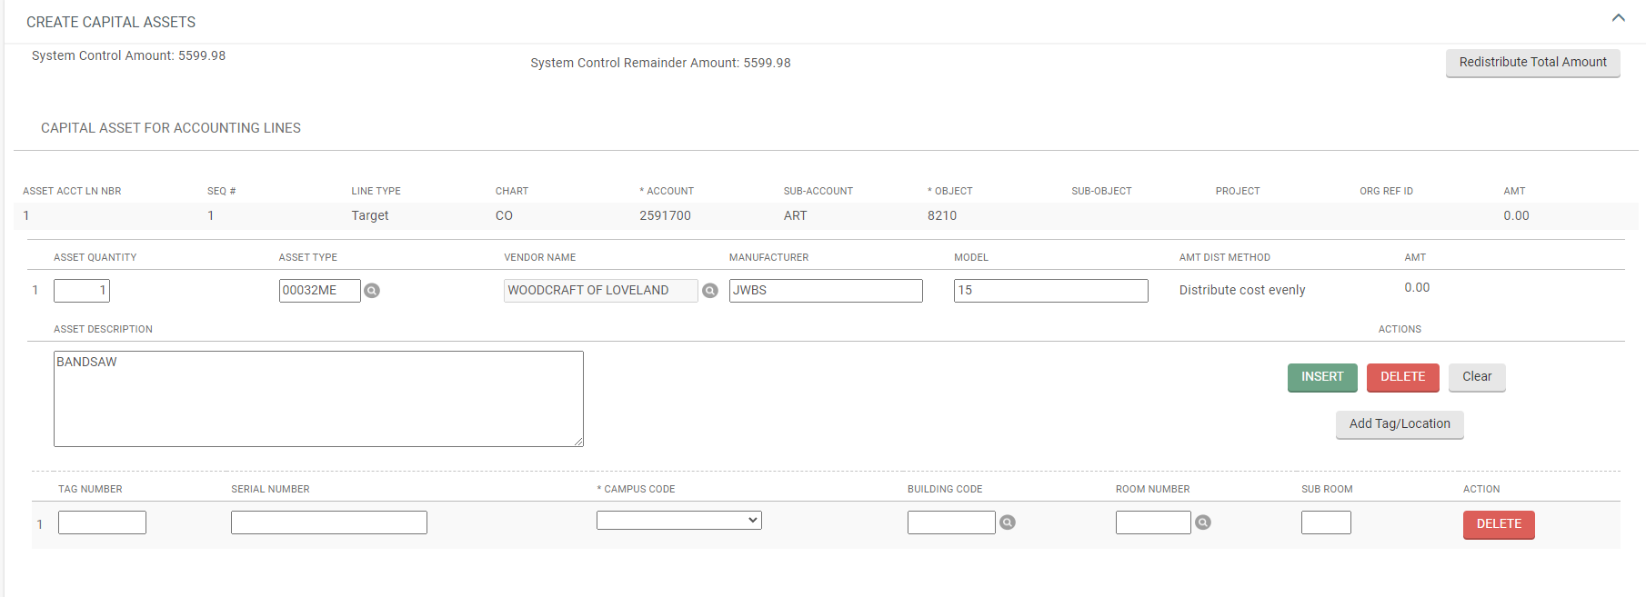
Create capital assets tab
For each asset quantity entered, a Tag Number box will show.
Leave the Tag Number field blank (Property will assign the decal number when it routes to them).
Enter the Serial Number (if known)
The Campus Code (MC-Main Campus if CSU Fort Collins, PC-Pueblo Campus if CSU Pueblo), Building Code, and Room Number are required for each asset.

Slide 57
Create capital assets tab
Tag Number: Leave Blank
Serial Number: Enter the Serial Number, if known. Otherwise, Leave Blank
Enter the Campus Code: “MC”
Enter the Building Code: “0151”
Enter the Room Number: “C100”

Slide 58
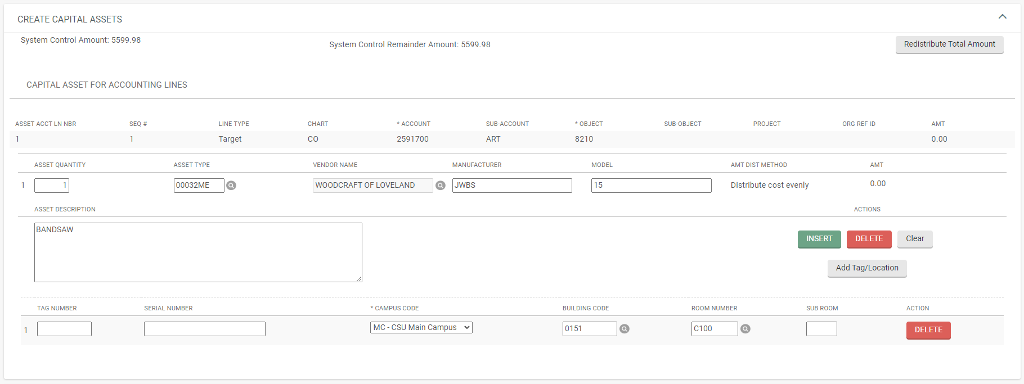
SYSTEM CONTROL AMOUNT
Once your information is entered, you must clear the System Control Amount to show zero and populate the asset amount.
Click on the “Redistribute Total Amount” button.

Slide 59
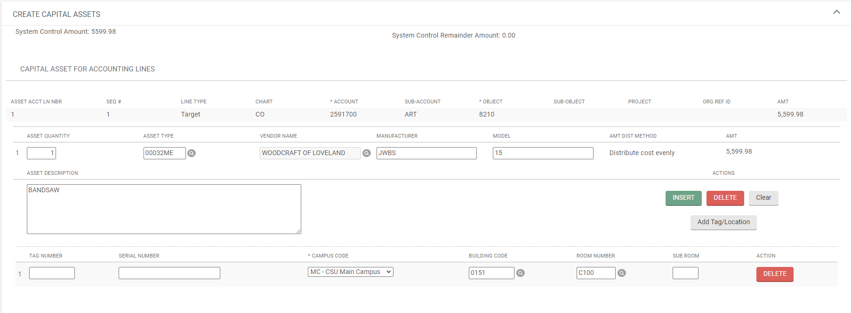
SYSTEM CONTROL AMOUNT
The System Control Amount will now show zero.
The Amount will be populated for the asset.

Slide 60
LATE ADJUSTMENT CERTIFICATION TAB
When required, you must complete each box.

Slide 61
NOTES AND ATTACHMENTS TAB
Attach any backup in the Notes and Attachments Tab and click on “add”.

Slide 62
Document options
Submit, Save, Close, or Cancel document are available options.
WARNING: You would normally click on submit, however, for these training documents if you click on “submit” the same information will not be available for future trainings. For training purposes, please click on “Cancel” when practicing GLT documents using the information in the examples.
Click on: “Cancel”.

Slide 63
General Ledger Transfer document
EXAMPLE: FUNDING CHANGE-MODIFY ASSET
(single account to single account, single asset)

Slide 64
General Ledger Transfer document
Bring up a GLT document

Slide 65
Document Overview tab
Description: Enter a brief description.
Explanation: Enter any necessary information (e.g., Funding Change)
Organization Document Number: Enter the PO number (In this example, information from PO 816564 was used).

Slide 66
Accounting Lines LOOKUP TAB
Doing an Asset Payment Lookup beforehand (when modifying an asset) will help find required information, however, the posting period code listed may not be the posting period code that was used on the payment document.
Confirm, enter, change, or leave blank any of the following information per the asset payment lookup information.
University Fiscal Year: 2023 (confirm)
University Fiscal Accounting Period: (Change to 07, from the payment lookup)
The Chart Code: (Enter CO)
The Account Number: (Enter 1670715)
Object Code: (Enter 8210)
Document Number: (Enter 30469073)
Then click on “Search”

Slide 67
Accounting Lines LOOKUP TAB
The following search results are retrieved.
Notice, “There were no results found.”
It may be necessary to alter your search data:
University Fiscal Accounting Period: Change to a wild card search by entering “**”
Then click on “Search”

Slide 68
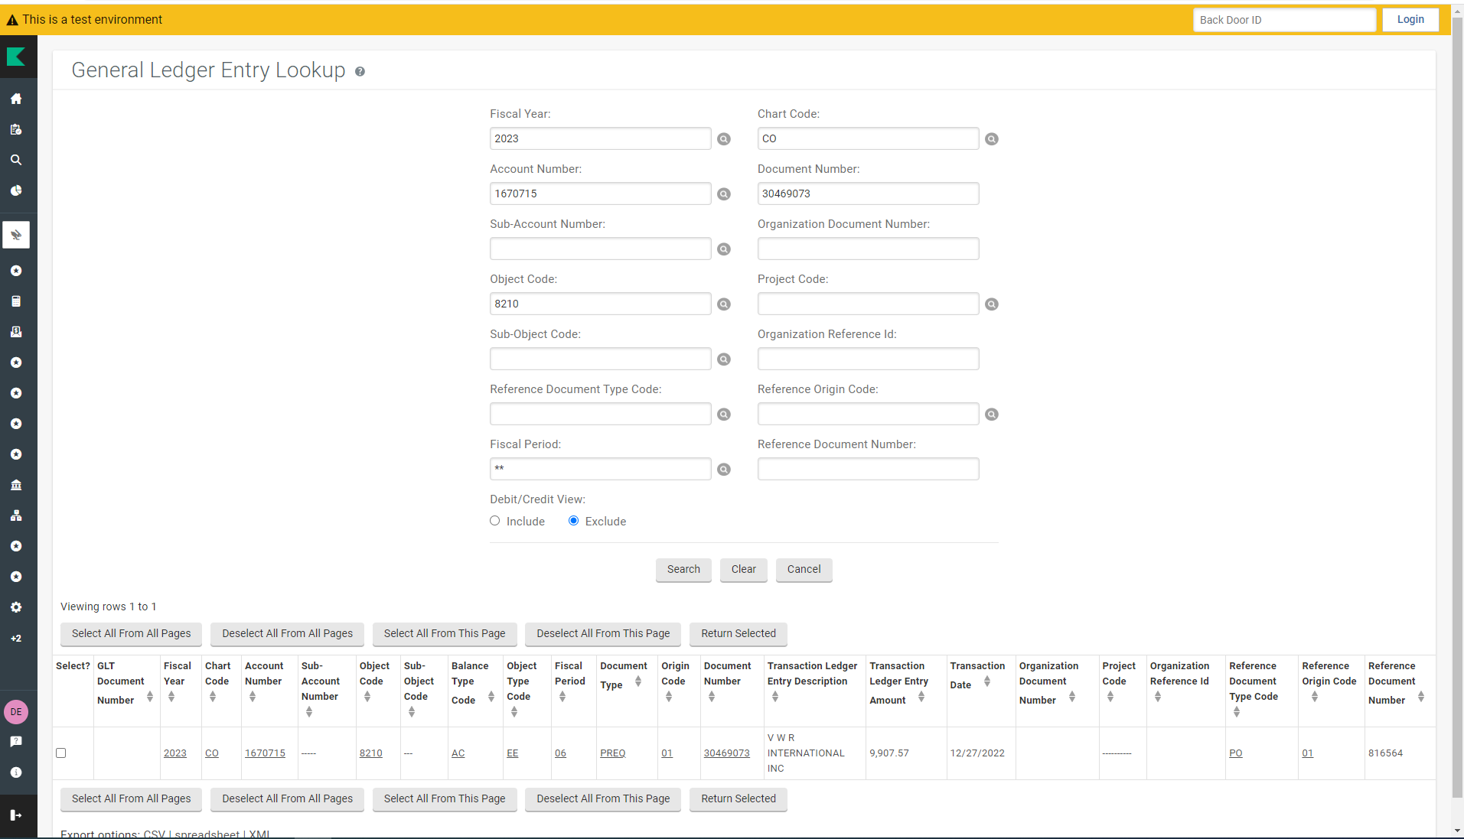
Accounting Lines LOOKUP TAB
The following search results are retrieved.
Confirm the information you were expecting to see is correct (e.g., double check the account number, object code, and amount).
Select the line to retrieve.
Click on “Return Selected”

Slide 69
Accounting Lines TAB
You will be returned to the document and the Accounting Lines tab “FROM” Line will be populated with the entered account, object code and amount.
Click on “COPY ALL”

Slide 70
Accounting Lines TAB
The Accounting Lines tab “TO” Line will be populated with the “FROM” line information.

Slide 71
Accounting Lines TAB
Change the information in the “TO” line to what you need it to reflect (e.g., new account number, new object code, amount, etc.).

Slide 72

Accounting Lines TAB
Account: Enter “1264400”.
Object Code: Keep the same
Amount: Keep the same

Slide 73
Accounting Lines for capitalization tab
When capital object codes are used, the Accounting Lines For Capitalization tab will open.
You will receive a message showing instructions regarding making changes after you click on the Generate button.
Click on: Generate

Slide 74
Accounting Lines for capitalization tab
The tab will expand and populate with all lines that used a capital object code.
In order to process the ACCOUNTING LINES FOR CAPITALIZATION tab:
First, select which lines to process.
You can select one line at a time or multiple lines at a time, depending upon what you are needing to do.
The Target (TO) line is the accounting line you are putting the amount to (debit).
The Source (FROM) line is the accounting line you are removing the amount from (credit).

Slide 75
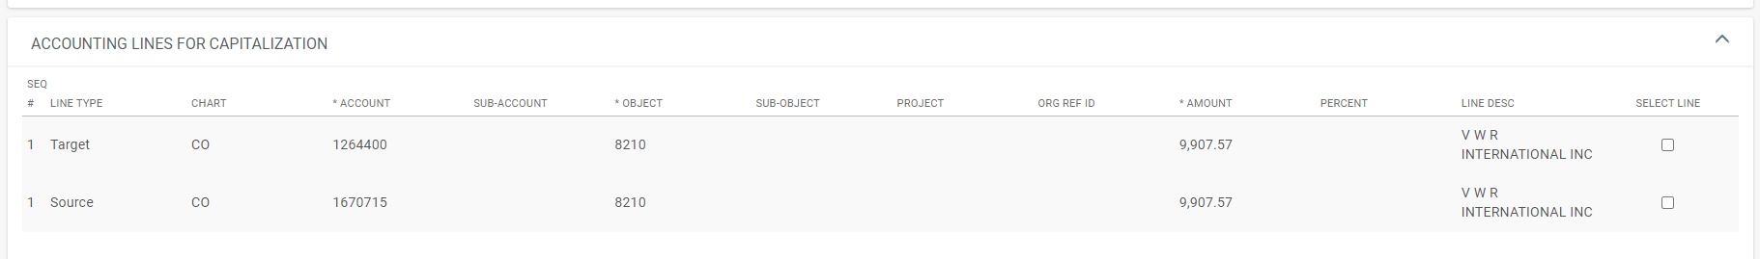
Accounting Lines for capitalization tab
For this example, we are changing the funding on one asset only.
So, you will select both lines because you want both the debit and credit to post to the asset.
Click on the “SELECT LINE” box for the Target line (TO/DEBIT).
and
Click on the “SELECT LINE” box for the Source line (FROM/CREDIT).

Slide 76
Accounting Lines for capitalization tab
You need to select either “Distribute cost evenly” or “Distribute cost by amount”.
NOTE: This example does not have multiple assets involved, so “Distribute cost by amount” is not necessary.
Select: Distribute cost evenly

Slide 77
Accounting Lines for capitalization tab
You need to select if you are creating an asset or assets or modifying an asset or assets.
Because the “Target/To” and the “Source/From” line both use a capital object code, you are modifying an existing asset.
Click on: Modify Asset

Slide 78
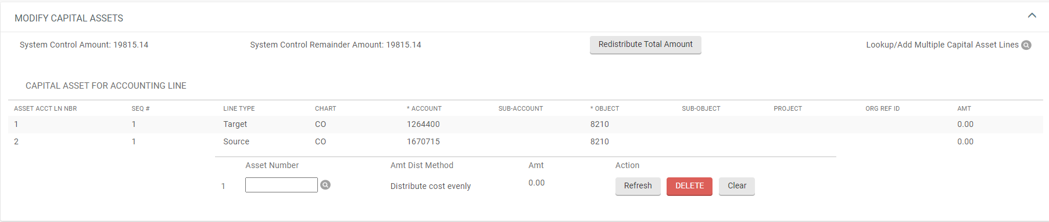
Modify CAPITAL ASSETS TAB
The Modify Capital Assets tab will open.
Enter the Asset Number (not the decal number).
If you don’t know the asset number, use asset lookup.
For a single asset lookup, use the Asset Number magnifying glass lookup.
For multiple capital asset lines, use the Lookup/Add Multiple Capital Asset Lines magnifying glass lookup.
Click on the: Asset Number Lookup magnifying glass.

Slide 79
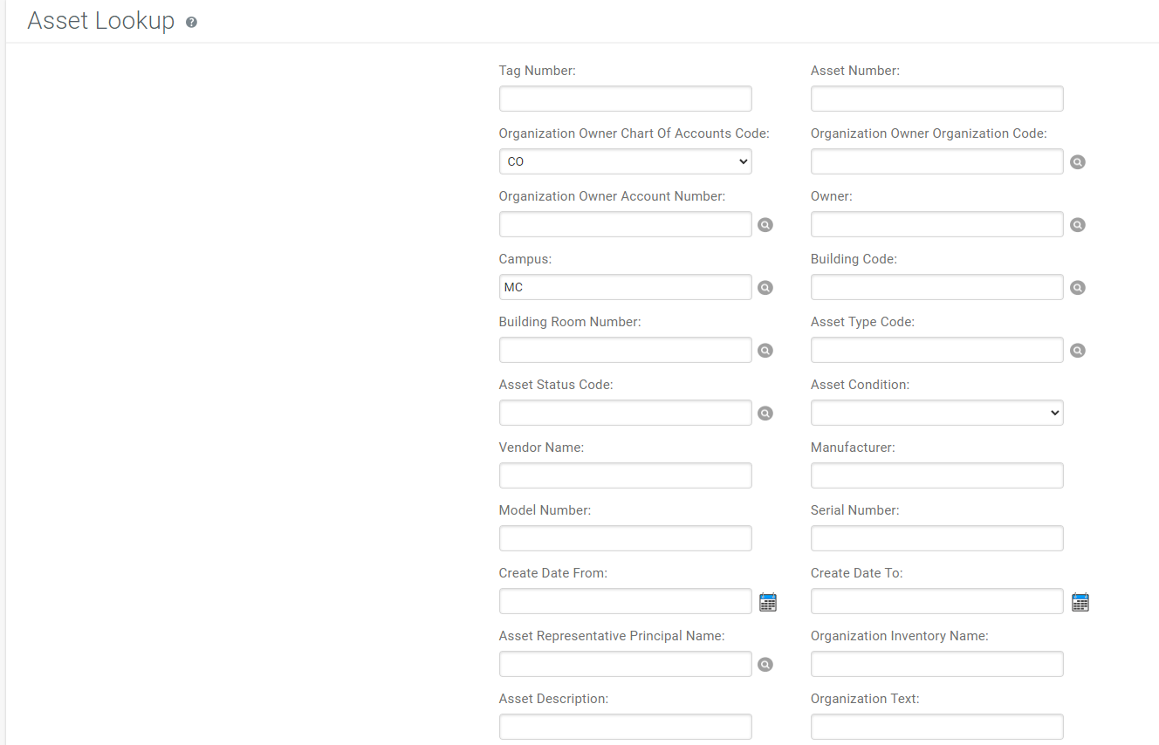
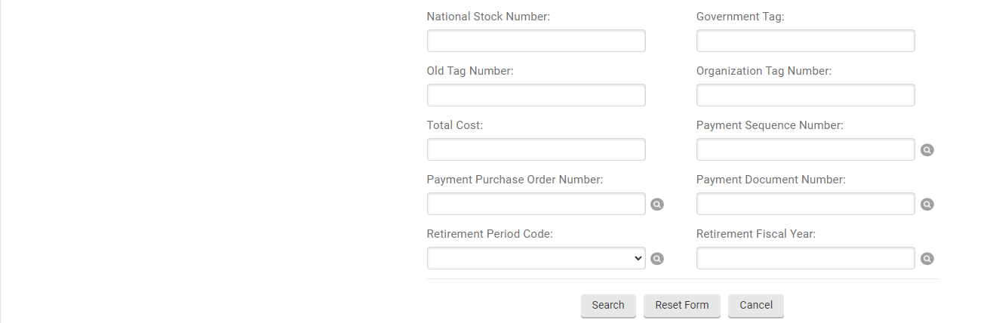
Asset lookup
The Asset Lookup tab will open.
Use known information to find the asset number. For Example, you can:
Enter the Tag/Decal Number
Enter the Asset Description (use wild cards “*”)
Enter the Payment Purchase Order Number
ETC.

Slide 80
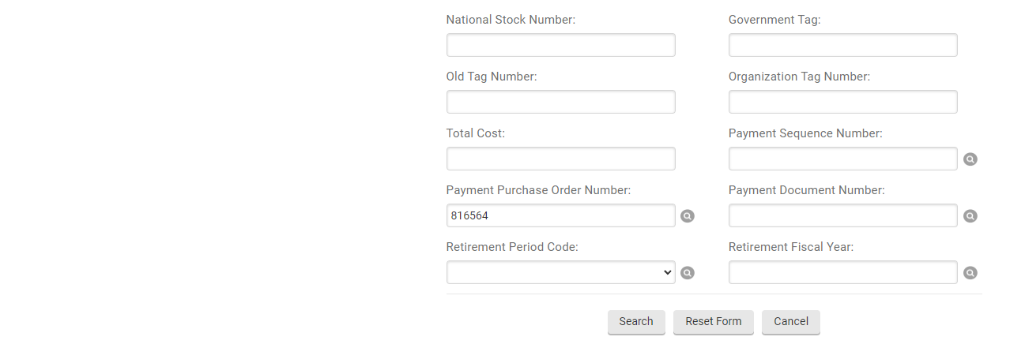
Asset lookup
Enter PO: 816564
Click on: “search”
The Search Results should show retrieved information.
Click on: “return value”.

Slide 81
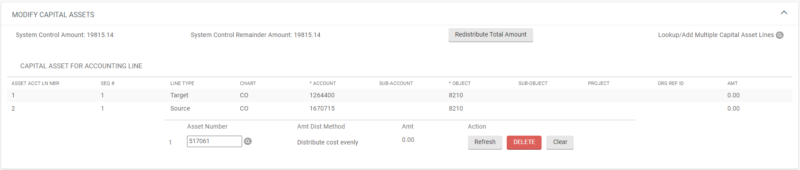
Modify CAPITAL ASSETS TAB
The Asset Number will now be populated.
Next, the amount (AMT) fields need to be populated.

Slide 82
Modify CAPITAL ASSETS TAB
Use the System Control Amount to populate the AMT fields.
Note: The amount is doubled because Kuali does not distinguish between debits and credits, so it adds both the credit and debit amount together.
Click on: “Redistribute Total Amount”.

Slide 83
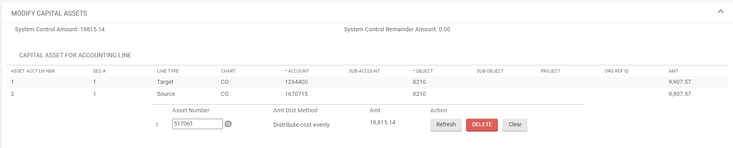
Modify CAPITAL ASSETS TAB
The AMT fields should now be populated.
And the System Control Remainder Amount will show “0.00”.

Slide 84
LATE ADJUSTMENT CERTIFICATION TAB
When required, you must complete each box.

Slide 85
NOTES AND ATTACHMENTS TAB
Attach any backup in the Notes and Attachments Tab and click on “add”.

Slide 86
Document options
Submit, Save, Close, or Cancel document are available options.
WARNING: You would normally click on submit, however, for these training documents if you click on “submit” the same information will not be available for future trainings. For training purposes, please click on “Cancel” when practicing GLT documents using the information in the examples.
Click on: “Cancel”.

