Slide 1
PURCHASING CAPITAL EQUIPMENT GUIDE
EVERYTHING FROM UNDERSTANDING CAPITAL EQUIPMENT TO CAPITAL ASSET REQUISITIONS
Presented by Debra Ellison
Property Management
970-491-2270

Slide 2
OVERVIEW
PART ONE – UNDERSTANDING CAPITAL EQUIPMENT AND CAPITAL EQUIPMENT OBJECT CODES
Capital Equipment Definition Page 4
Betterments/Upgrades Page 5
Costs to Capitalize Page 6
Costs to Expense Page 7
Selecting Capital Object Codes Page 8
GASB 87 and 96 Page 31
Capital Object Codes Summary Page 32
Split Funding Page 33
System Assets Page 35
PART TWO – UNDERSTANDING CAPITAL EQUIPMENT REQUISITIONS
Capital Asset Requisition Page 46
Capital Asset Tab Page 49
Direct to Vendor Lease Requisition Page 59
Practice Requisition Page 61
Making Changes Page 87

Slide 3
PART ONE

Slide 4
CAPITAL EQUIPMENT DEFINITION
Capital Equipment: Capital equipment, also known as movable equipment, includes items which are not considered an integral part of a university building, are non-expendable, and do not lose their identity through incorporation into a more complex unit.
An item must meet two specific criteria in order to qualify as capital equipment. It must have (1) an acquisition value of $10,000 or greater when federal/sponsor funding is not involved or $5,000 when federal/sponsor funding is involved (unless part of a contract or grant where it specifically states equipment will be tracked at any value), and (2) a useful life expectancy of one year or greater.
Determining the acquisition value:
Assets are recorded net of cash and other earned discounts.
A trade-in allowance can result in the reduction of the acquisition value. The book value of the asset being traded-in must be considered since it will be incorporated back into the acquisition value of the new asset when determining if the new asset meets the capitalization threshold. (Property Management will handle any accounting transactions related to incorporating the book value back into the asset acquisition value).
PCARDS are not to be used when purchasing capital equipment.
Notes:
Expendable items consist of things like consumables and disposables.

Slide 5
BETTERMENTS/UPGRADES
Betterment: An enhancement, modification, upgrade, or other similar expenditure in connection with an existing asset, which significantly extends its useful life, increases its utility or efficiency, or otherwise adds to the benefits it can yield.
Upgrade: Raise to a higher standard, in particular, improve an asset by either adding or replacing components.
Betterments/Upgrades will be capitalized according the Business Rules for Modifying Existing Assets.
If the betterment/upgrade is purchased within the same fiscal year as the existing asset and costs $1,000 or more, it is capitalized using “modify existing” when completing the requisition.
If the betterment/upgrade is purchased in a different fiscal year than the existing asset, it must meet the capitalization threshold to be capitalized.
Provide Property Management with the asset number and/or decal number of the existing asset on any documentation involving betterments and upgrades.
Notes:
Replacing an entire asset is not considered a betterment or upgrade for the purpose of these definitions. Only modifying, adding to, or replacing components on an existing asset would fall under the betterment or upgrade definitions. Any add-ons or replacement parts must meet the qualifications of a betterment or upgrade. Like-for-like parts or components not meeting the qualifications are considered repair/replacement parts and are expensed regardless of cost.

Slide 6
COSTS TO CAPITALIZE
Examples of costs that can be capitalized with equipment purchases may include:
Shipping or Freight
Transportation or In-Transit Insurance
Installation
Cost of Assembling the Asset
Preparing the Site and Asset for its Intended Use
Modifications, Attachments, Accessories or Auxiliary Apparatus that are necessary to make the property useable for the purpose of which it was acquired.
Notes:
If including these costs to the asset put the value over $10,000.00 ($5,000.00 for Federal/Sponsor funds), it should be capitalized. For example, shipping should be capitalized when purchasing a capital asset. If the shipping is split up on the quote between a capital asset and a supply, you will need to make a separate line item for the non-capital item’s shipping cost. If the shipping cost is a lump sum and you are ordering both capital assets and supplies, capitalize the entire shipping amount. Property will allocate shipping if multiple assets are ordered.

Slide 7
COSTS TO EXPENSE
Examples of costs that are expensed (regardless of cost) may include:
Repair or replacement parts that are not considered a betterment or upgrade (use 6202-Repair Part).
An item or substance that has no shape or identity, or loses that shape or identity upon detachment or removal from its original location (i.e., Materials/Consumables).
Demolishing or dismantling, reassembling or reinstalling due to movement or rearrangement of equipment.
Maintenance*, Warranty*, Support*, or Service Agreements* (6602-Maintenance Services or 6802-Repair Services).
Training*
*If these items are lumped into the asset cost without a separate amount listed, then they are included in the cost of the asset.
Notes:
Travel costs will depend upon what it is necessary for. If it is for installation, it should be capitalized. If it is for Training, it should be expensed.

Slide 8
SELECTING CAPITAL OBJECT CODES
THERE ARE MULTIPLE OBJECT CODES TO CHOOSE FROM
FACTORS THAT INFLUENCE OBJECT CODES:
  FUNDING (53, 77, 99, etc.)
  FUND SOURCE CODE (11, 21, 22, 31, 32, 33, 34, 35, 41, 51, 61, and 71)
  TITLE (CSU/Conditional, Federal, Sponsor, External)
  ASSET TYPE CODE (General Equipment, Vehicles, Software, Art)
  LEASES (Payments and Down Payments)
  GASB 87 and GASB 96

Slide 9
ACCOUNT NUMBER/FUNDING
CSU account numbers vary.
Construction (plant fund) accounts usually start with 77.
County Extension accounts usually start with 99.
Federal/Sponsor accounts usually start with 53.

Slide 10
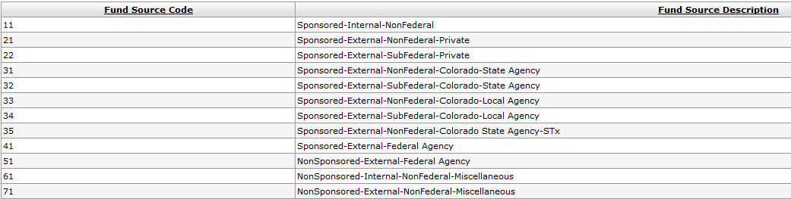
FUND SOURCE CODES
There are 12 Fund Source Codes.

Slide 11
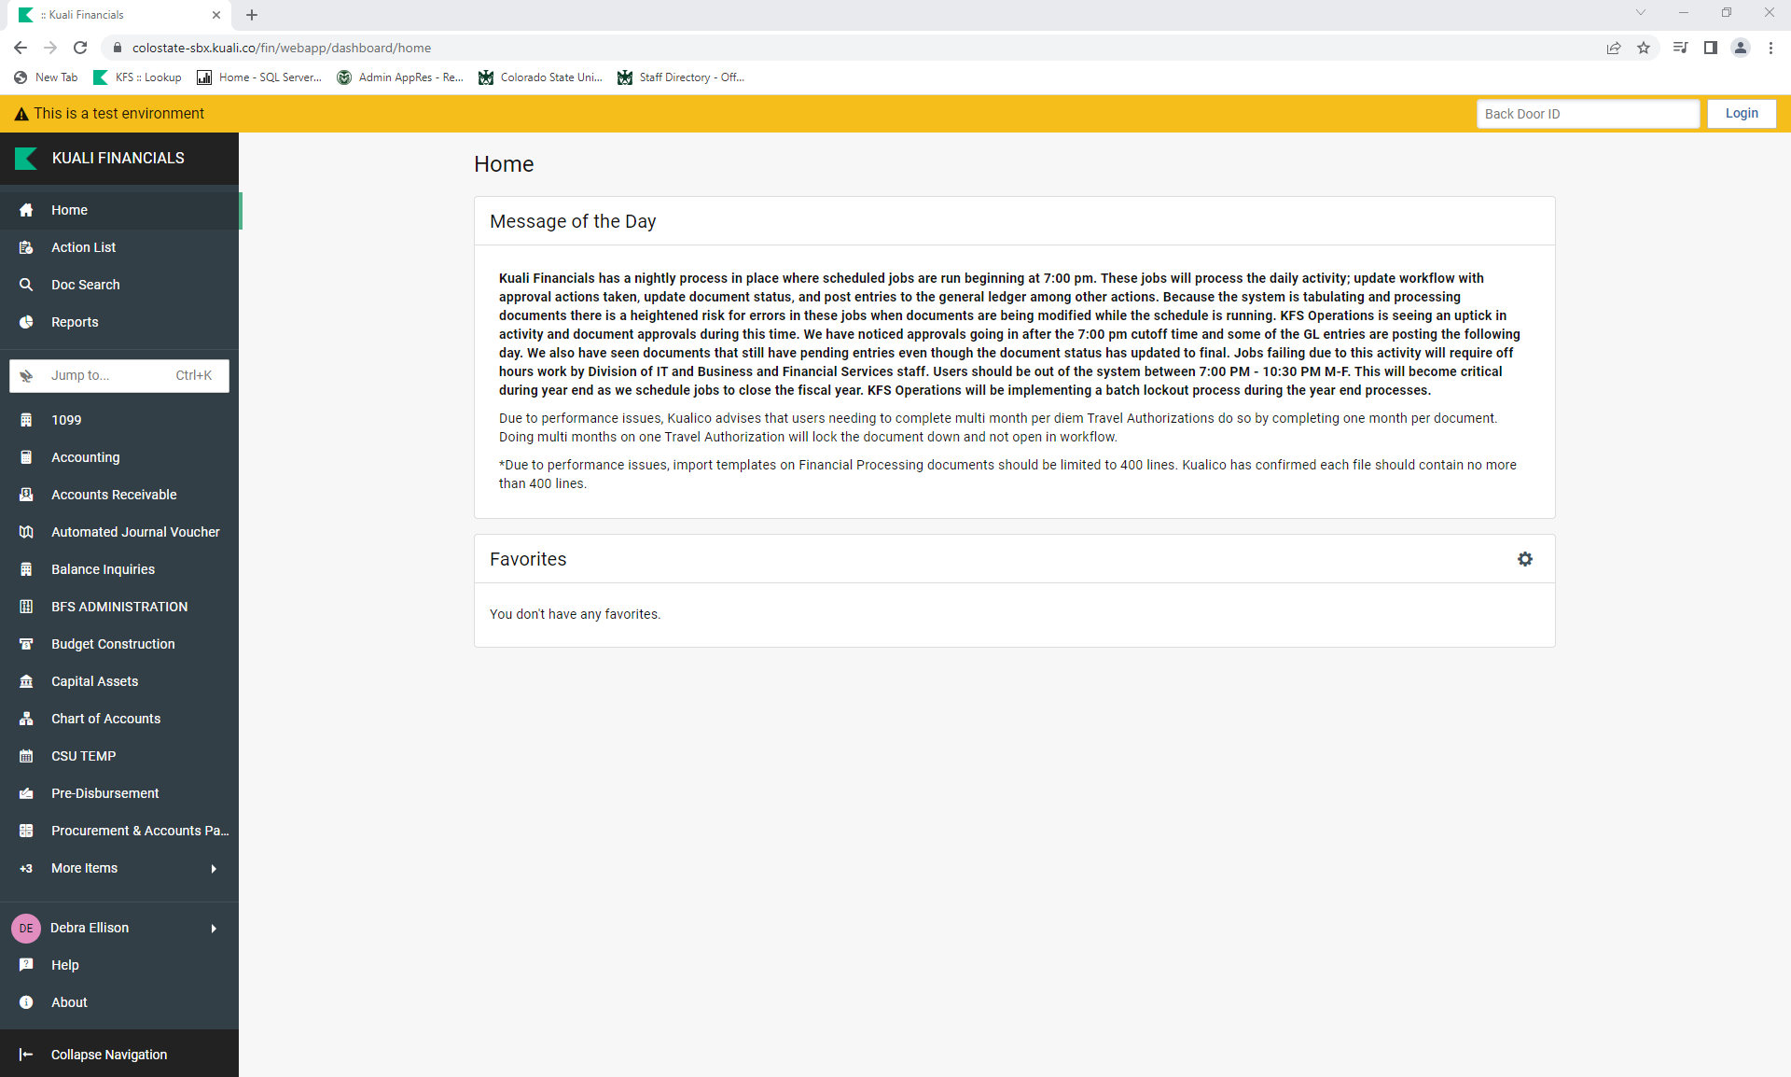
FINDING THE FUND SOURCE CODE
You will need to do an account lookup in Kuali to find the Fund Source Code.
Notes:
You can get to this page by doing an account lookup from the main page in Kuali or by clicking on the account being used in your requisition.

Slide 12
FINDING THE FUND SOURCE CODE
Click on “CHART OF ACCOUNTS” to open the screen.

Slide 13
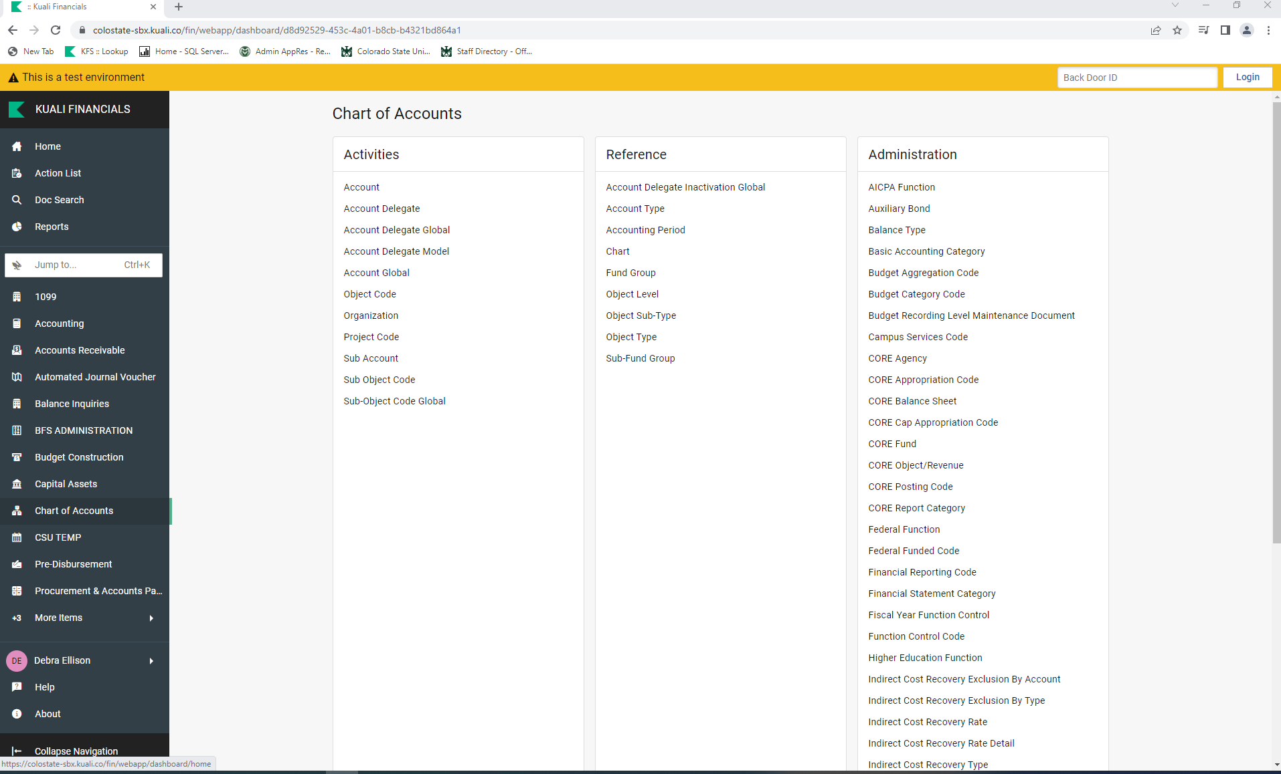
FINDING THE FUND SOURCE CODE
Click on “Account”.

Slide 14
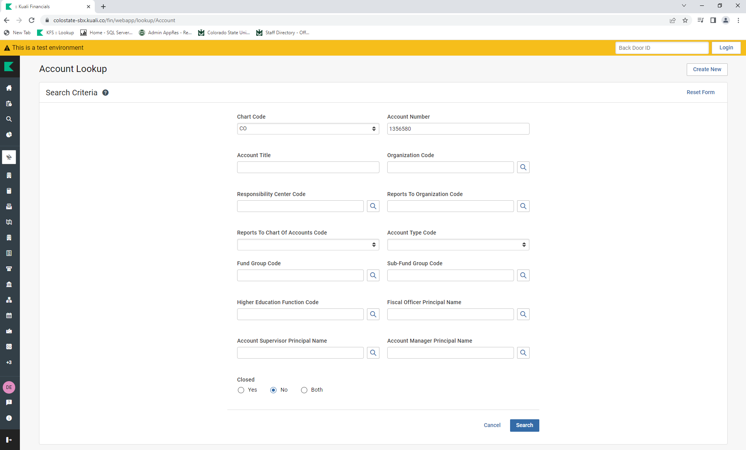
FINDING THE FUND SOURCE CODE
Enter the account number (use 1356580) and click on “Search”.

Slide 15
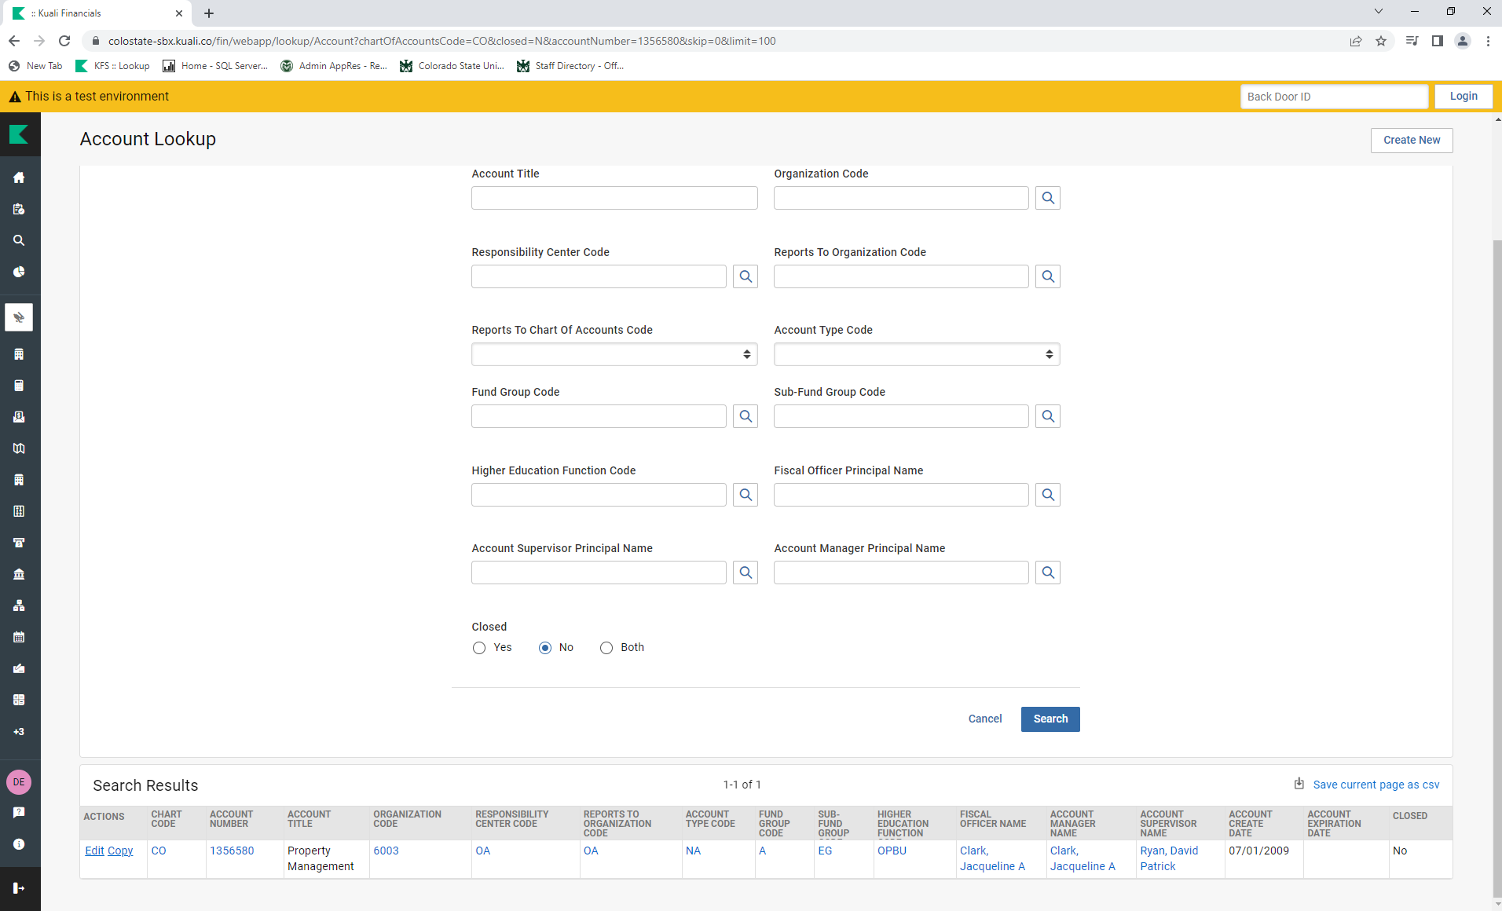
FINDING THE FUND SOURCE CODE
When you have your result, click on the Account Number.

Slide 16
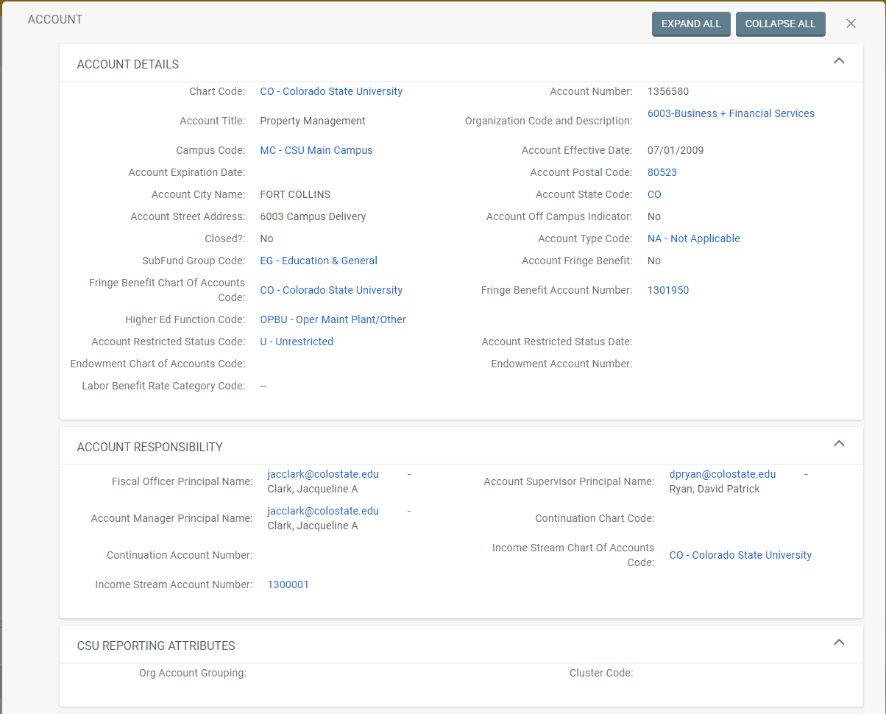
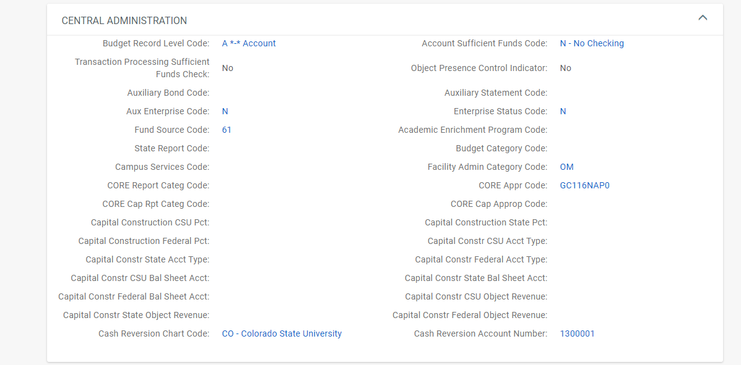
FINDING THE FUND SOURCE CODE
Scroll to find the Fund Source Code listed in the Central Administration section.

Slide 17
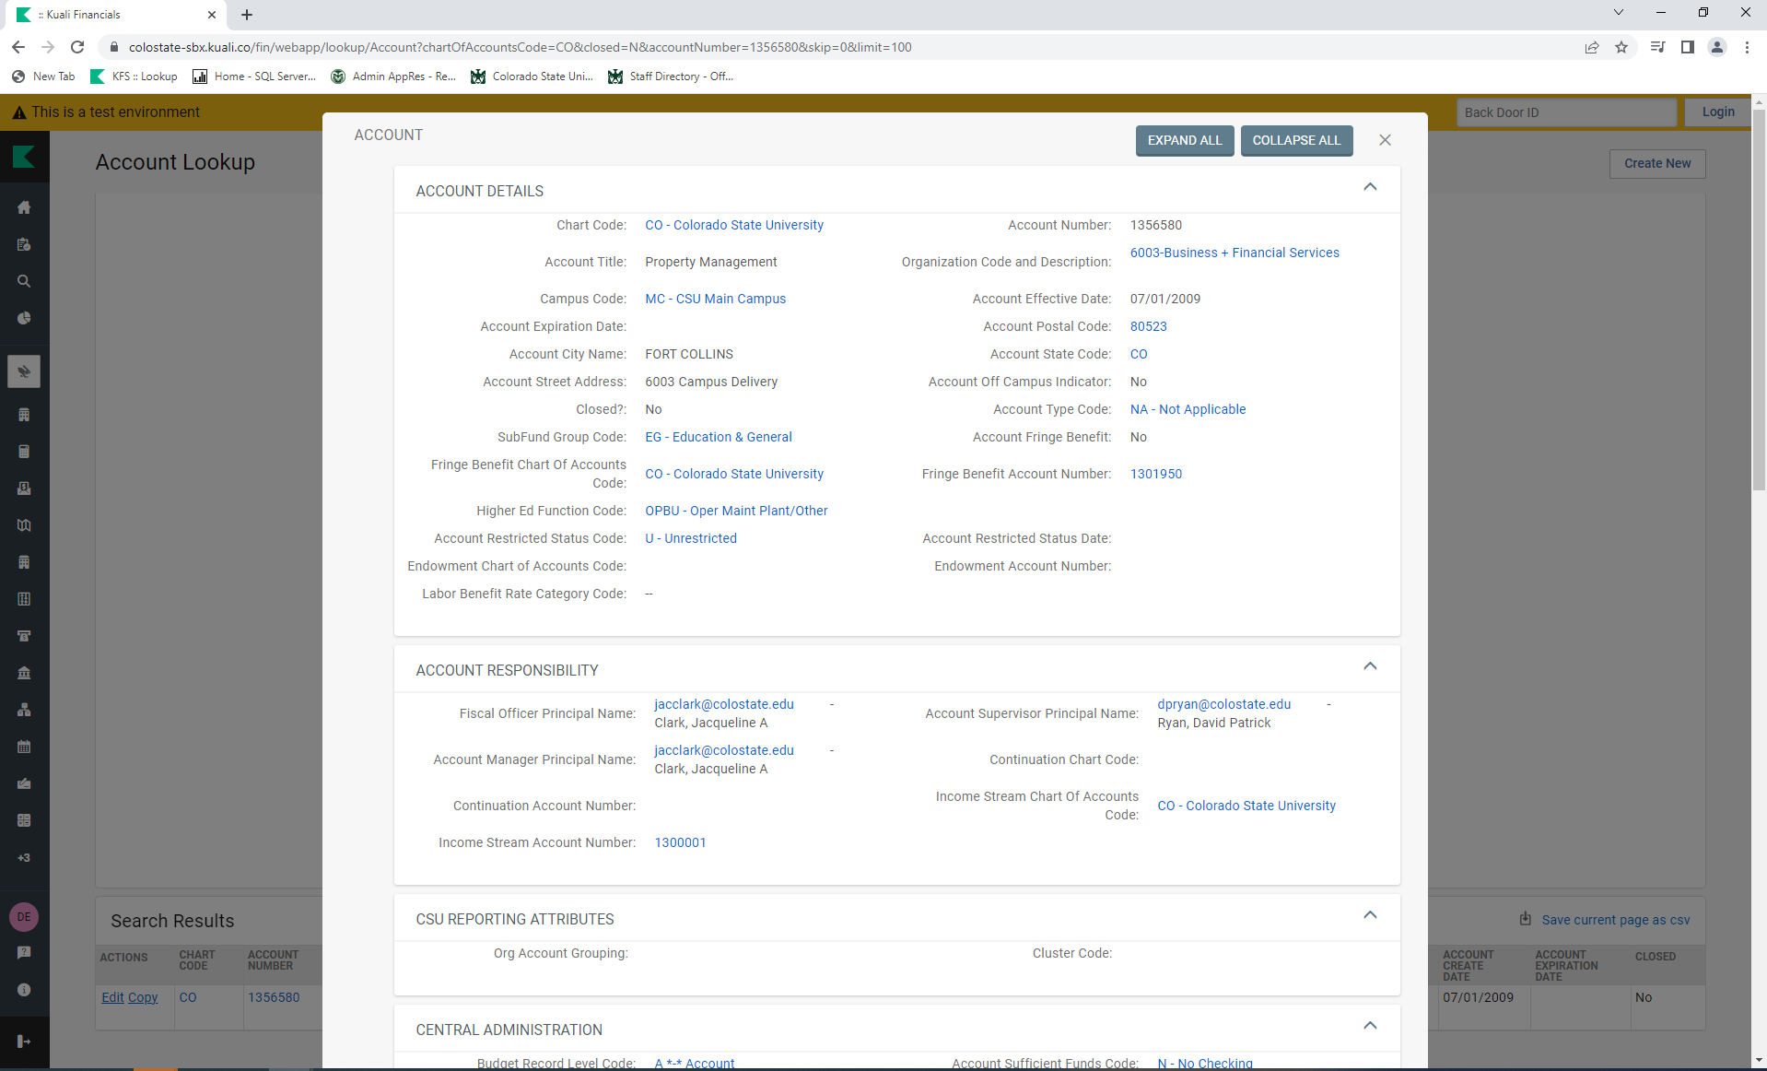
FINDING THE FUND SOURCE CODE
To close the Account Screen, click on the “X” next to “COLLAPSE ALL”.

Slide 18
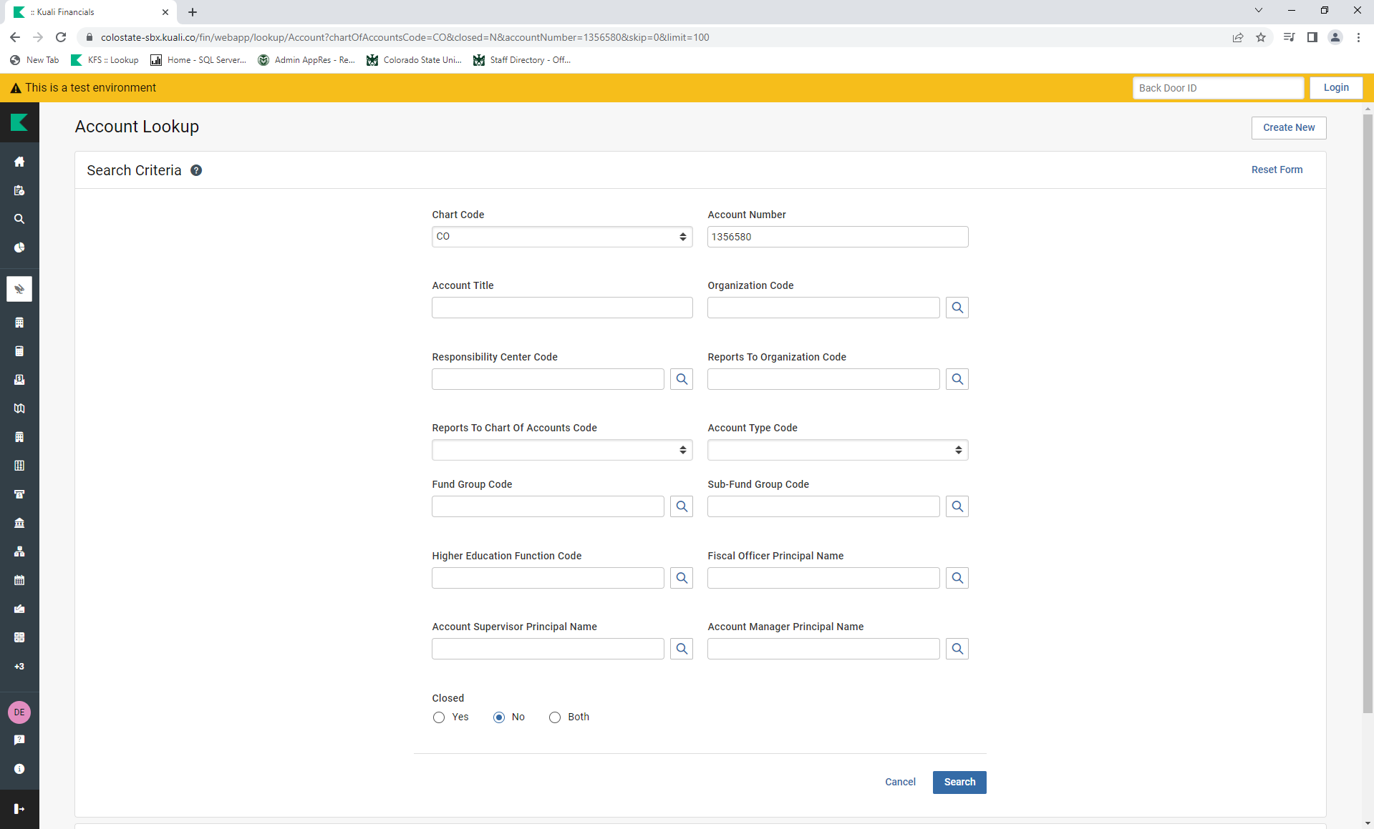
Once you are back to the Account Lookup, click on The green Kuali Logo to go back to the home page.

Slide 19
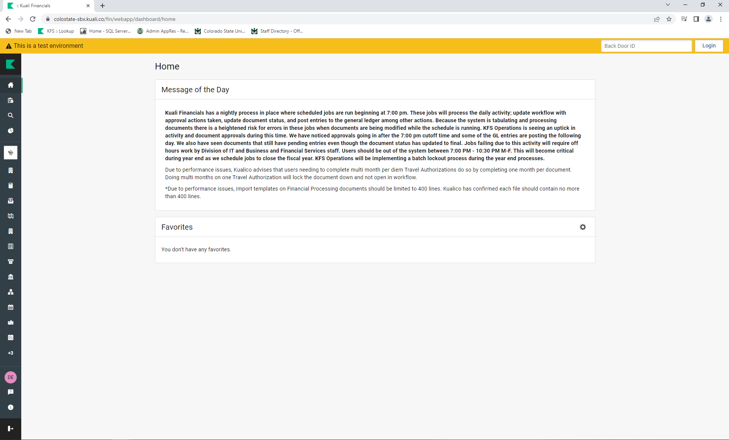
You should now be back on the Home page.

Slide 20
RELATIONSHIP BETWEEN THE ACCOUNT NUMBER AND THE FUND SOURCE CODE
CSU FUNDS
Fund Source Codes 11, 61, and 71
11 Sponsored-Internal-NonFederal
61 NonSponsored-Internal-NonFederal-Miscellaneous
71 NonSponsored-External-NonFederal-Miscellaneous
CSU Plant funds also have specific object codes.
These are usually 77 funds.
COUNTY EXTENSION FUNDS (DO NOT CAPITALIZE ON CSU BOOKS)
These are usually 99 funds with Org Code 4XXX.
FEDERAL FUNDS (need to be tracked separately)
These are usually 53 funds but can also be other.
Fund Source Codes 22, 32, 34, 41, and 51
22 Sponsored-External-SubFederal-Private
32 Sponsored-External-SubFederal-Colorado-State Agency
34 Sponsored-External-SubFederal-Colorado-Local Agency
41 Sponsored-External-Federal Agency
51 NonSponsored-External-Federal Agency
SPONSOR FUNDS
These are usually 53 funds but can also be other.
Fund Source Codes 21, 31, 33, and 35
21 Sponsored-External-NonFederal-Private
31 Sponsored-External-NonFederal-Colorado-State Agency
33 Sponsored-External-NonFederal-Colorado-Local Agency
35 Sponsored-External-NonFederal-Colorado State Agency-STx

Slide 21
OWNERSHIP/TITLE
For CSU funds, including 77 funds; assume ownership/title to be CSU.
For County Extension funds, 99 funds; no capital assets should be purchased on County Extension funds unless title is granted to CSU (in which funds should be transferred to a CSU account to purchase the asset). When title is not granted to CSU, purchase assets as non-capital, using object code 6210.
For 53 funds, ownership/title will either be; CSU/CONDITIONAL, SPONSOR, or FEDERAL.

Slide 22

FINDING THE TITLE
For all 53 funds, you will need to go to the Research Project Status Report (RPS) page to look up the title.
Start on CSU’s homepage.
Click on RESOURCES.
Notes:
OSP is also available to provide title information.

Slide 23
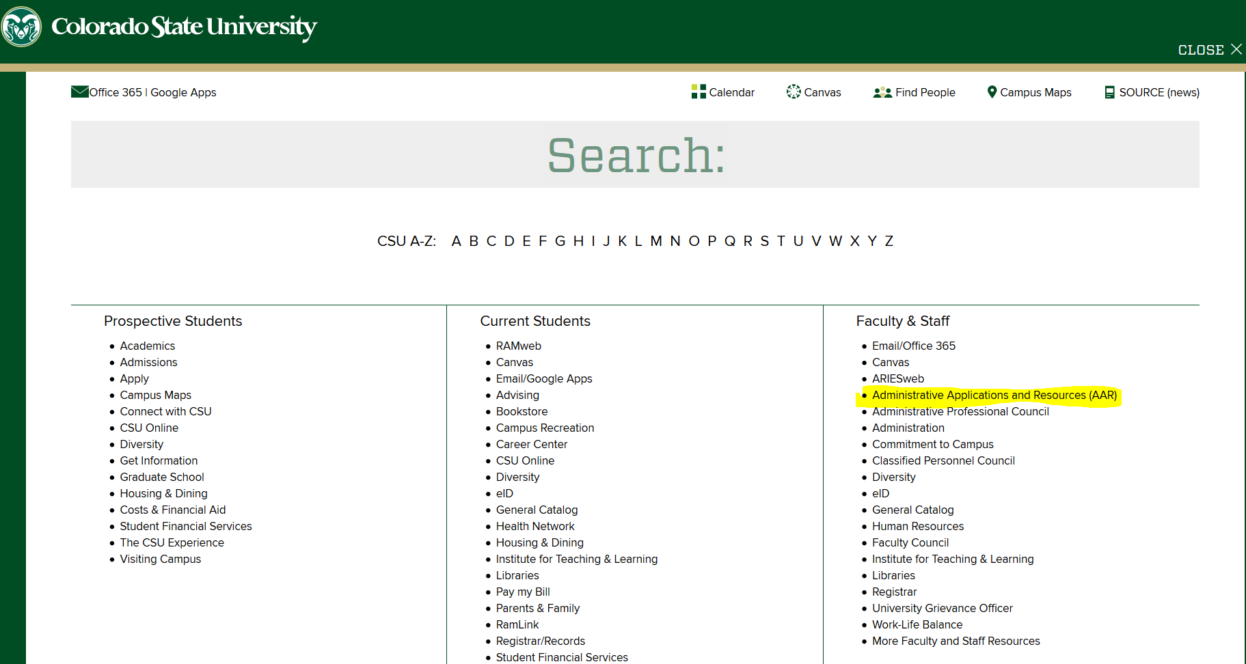
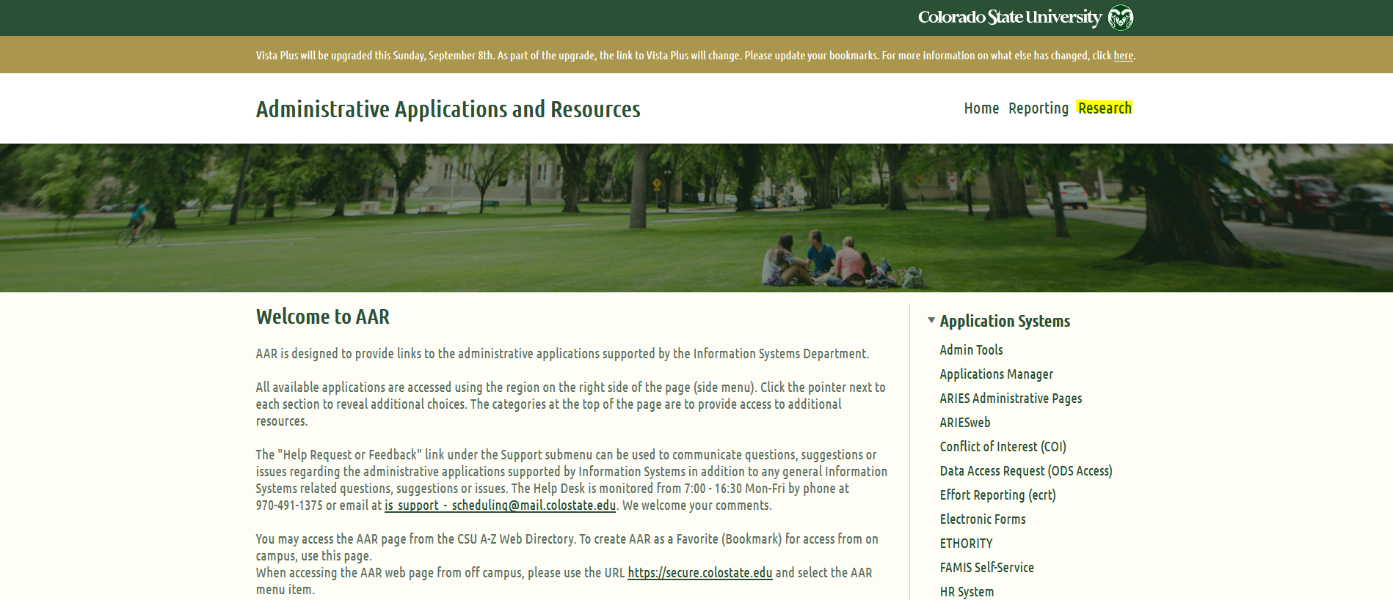
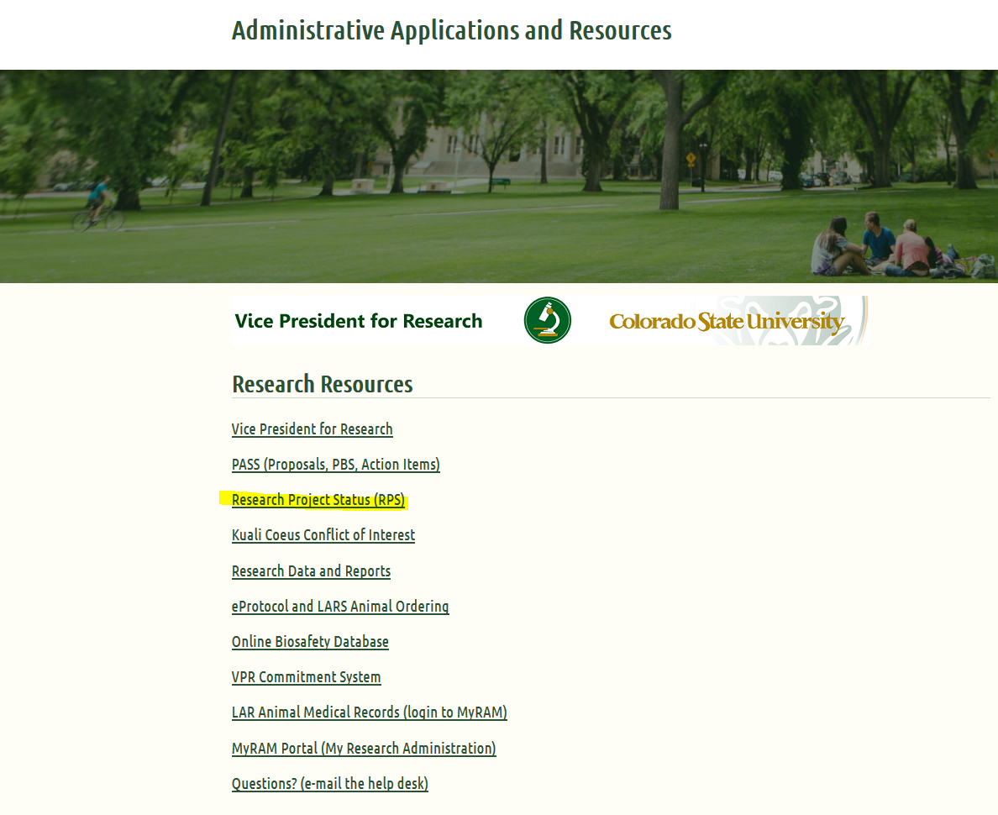
FINDING THE TITLE
From the CSU resources page, click on Administrative Applications Resources (AAR). Next, click on the “Research” heading.
Then click on Research Project Status (RPS)

Slide 24
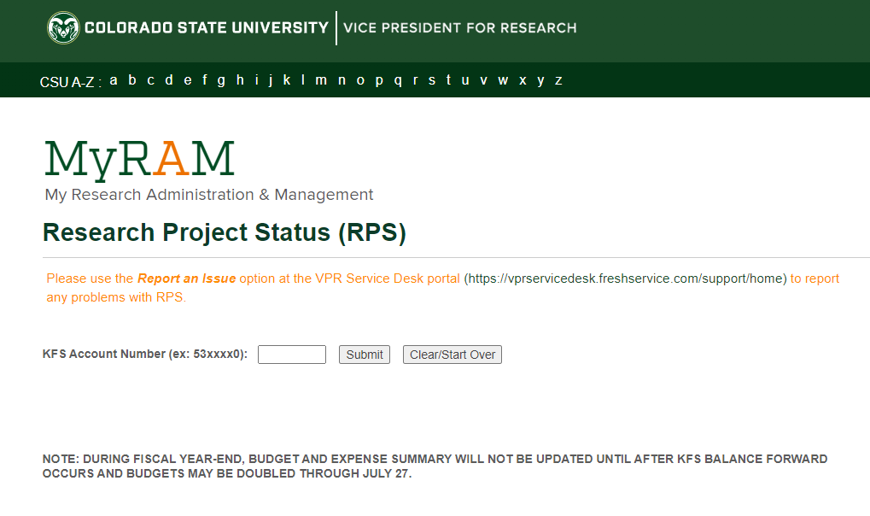
FINDING THE TITLE
You may need to log in. Otherwise, the Research Project Status (RPS) page will appear.
Enter the 53 account number (e.g., 5381091) and click on Submit.

Slide 25
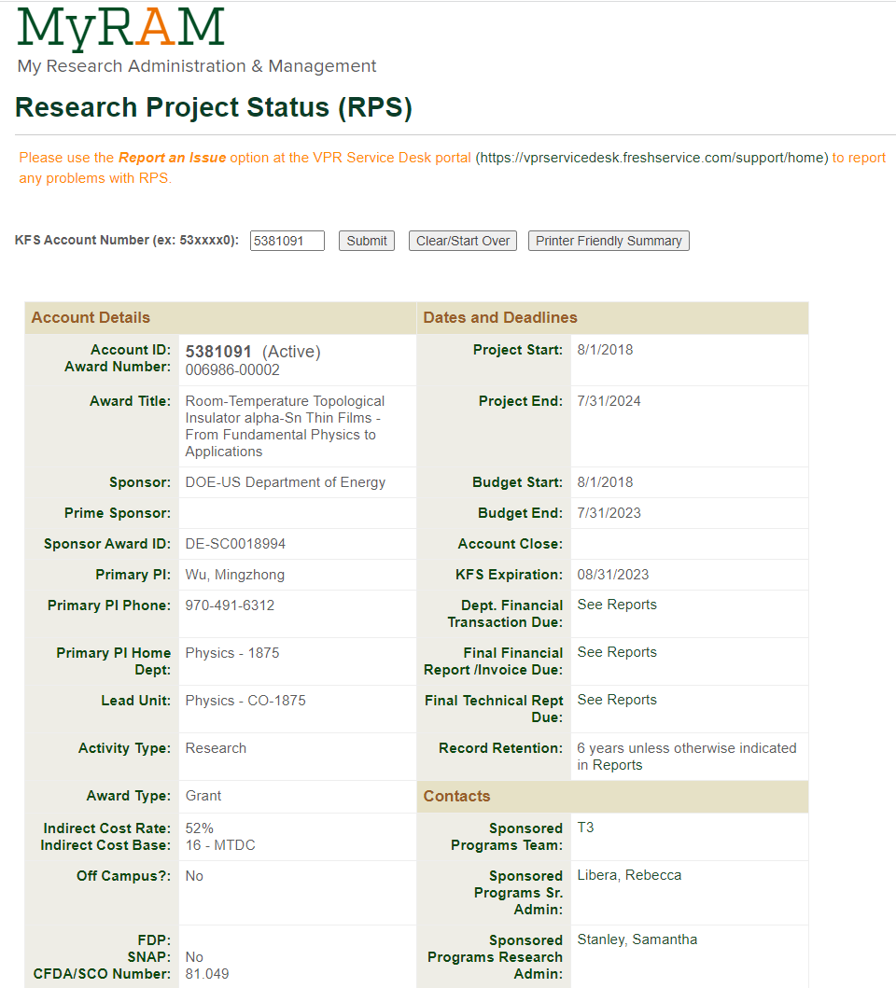
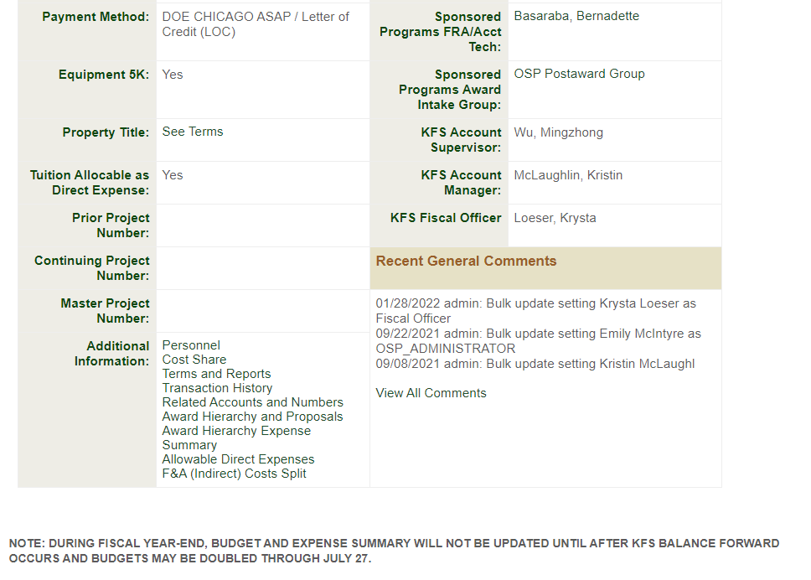
FINDING THE TITLE
Find the Property Title and click on “See Terms”.

Slide 26
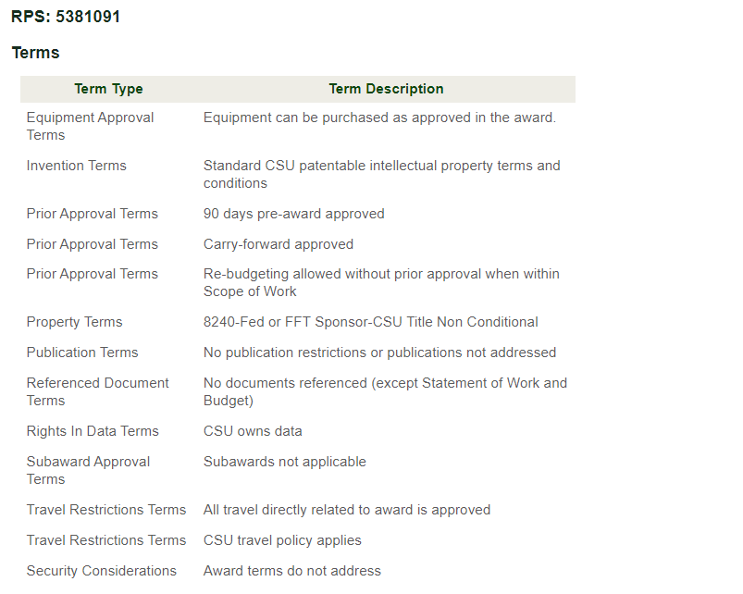
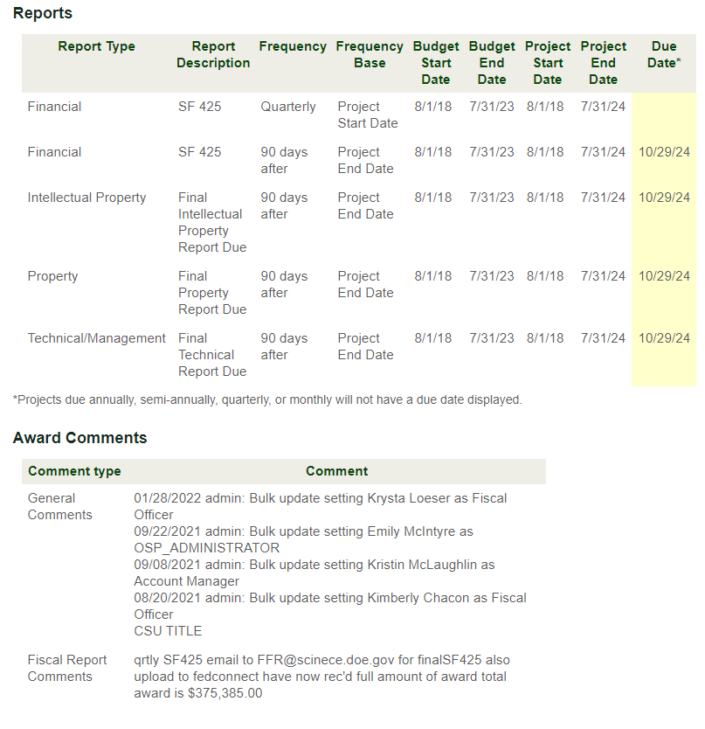

FINDING THE TITLE
From the Terms page, look for Property Terms and or and General or Property Comments. Look for the title.
Notes:
You may see an object code listed, it may or may not be up-to-date. Use the fund source code and title to choose the correct object code.

Slide 27
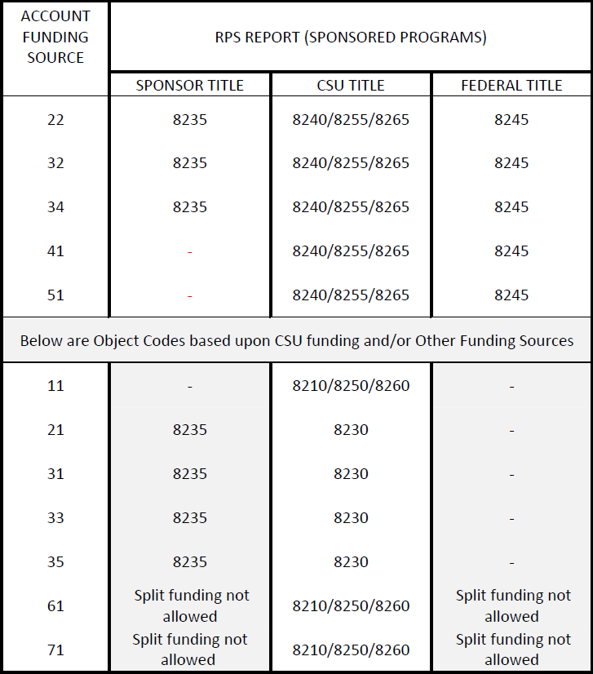
RELATIONSHIP BETWEEN OBJECT CODES, FUND SOURCE CODES, AND OWNERSHIP/TITLE
Notes:
All Sponsor Titled equipment will be 8235, regardless of other factors. All Federal Titled equipment will be 8245, regardless of other factors.

Slide 28
ASSET TYPE CODE
General Equipment
(SI) Scientific Instruments
(OF) Office Equipment [Furniture, etc.]
(IS) Info Systems [Computer Hardware, etc.]
(ME) Machinery [Farm/Ground, Tractors, Shop/Maintenance, etc.] (RE) Recreation Equipment [ATV’s, Golf Carts, etc.]
(VH*) Other Vehicles [Watercraft*, Aircraft*, Trailers/Storage Containers*, and Snowmobiles*.]
Vehicles
(VH) Buses, Trucks, Vans, Automobiles, and Motorcycles.
Software
(SW) Stand-Alone Software. If software will be preloaded, use the appropriate equipment object code.
Art/Museum Objects
(AH) Individual Items or Collections.
Notes:
Drones fall under Scientific Instruments (SI), not aircraft.

Slide 29
RELATIONSHIP BETWEEN THE ASSET TYPE CODE AND OBJECT CODES
Equipment: (SI, OF, IS, ME, RE, VH)
    8210/8240/8230/8245/8235/8910
Vehicles: (VH) (Only Buses, Trucks, Vans, Automobiles, and Motorcycles)
    8250/8255/8915/8245/8235
Software: (SW) (Stand-Alone)
    8260/8265/8930/8245/8235
Art/Museum Objects: (AH)
    8280/8900/8245/8235
  *Watercraft, aircraft, trailers/storage containers, and snowmobiles all use VH, but are considered equipment (not street vehicles) for object code purposes.
Notes:
Some assets are considered equipment but have VH at the end of their asset type code. Also, assets like ATV’S and Golf Carts do not have VH at the end of their asset type code and would fall under Equipment using the Recreational Equipment (RE) Asset Type Code. Drones use asset type code 78225SI. Only Buses, Trucks, Vans, Automobiles, and Motorcycles require a specific object code. These are licensed for street use and need specific object codes for reporting purposes.

Slide 30
LEASE PAYMENT OBJECT CODES
Departments are required to send lease information to the Property Management Lease Accountant prior to making any lease purchase. Once reviewed, Property Management will set up the asset(s) in the system.
Direct to Vendor Lease purchases are made directly from a vendor using a requisition versus going through CSURF. Unlike CSURF payments, payments will be generated using a Payment Request or Disbursement Voucher and are based upon the payment terms entered in the requisition. The requisition must show “modify asset” and use the asset number(s) provided by Property Management.
Below are lease payment object codes:
8300 – Furniture/Fixture – CSU Title
8310 – Other Capital Equipment – CSU Title
8320 – Other Real Property – CSU Title
8920 – (77) Furniture/Fixture – CSU Title
8925 – (77) Other Cap Equipment – CSU Title
NOTE: All down payments on any leases should use the appropriate equipment object code, not a lease payment object code.
Notes:
*CSURF, Colorado State University Research Foundation. A Lease purchase means CSU will own the equipment at the end of the lease.

Slide 31
GASB 87/96 OBJECT CODES
GASB 87
Term longer than 12 months
Total Liability >$25k
Type of Lease
  Equipment Lease
    8410-RTU Equipment Lease Payment
  Vehicle Lease
    8411-RTU Vehicle Equipment Lease Payment
  Building Lease
    8414-RTU Building Lease Payment
  Land Lease
    8415-RTU Land Lease Payment
GASB 96
Subscription-Based IT Arrangements (SBITA)
Term longer than 12 months
Total Liability >$50k
  We must have substantial control over how the software is used
  8416-SBITA Lease Payment
Notes:
General Accounting Standards Board (GASB). GASB 87 and GASB 96 track liabilities. These are different than rent expenses (which are short term and do not meet the above requirements). Contact Property Management’s Lease Accountant for any assistance.

Slide 32
PUTTING IT ALL TOGETHER
Notes:
Watch for special funding object codes (53, 77, 99).

Slide 33
SPLIT FUNDING
When split-funding a line item; if the line item is capital, you may need mixed capital object codes (e.g., 8210, CSU fund with 8240, Sponsor fund).
Do not mix capital and non-capital object codes on the same line item (e.g., no 8210, capital with 6201, expense). It is ok to have capital and non-capital object codes on different line items on the same requisition, however.
When split funding non-capital items, be aware to use the same expense object codes on the same line item (e.g., 6201, supplies with 6201, supplies and not 6201, supplies with 6602, maintenance services).
Be cautious when mixing titles (CSU w/ Federal/Sponsor).
Do not mix ownership/title between Federal and Sponsor on the same line item (e.g., 8235 with 8245).
No split funding on any 21 fund equipment purchases.

Slide 34
QUESTIONS ON OBJECT CODES?

Slide 35
SYSTEM ASSETS
DEFINITIONS
Stand-Alone Assets: Predominantly single unit assets that function on their own. When ordering stand-alone assets, usually “Individual Assets” is used the Capital Asset tab if the line item will not be combined with any other costs and no capital systems assets are being purchased on the same requisition. The quantity ordered on each line would be the number of assets created unless otherwise noted.
System Assets: Assets that have multiple items combined that act as a system. When line items need to be combined to create an asset, usually One System or Multiple Systems is used in the Capital Asset tab. It is important to provide what lines make up each asset.
NOTES:
When submitting requisitions with multiple line items, each line item needs to be reviewed to determine if it is a stand-alone asset; if it is part of a system asset (accessory, component, etc.); if it is a consumable (expensed); or if it is a service that should be included in the cost or expensed. The total cost of each asset would include all line items that make up the asset (including eligible service costs), less any discounts. Any credits (trade-ins, discounts, etc.) should be incorporated into line items and noted in the description field of each line item they are being applied to.
When submitting requisitions involving multiple line items and/or multiple quantities per line item, you will need to provide how many assets will be created and how many of the items ordered will be distributed per asset. If each system asset created will be identical (costs split equally), One System can be used and the number of assets created should be noted in the appropriate field in the Capital Asset Tab. Otherwise, for custom line combinations, use “Multiple Assets” and provide details regarding what lines and quantities make up each asset and the description of each asset in the appropriate note boxes.
Contact Procurement if you need assistance in using a template to upload quotes that contain several line items.
Notes:
If a line item has a discount, the Description Field would read similar to; Widget, $20,000 less 10% discount of $2,000. And the line item total would be $18,000.

Slide 36
SYSTEM ASSETS
Types of System Assets:
Group Asset (Non-Cap)
Cluster Asset
Bundled Asset
Combined Asset
Host Asset
Multiple Unit Asset
Electronic System Asset
Notes:
Most of these contain similar criteria. They are only categorized to show multiple examples of a system asset.

Slide 37

SYSTEM ASSETS
GROUP ASSET (NON-CAP): Multiple units of like items that do not meet capital criteria on their own; and the units will function together and are interchangeable but are not necessary to make the conglomeration useable. Connection is usually minimal (by a cable or wired connections).
Look for the terms Modular, Linked, Segment, etc.
Key: Individual like items do not meet capital criteria but the quantity ordered puts the total amount at or above capital criteria. If you remove or rearrange one of the items, the asset will still function.
Your line item will look like the example below:
Notes:
Group assets can contain sections of like items that do not meet capital criteria on their own, however, when grouped together the total cost meets the capitalization threshold only because of the quantity ordered. Adding or removing a section will not have any impact on the asset. Group Assets are not capitalized. Consideration for capitalization is given only when other factors are involved and any exceptions regarding capitalization will be decided on a case-by-case basis.

Slide 38
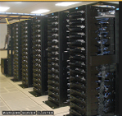
SYSTEM ASSETS
CLUSTER ASSET: A combination of similar individual assets that can function independently but may be related to or associated with a larger conglomeration for management or control purposes. These items meet capital criteria on an individual basis. Combining them as a Cluster may be permanent or temporary. Individual assets can be added or removed.
Key: Identical items meeting capital criteria should be capitalized as stand-alone items, when practical. Merging the assets into a cluster asset may be considered in exceptional cases.
Your line item will look like the example below:
Notes:
Consideration for capitalization as a cluster is given only when other factors are involved (primarily for inventory control purposes or when required on a 53-fund project where the cluster will contain all data related to that project and the items will stay together for the duration of the project.). Any exceptions regarding capitalization will be decided on a case-by-case basis.

Slide 39

SYSTEM ASSETS
BUNDLED ASSET: The cost of the asset is bundled and meets capital criteria, but individual items costs are unknown. The items will be kept together as one asset.
Look for the terms Kit or Set.
Key: Quotes will not have individual item costs listed.
Exception: If you are purchasing the exact same independent items in bulk for cost purposes only and you know the number of items you are purchasing (e.g., 1 BD, $12,000, the bundle consists of 1000 widgets), you can determine the individual cost by dividing the total cost by the number of items being purchased ($12,000/1,000 = $12 each). You would use the individual cost to determine whether to capitalize each item individually or expense the entire bundle.
Your line item will look like the example below:
Notes:
BD is the Unit of Measure Code for Bundle. Justification should be provided regarding capitalization or expense reasons.

Slide 40

SYSTEM ASSETS
COMBINED ASSET: A combination of items that function together as a single asset. The items generally would not be capitalized on their own, but as a conglomeration the total cost meets the capitalization threshold. Combined assets are connected in a manner of dependency.
Look for the terms Assembled or Fabricated.
Key: All items are needed to make the asset function as-a-whole. If any item is removed, the asset will not function as a whole asset. Items are integrated. If the items were purchased separately, they would generally not be capitalized individually; however, once assembled or fabricated, they create an asset.
NOTE: If you are building an asset over a long period of time (perhaps even crossing fiscal years) and purchases are made on multiple PO’s and/or from multiple vendors, a Work-in-Process (WIP) should be set up to capture the costs until the asset is completed.
You will have multiple line items that need to be combined.
Notes:
Fabrications usually fall into this category. An asset is being built out of parts and pieces purchased either all at once or over time. If so, set up a WIP using an 88 fund for 53 funds or an 89 fund for other funding. Microscopes are also ordered in pieces and assembled into an asset.

Slide 41
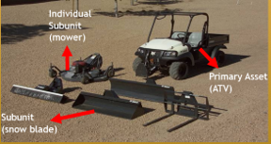
SYSTEM ASSETS
HOST ASSET: The host asset is a primary asset that can have attachments, accessories, or auxiliary apparatus. Connection is usually minimal (by cable or wire connection). The attachments, accessories, or auxiliary apparatus are interchangeable and do not function with each other but are easily interchangeable with another primary asset.
Look for the terms Attachment, Accessory, or Auxiliary Apparatus.
Key: The primary asset meets capital criteria and can function on its own, but is purchased with attachments, accessories, or auxiliary apparatus on the same requisition and capitalized as one asset.
You will have multiple line items that need to be combined.
Notes:
These are assets with accessories. All accessories are ordered at the same time with the intention to be used with the asset they are being purchased for and would be included in the cost of the asset to determine if the asset will be capitalized or expensed.

Slide 42
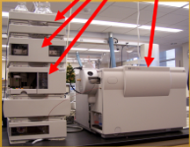
SYSTEM ASSETS
MULTIPLE UNIT ASSET: Any combination of items that function together as a one asset. The conglomeration meets capital criteria. The life and usefulness of the items are mainly dependent on the property unit as-a-whole and are not likely to be transferred and will usually be disposed of as a complete asset. Assets of this type will be entered in the asset records as a single asset. If any single item is removed and needs to be replaced, the new items should be purchased as a repair/replacement part (expensed), unless it qualifies as a betterment or upgrade.
Look for the term System.
Key: Multiple items are connected to make the asset function as-a-whole.
You will have multiple line items that need to be combined.
Notes:
These assets can consist of expensive components that may or may not meet the capital threshold on their own, but the entire asset is over the capital threshold and is used as a conglomeration.

Slide 43
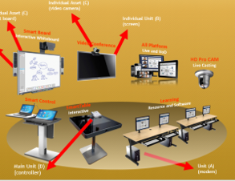
SYSTEM ASSETS
ELECTRONIC SYSTEM ASSET: This category is separated due to the nature of combining items together such as; desk top computers, audio rooms, video rooms, telephone systems, or any other technical items that work together.
Look for the term System.
Key: Multiple items are connected to make the asset function as-a-whole.
NOTE: Physical attachment, lack of interchangeability are attributes that are considered when determining whether to capitalize or expense. Most 77 fund purchases do not itemize the cost of each component, so capitalizing the system as one asset at the full value paid, is likely to happen. When components have listed prices, many attributes are considered to determine if they should be capitalized or expensed on an individual basis or capitalized as a system.
You will have multiple line items that need to be combined.
Notes:
Most items do not meet the capital threshold and may not even meet the one-year life. Electronic system components are usually replaced or moved frequently. Attributes to consider are; cost, use, how and when items are purchased, connectivity, dependency on other items, interchangeability and disposal.

Slide 44
QUESTIONS ON SYSTEM ASSETS?

Slide 45
PART TWO

Slide 46
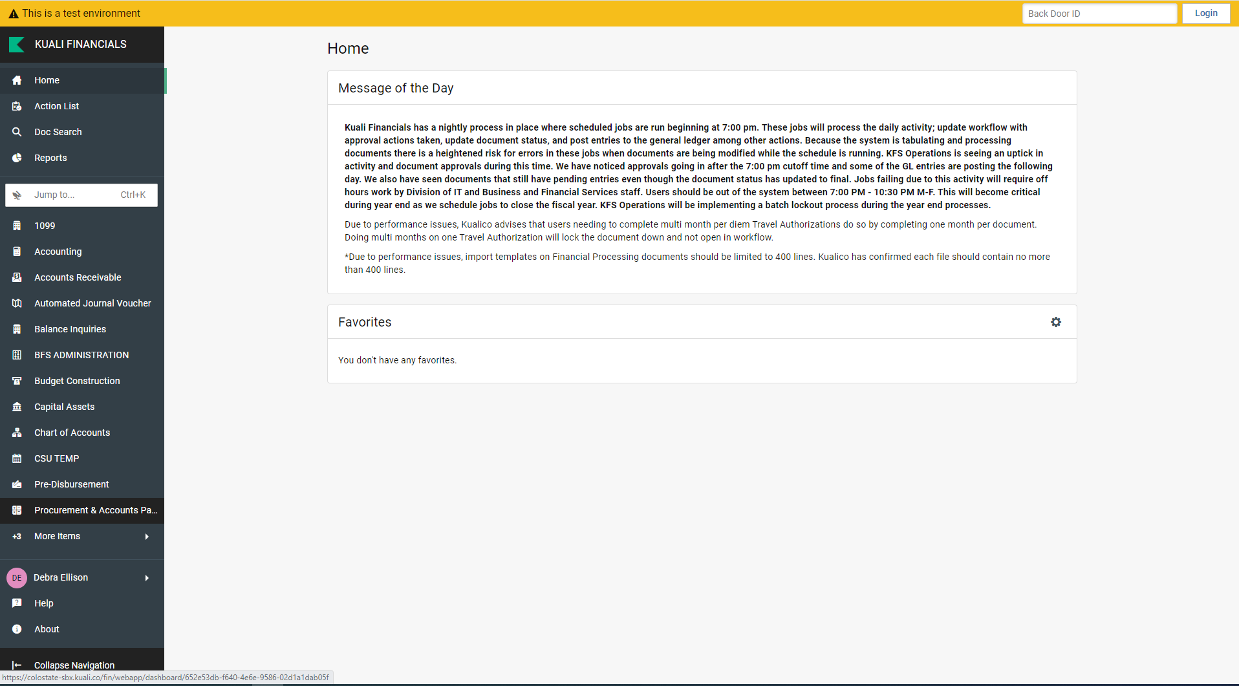
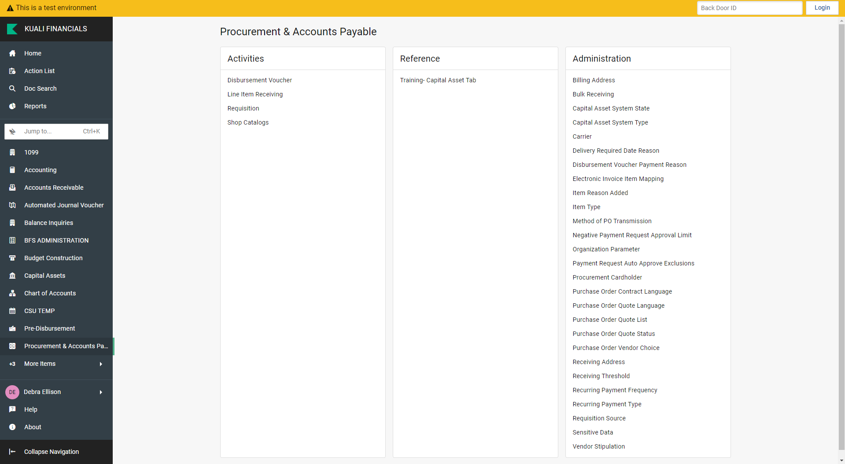
CAPITAL ASSET REQUISITON
From Home, click on “PROCUREMENT & ACCOUNTS PAYABLE”, then click on “Requisition”.

Slide 47
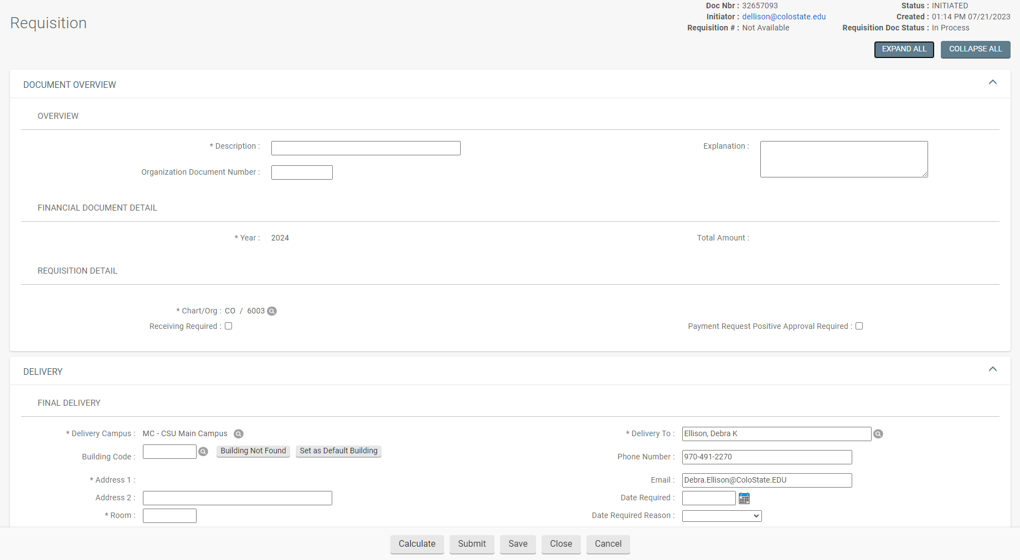
COLLAPSE ALL BUTTON
Notes:
One tip is to use the Collapse All button. This will collapse the document into a “tabs only” view. From here, you can open the tabs you want to work on.

Slide 48
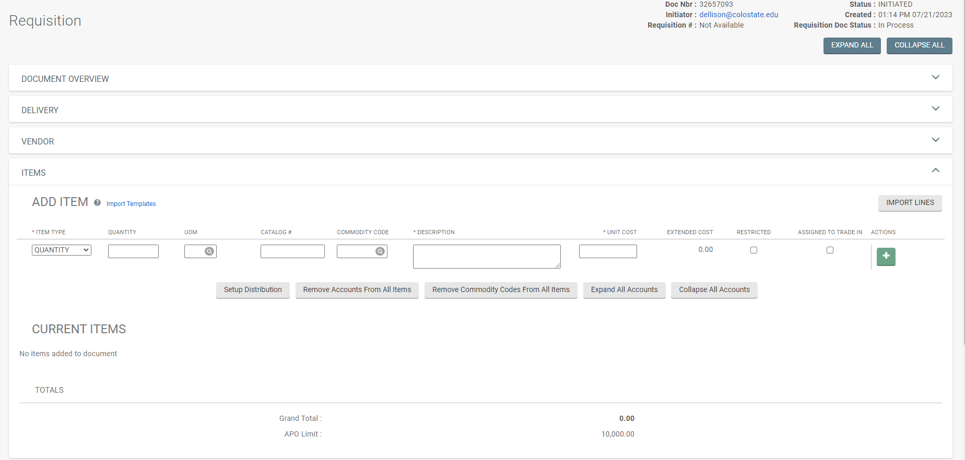
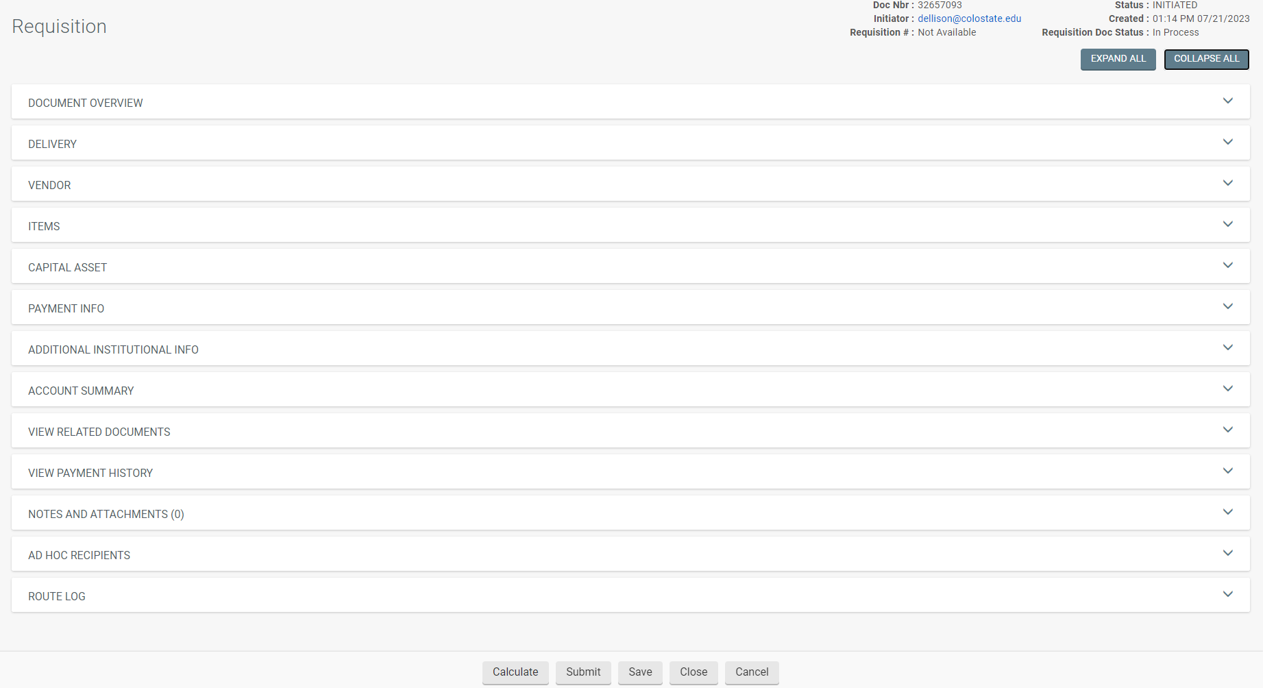
ITEMS TAB
The Items tab should be lined out to match the quote (if there is a price listed, a line item should be entered for that item).
A quantity is required for capital asset object codes, unless it is a service. Use “no quantity” for services. Track which line items will make up your asset(s) to help with completing the Capital Asset Tab.
Shop Catalog items should be uploaded from the Shop Catalog site.
Notes:
The Items Tab will affect the Capital Asset Tab and the Account Summary tab. When ordering an asset, a quantity is required. There are exceptions (usually due to multiple invoices needing to be submitted).

Slide 49
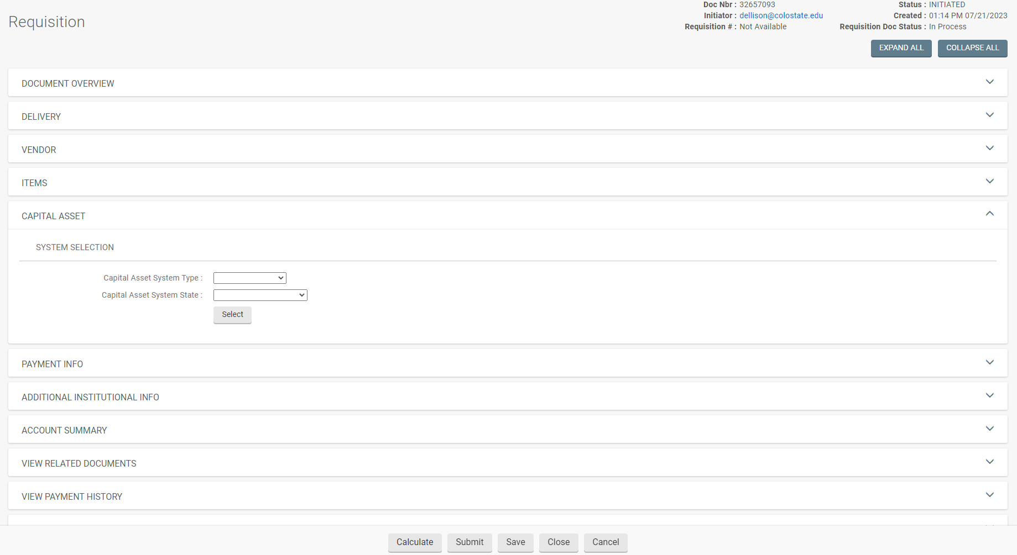
CAPITAL ASSET TAB
If capital object codes were used in any of the line items, the Capital Asset Tab will need to be completed.

Slide 50
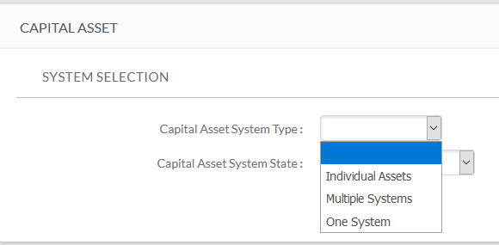


CAPITAL ASSET SYSTEM TYPE
  The Capital Asset System Type is used to provide information regarding how to process each capital asset object code line item.
  You have the following choices:
  Individual Assets
  Multiple Systems
  One System
Notes:
This information is used to create the appropriate quantity and cost of each asset.

Slide 51
CAPITAL ASSET SYSTEM TYPE
  Individual Assets is used when none of the capital asset object code lines on the requisition will be combined with any other capital asset object code line. Any lines using a capital object code will create an individual stand-alone asset (or identical assets based on the quantity ordered on that line) and the cost of each individual asset must meet the capitalization threshold on its own merit. So, if shipping is capitalized on a separate line item, do not use Individual Assets because shipping should be included in the cost of the asset. (Each line item stands-alone).
  Multiple Systems is used when the criteria for Individual Assets or One System is not met. It is also used for combining multiple requisition costs to create an asset or assets; or when modifying an existing asset. Capital object code line items will be combined in different ways to create any combination of assets. If needed, reference system assets to help sort the line items into system assets. (Lines using capital object codes are combined with other lines that also use a capital object code to create multiple assets).
  One System is used when you are combining all capital object code lines together to make a system asset or identical system assets (depending on the quantity ordered). All assets created will have identical costs. If needed, reference system assets to help sort the line items into system assets. (All lines are combined to create a system asset or identical system assets).
Notes:
Individual Assets means each line that used a capital asset object code needs to meet capital criteria on its own merit and individual line items will not be combined with any other line items. Know what line items need to be combined. One System means you are combining all capital object code line items into one system asset or identical system assets (if using a quantity of more than one each is used). Each capital line item quantity should be equally divisible by the number of assets being created so the cost of each asset is identical. All capital Service Costs will be allocated equally when the assets are created. There should be no Individual (stand-alone) Assets when One System is selected. Multiple Systems is used for all other scenarios involving multiple line items and multiple quantities. It is important to provide information regarding how to combine line items to create each asset (or identical assets if more than one each is used) and how many assets will be created when Multiple Systems is selected.

Slide 52
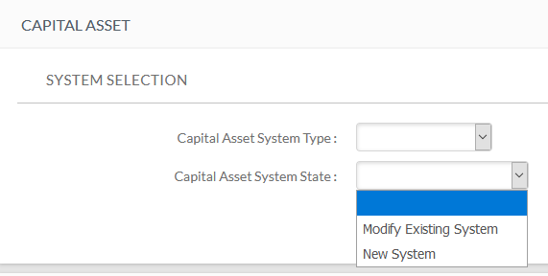
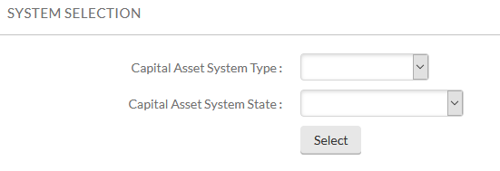
CAPITAL ASSET SYSTEM STATE
The Capital Asset System State is used to select if this purchase will add costs to an existing asset or if this purchase will create a new asset or system asset.
Modify Existing System (adding to or upgrading an existing active asset)
New System (create a new capital asset)
Once you have made your System Selections, click on “Select”.
  Note: The threshold limit is $1,000 when using modify existing within the same fiscal year. If the item is being purchased a different fiscal year than the original asset, the new purchase must meet the threshold for capitalization.
Notes:
Depending upon the information entered in the System Selection section, different information will be required when completing the Capital Asset tab.

Slide 53
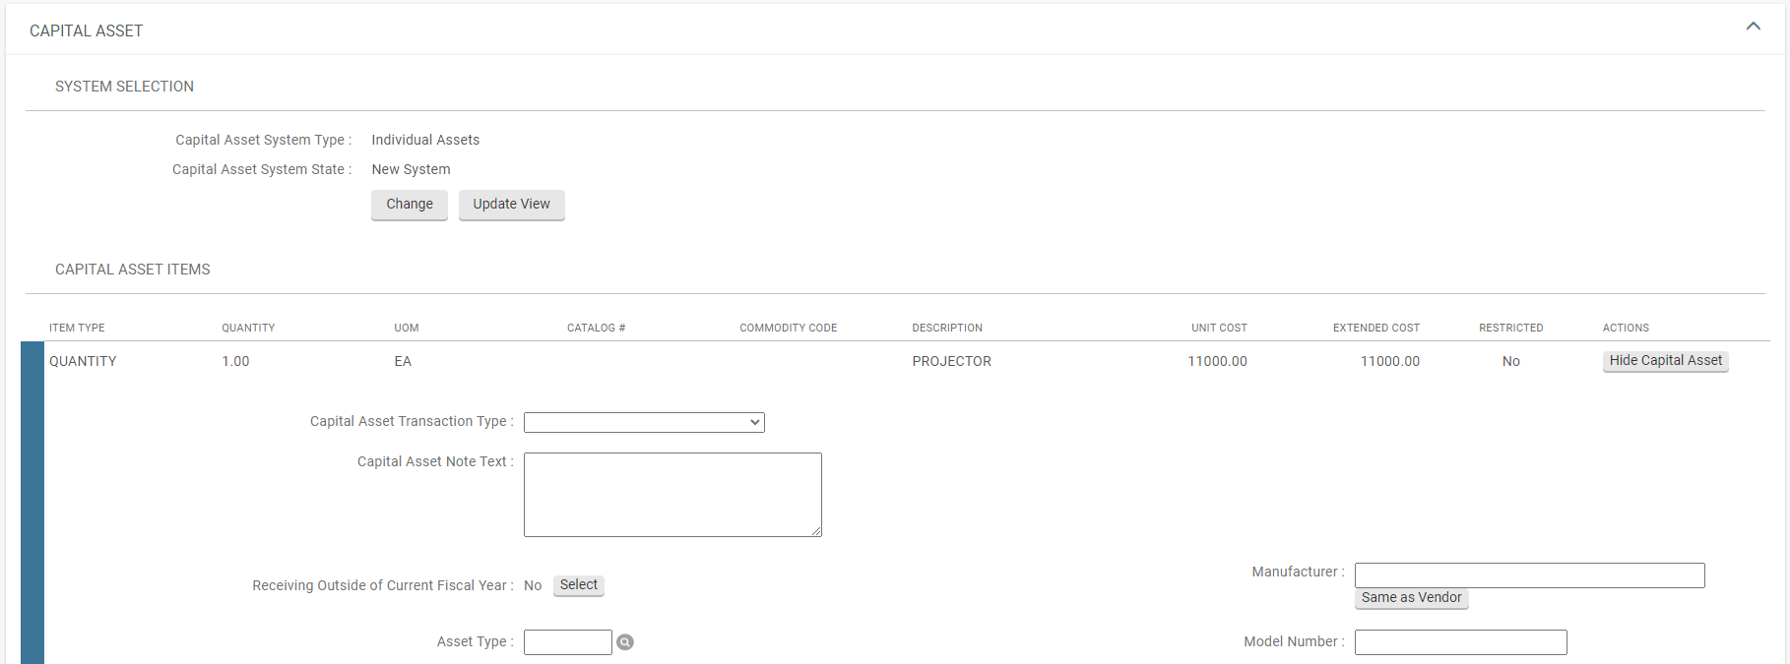
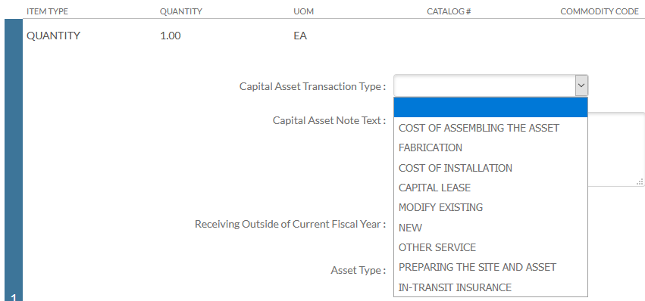
INDIVIDUAL ASSETS
Notes:
Capital asset object codes need a quantity. However, if you have a service that will be capitalized, you can use “no quantity” in your Line item but here is where you will select a “service” Capital Asset Transaction Type. Other Service is the one used mostly for shipping. If you get an error message when saving or submitting, check to see if you have a quantity or no quantity in your line items and make sure you have the correct Capital Asset Transaction Type that matches.

Slide 54
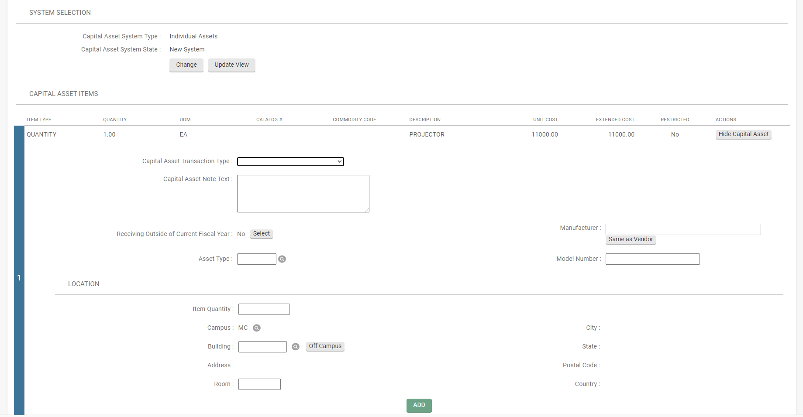
INDIVIDUAL ASSETS
Capital Asset Note Text: The note text is used to describe how capital line items are connected and other necessary information.
Manufacturer: Enter if known, otherwise click on “same as vendor”
Model: Enter if known, otherwise put “unknown or custom”
Asset Type: Look it up using the magnifying glass. It should match the asset description.
Location information is not required and can be left blank. If entered, the quantity ordered will need to match the Item Quantity you are entering the location for.
Notes:
It is helpful to enter the asset location so it can be found for tagging. The location must always be an on-campus location (a location listed in the system). Assets located off-campus will require a loan document once the asset is created.

Slide 55
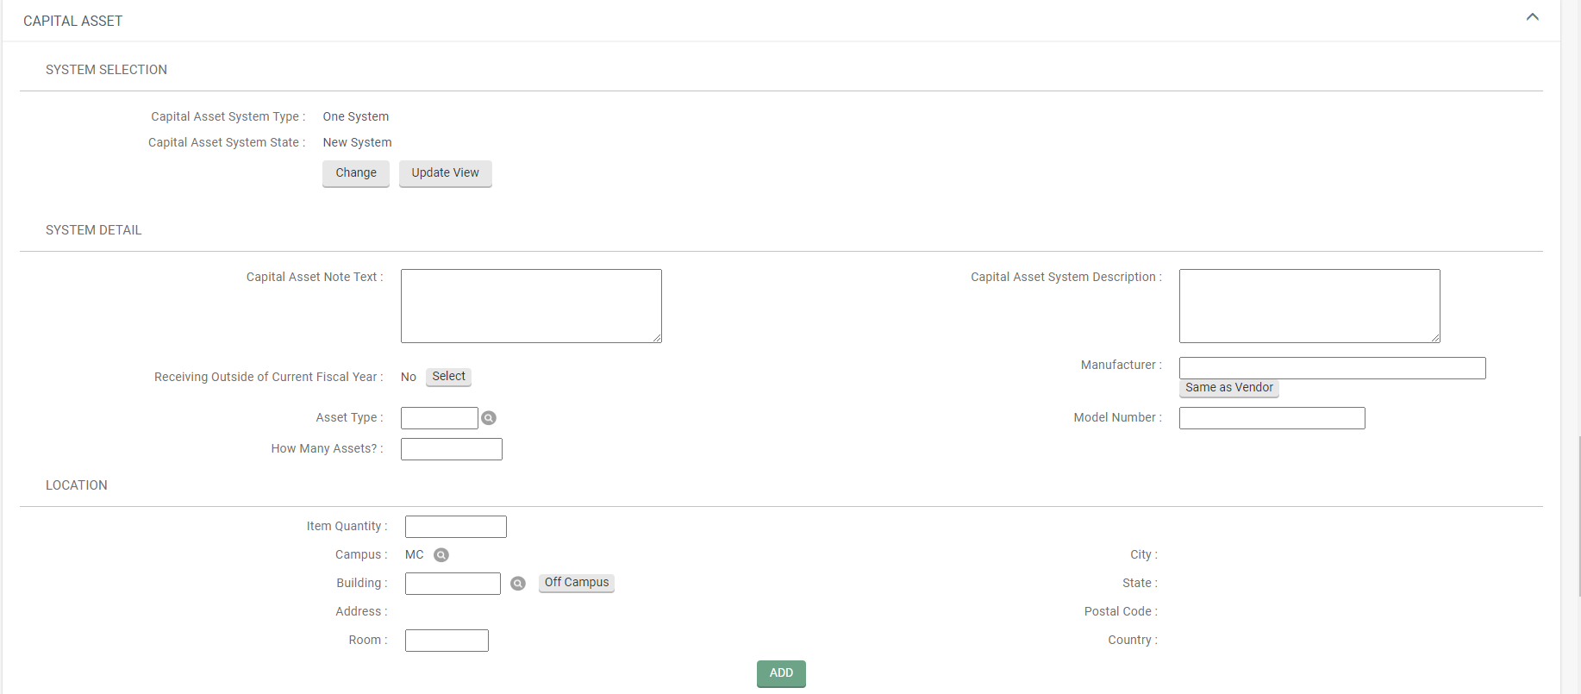
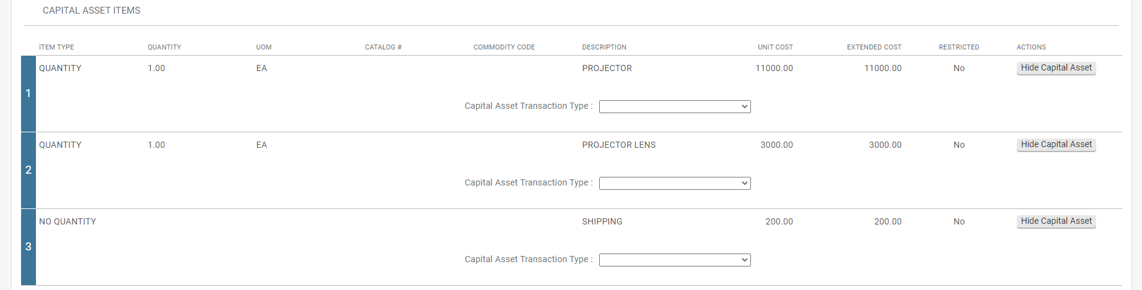
ONE SYSTEM
Capital Asset Note Text: Combine all capital lines
Capital Asset System Description: Asset description should match Asset Type Code description
Manufacturer: Enter if known, otherwise click on “same as vendor”
Model: Enter if known, otherwise put “unknown or custom”
Asset Type: Look up the asset description and return to populate the Asset Type Code
How Many Assets?: Number of assets to be created (may or may not match quantities ordered; however, your assets should be identical so quantities should be distributed equally).
Capital Asset Transaction Type: L1: New/L2: New/L3: Other Service
Notes:
One System means to combine all capital object code lines together. Each line that uses a capital object code will be brought into the Capital Asset tab for processing. It asks for similar information as the Individual Assets information. When using One System, if more than one asset is being created, they should be identical.

Slide 56
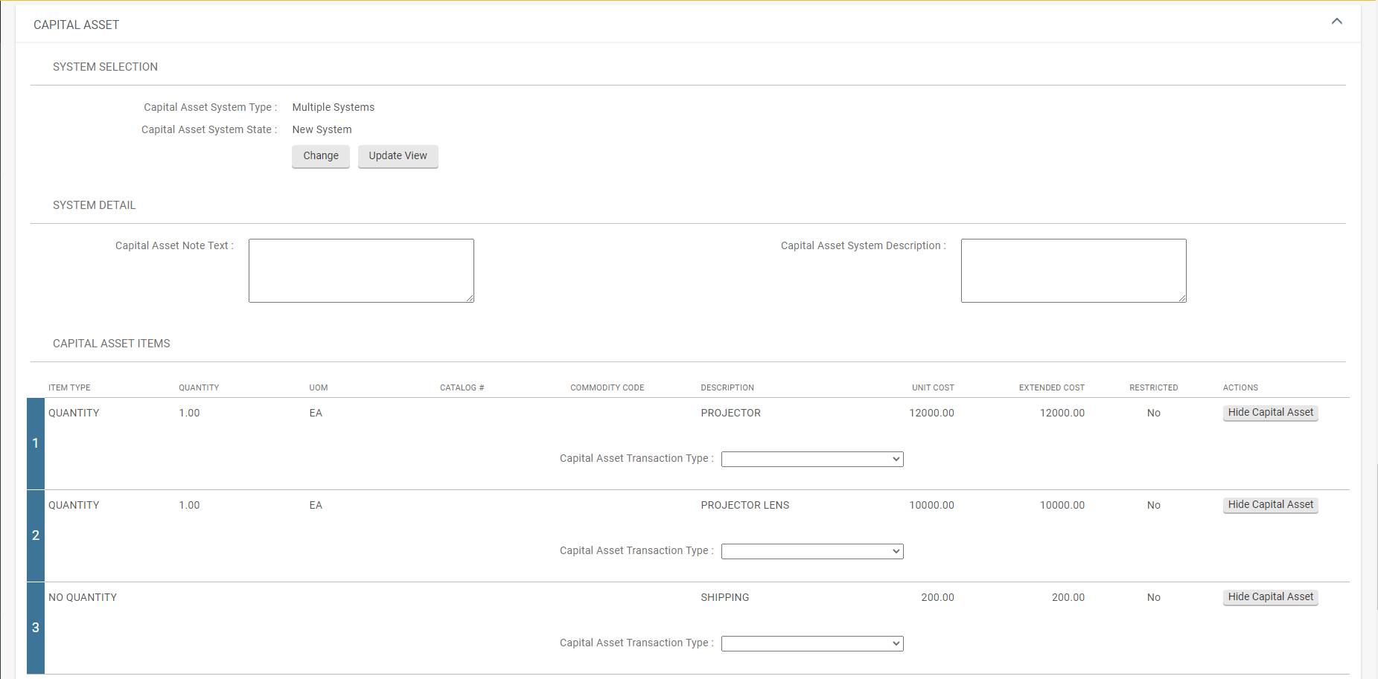
MULTIPLE SYSTEMS
Multiple Systems doesn’t ask for the same detailed information as Individual Assets and One System.
The Capital Asset Note Text is extremely important. It describes how to combine lines.
The Capital Asset System Description should state each asset’s description that will be created.
Notes:
Only the capital object code lines should be brought in. Line 3 is under the capital threshold, which means that Individual Assets should not be used. One system isn’t used because we aren’t combining all three lines (lines 1 and 2 are separate assets and line 3 will be allocated to each asset). The capital asset note text is used to describe how the lines items should be combine along with any other relevant information, such as number of assets being created. Next, we have the capital asset system description. This wasn’t required when “Individual Assets” was selected; but was required when “One System” was selected. Here you will describe the asset or assets you are ordering. Notice: Manufacturer, Model, Asset Type and Number of Assets are not shown or required when using “Multiple Systems”. Also notice, the Capital Asset Transaction Type Code is in a different location than the Individual Assets example. Neither lines 1 or 2 are services, so “new” should be used for the Capital Asset Transaction Type Code. Line 3 is a service (no quantity), so a service Capital Asset Transaction Type Code should be used.

Slide 57
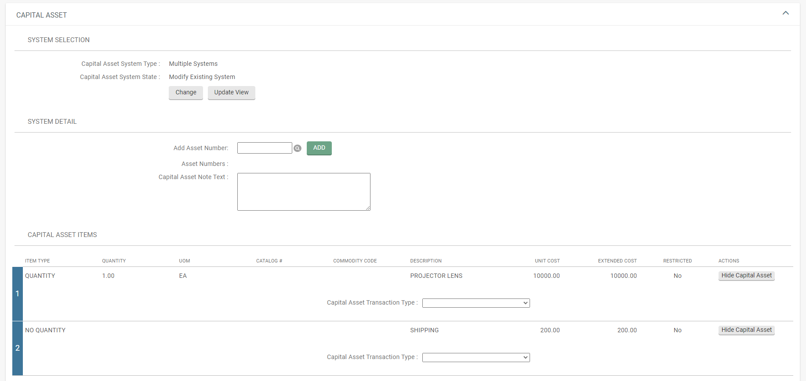
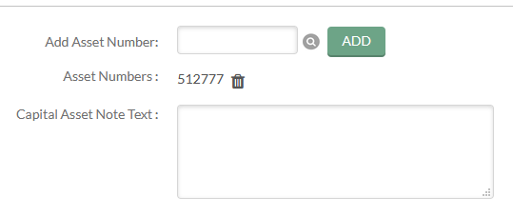
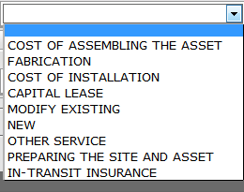
MULTIPLE SYSTEMS (MODIFY EXISTING)
You will be asked for the Asset Number. This is not the decal/tag number. You can click on the magnifying glass to find the asset number. Once found, click on return selected.
The Asset Number will populate in the field.
Then, click on “add”.
You can add additional assets or delete assets for changes.
Capital Asset Note Text: Put in a description such as; accessory for decal xxxxxx
Capital Asset Transaction Type: Select “MODIFY EXISTING” and “OTHER SERVICE”.
Notes:
Modify Existing is also used when making Direct to Vendor Lease Payments. The lease accountant in BFS will set up assets and the department will submit the requisition for the payments.

Slide 58
QUESTIONS ON CAPITAL ASSET TAB?

Slide 59
DIRECT TO VENDOR LEASE REQUISTION
Departments are required to send lease information to the Property Management Lease Accountant prior to submitting direct to vendor lease requisitions. Property Management will set up the asset(s) in the system to be used when submitting the requisition.
Lease purchases directly from a vendor are done using a requisition versus going through CSURF. Unlike CSURF payments, payment terms will be set up on the requisition using the appropriate lease payment object code. The requisition must show “modify asset” and use the asset number(s) provided by Property Management.
Payments will be generated from a Payment Request or Disbursement Voucher and will be based upon payment terms entered in the requisition.
CSURF lease purchases will be handled between CSURF, Property Management, the Department, and Procurement. CSURF will initiate the payments on a Distribution of Income and Expense document.
NOTE: All down payments on any leases should use the appropriate equipment object code, not a lease payment object code.
Notes:
*CSURF, Colorado State University Research Foundation. A Lease purchase means CSU will own the equipment at the end of the lease.

Slide 60
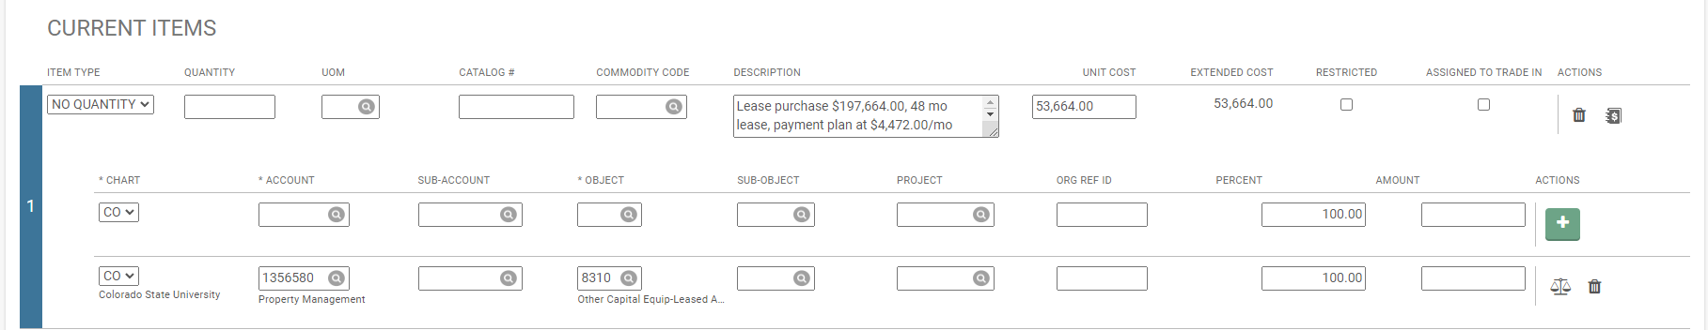
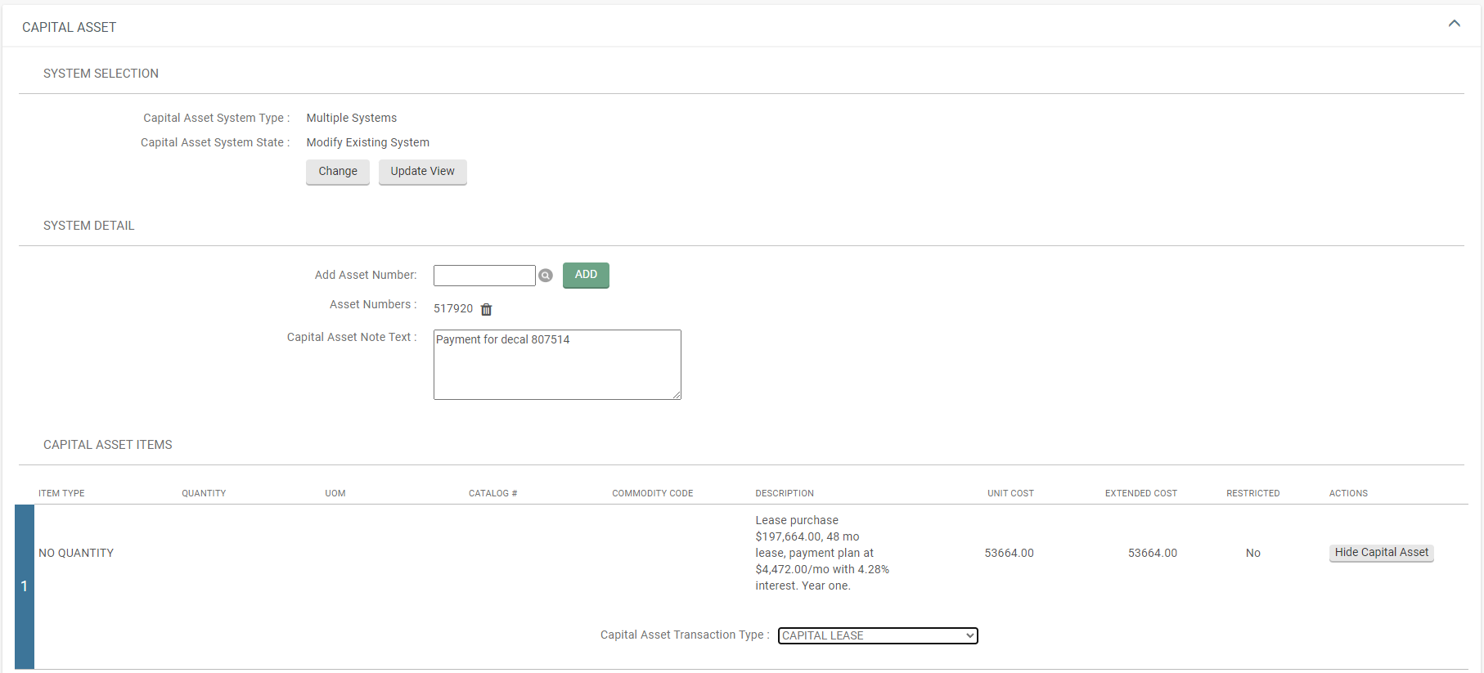
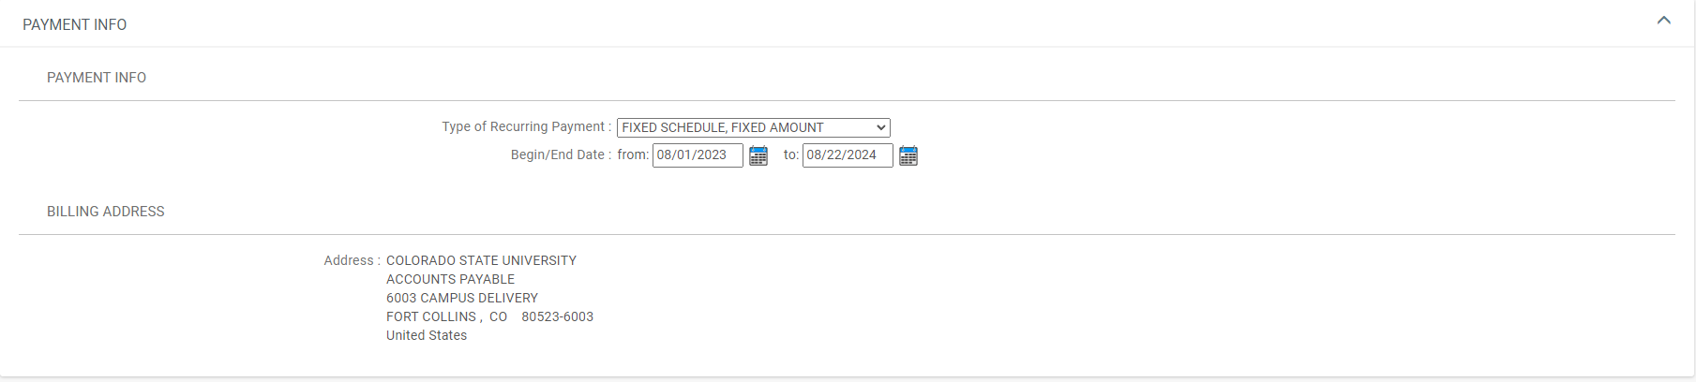
LEASE PURCHASE REQUISTION
Notes:
Use “NO QUANTITY”, the appropriate lease payment object code, Multiple Systems, Modify Existing System, enter the Asset Number (provided by Property Management), provide any additional note text, use “CAPITAL LEASE” for the Asset Transaction Type, and set up the payment terms in the Payment Info tab.

Slide 61
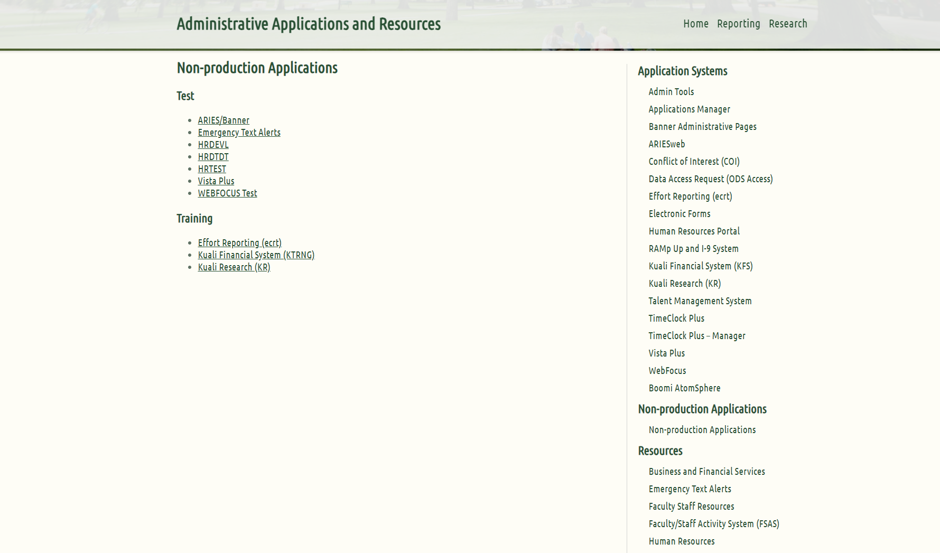
PRACTICE REQUISITON
From CSU Application Systems, find “Non-production Applications” and click on it.
Under “Training”, select “Kuali Financial System (KTRNG)

Slide 62
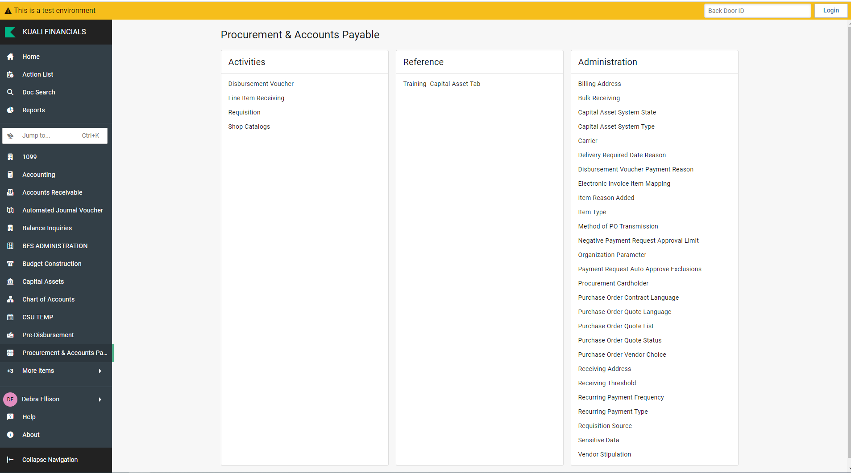
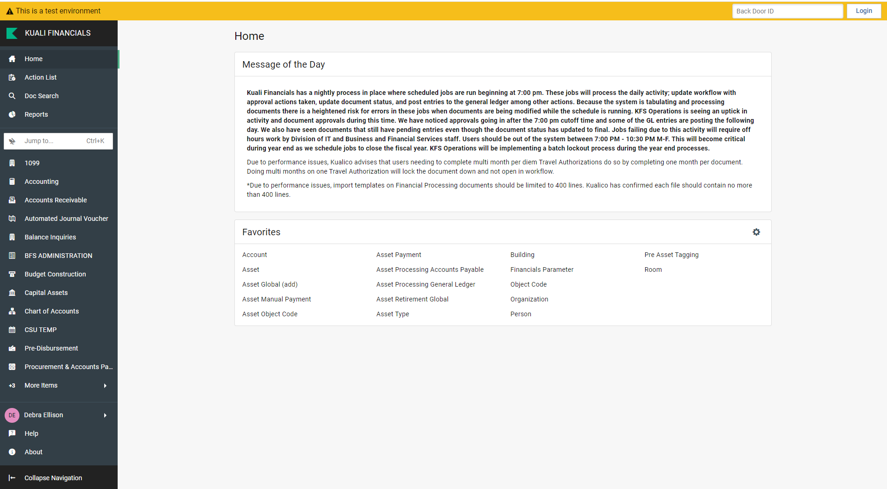
PRACTICE REQUISITON
From Home, click on “PROCUREMENT & ACCOUNTS PAYABLE”, then click on “Requisition”.

Slide 63
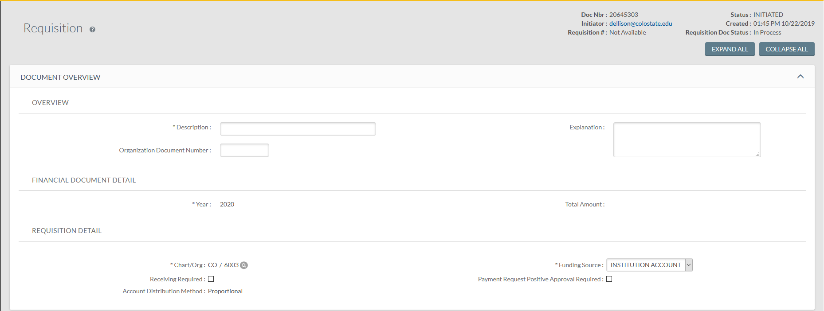
PRACTICE REQUISITON
Enter the following information:
Description: Test
Explanation: Test

Slide 64
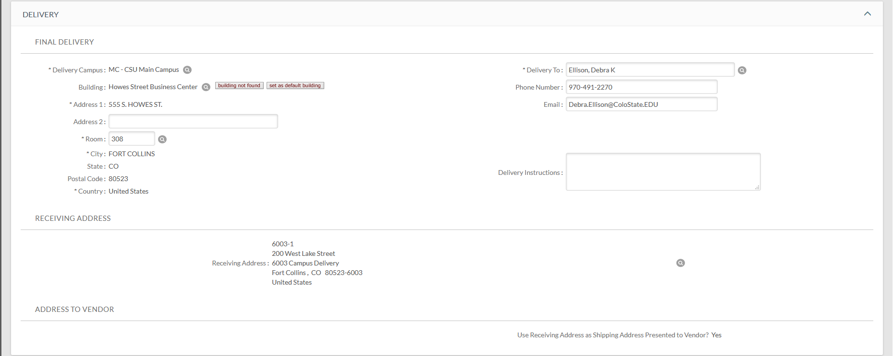
PRACTICE REQUISITON
Enter the following information:
Building: Use the Magnifying Glass to Lookup 0926
Once entered, you have the option to use “set as default building” which will automatically populate the same building on future requisitions.
Room: 308
Delivery Instructions: Internal Use Only (Vendor will not see this)
Notes:
You have the option to use “set as default building” which will automatically populate the building on future requisitions.

Slide 65
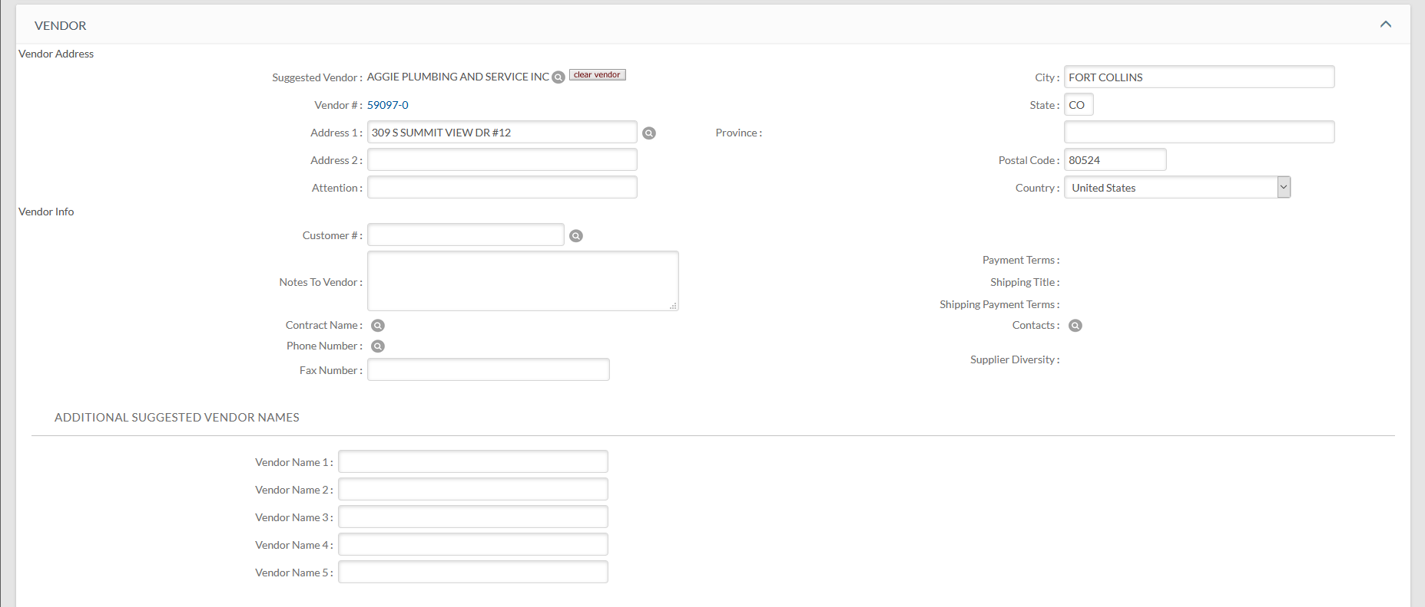
PRACTICE REQUISITON
Enter the following information:
Vendor: Use the Magnifying Glass to Lookup AGGIE PLUMBING AND SERVICE INC

Slide 66

PRACTICE REQUISITON
If you have multiple lines, you can use “IMPORT LINES” (contact procurement for template).
Enter Line 1:
Item Type: QUANTITY (This is automatically populated; it can be changed to “NO QUANTITY”).
Quantity: 2
UOM: EA
Description: WIDGET
Unit Cost: 15000 (Capital threshold is $5,000 for 53 funds, $10,000 for other funding)
Click on the Plus Sign to add the line
Notes:
As you enter each line, keep in mind if it meets capital criteria or not (i.e. is it a stand-alone item, is it an accessory, or is it a capitalized service cost).

Slide 67

PRACTICE REQUISITON
Enter Line 2:
Item Type: QUANTITY
Quantity: 2
UOM: EA
Description: GADGET
Unit Cost: 11000
Click on the Plus Sign to add the line

Slide 68

PRACTICE REQUISITON
Enter Line 3:
Item Type: QUANTITY
Quantity: 2
UOM: EA
Description: GIZMO
Unit Cost: 1000
Click on the Plus Sign to add the line

Slide 69

PRACTICE REQUISITON
Enter Line 4:
Item Type: NO QUANTITY
Quantity: BLANK
UOM: BLANK
Description: SHIPPING
Unit Cost: 200
Click on the Plus Button to add the line

Slide 70

PRACTICE REQUISITON
You can enter the accounting lines individually by clicking on the “dollar sign”
Or you can enter accounting lines by clicking on “Setup Distribution”
Click on: Setup Distribution

Slide 71

PRACTICE REQUISITON
Enter Account: 1356580
Enter Object Code: 8210
Click on the Plus Button to add the accounting line
Notes:
What object code is most appropriate?

Slide 72

PRACTICE REQUISITON
When using Setup Distribution, you can continue to enter accounts (split funding). Enter all accounts before clicking on “Distribute to Items”.
Clicking on “Distribute to Items” will distribute all entered accounting lines to each line item that does not have accounting line information already populated.
Click on: Distribute to Items
Notes:
Keep in mind, you may need to make changes on each individual line regarding the account or object code, etc.

Slide 73


PRACTICE REQUISITON
You will get a message at the top of your Requisition.
Click on: “Expand All Accounts”

Slide 74


PRACTICE REQUISITON
All accounts and object codes entered will be populated under the line items.
Once populated, you can change the account or object code to suit the line item depending on how the lines are related when creating an asset or assets.

Slide 75
PRACTICE REQUISITON
In the below example, there are two each of lines 1-3 and only two lines meet the capital threshold of $10,000 (for non-53 funds). Also, shipping is a cost included when capitalization is involved. In this example, we will assume all lines will be combined to create two identical assets.

Slide 76

PRACTICE REQUISITON
Enter the following in the Capital Asset tab:
Capital Asset System Type: One System (because all lines will be combined)
Capital Asset System State: New System
Click on “Select”

Slide 77

PRACTICE REQUISITON
The CAPITAL ASSET tab will open.
Capital Asset Note Text: Combine all lines
Capital Asset System Description: Do-Hickey
Manufacturer: Enter or click on “Same as Vendor”
Model: Custom
Asset Type Code: Lookup or use 78225SI (Note, if entering manually, you must capitalize the letters)
How Many Assets: 2
The location is optional, however, if you know where the asset(s) will be located, you will enter this information.
Enter the location for each asset (match the quantity if located in the same location, otherwise, enter individual asset’s location using Item Quantity “1” for each asset in a different location).
Enter the Building and Room Number
Make sure you click on “ADD” if you entered the location.
NOTE: Do not use “Off Campus”, loan documents are used for assets located off-site.
Notes:
As we reviewed earlier, you will need to enter different information based upon which Capital Asset System Type and Capital Asset System State was selected. The Note Text is used to let the asset processor know how to combine line items to create an asset or assets. The Description should help determine the Asset Type Code (remember, the asset type code helps with the object code).

Slide 78

PRACTICE REQUISITON
The line items that used a capital object code are brought into the CAPITAL ASSET tab.
Enter the following Capital Asset Transaction Types: Line 1: NEW; Line 2: NEW; Line 3: NEW; Line 4: OTHER SERVICE
Notes:
Line items showing “NO QUANTITY” will need a service Capital Asset Transaction Type.

Slide 79


PRACTICE REQUISITON
The PAYMENT INFO tab needs to be completed if you are submitting a “direct to vendor” lease.
Enter the Type of Recurring Payment (select from the drop down).
Enter the Begin/End Date.

Slide 80

PRACTICE REQUISITON
The ADDITIONAL INSTITUTIONAL INFO tab will be populated with the person’s information who created the requisition.

Slide 81

PRACTICE REQUISITON
The ACCOUNT SUMMARY tab may or may not be populated. It provides a summary of each account.
If it is not populated, you can click on “Refresh Account Summary”. NOTE: When making changes, “Refresh Account Summary” plays an important role.
The line items will be matched to the account and object code used showing the total for that account and object code.

Slide 82

PRACTICE REQUISITON
The VIEW RELATED DOCUMENTS tab and VIEW PAYMENT HISTORY tab should both be blank.

Slide 83

PRACTICE REQUISITON
The NOTES AND ATTACHMENTS tab is used for notes.
Attach quotes (when not uploaded from shop catalogs), Equipment Acquisition Requests (EARs) for 21 fund equipment purchases, equipment release authorizations for trade-ins, etc., and/or other necessary documents.
When needed, you can click on “Send to Vendor?”.
Make sure you click the “add” button.

Slide 84

PRACTICE REQUISITON
The AD HOC RECIPIENTS tab can be used to send the document to others not listed in the route log.
You can send to an individual and select the Action Requested (APPROVE, COMPLETE, FYI, or ACKNOWLEDGE).
You can send to a group and select the Action Requested (APPROVE, COMPLETE, FYI, or ACKNOWLEDGE).
Click on “ADD”.

Slide 85


PRACTICE REQUISITON
The ROUTE LOG tab may or may not be populated. If you save your document, it will populate.
You can see who is listed next in the routing and what Action is needed.
If you have a group, you can click on the group to see the names of individuals within the group who can take the shown action.
Click on the “X” to go back.

Slide 86
PRACTICE REQUISITON
You will then have the following options:
Calculate: This will populate the line item monetary values.
Submit: This will submit your document (if you have any errors, you will get an error message).
Save: This will save your document. You can find it again in your action list to complete it.
Reload: This will revert back to the last entered information. If you saved your document, it will only revert back to information at that point in time.
Close: This will close your document (you will be asked if you want to save it before you close it).
Cancel: This will cancel your document.
Copy: This will copy your document (except the Capital Asset tab and any attachments). So, if your document was disapproved, once you have acknowledged it, you can do a search to find it and copy it (so you don’t have to reenter information). NOTE: If you used Shop Catalog, Copy is not available.

Slide 87
MAKING CHANGES
Questions to ask before making a change:
Is the CAPITAL ASSET tab already completed?
If so:
How will changing an object code from capital to non-capital or from non-capital to capital affect the Capital Asset tab information?
How will adding or deleting a line affect the Capital Asset tab information?

Slide 88
MAKING CHANGES
NOTE: Any time you make changes and BEFORE you have saved your document, you may click on the “reload” button to start over with your changes.
Once you have saved your document, you will be making new changes from that point on. Also, if you click on “Change” in the Capital Asset tab to remove information, reload will not repopulate the information in the Capital Asset tab.

Slide 89




MAKING CHANGES
The Capital Asset Tab, Items tab, and Account Summary tab are all related to each other.
NOTE: If the Capital Asset tab is not populated, make changes in the Items tab first, update the Account Summary tab next, and then enter the Capital Asset tab information.

Slide 90

MAKING CHANGES
CAPITAL ASSET TAB
If the Capital Asset tab is populated there are two buttons available:
Change
Update View

Slide 91


MAKING CHANGES
Any changes that involve:
Removing one or more line-items that were brought into the Capital Asset tab
Changing from one Capital Asset System Type (one system/multiple systems/individual assets) to another
Changing from one Capital Asset System State (new system/modify existing system) to another
Will require you to click on “Change”.
NOTE: You will receive a warning to asking if you want to clear the Capital Asset tab information. Click on “Yes”.

Slide 92
MAKING CHANGES
“Update View” is used whenever:
Object codes have been changed from Non-Capital to Capital.
Account numbers have been changed on capital asset object code line items.
Quantities have been changed on capital asset object code line items.
Descriptions have been changed on capital asset object code line items.
Amounts have been changed on capital asset line items.

Slide 93

MAKING CHANGES
ITEMS TAB
You can make the following changes in the Items Tab:
Edit Current Items: Item Type, Quantity, Unit of Measure, Catalog #, Commodity Code, Description, and Unit Cost. NOTE: You cannot edit shop catalog costs.
Account Changes
Object Code Changes
Adding/Deleting lines
Adding/Deleting Accounts
Notes:
Change the object code to 6201.

Slide 94


MAKING CHANGES
Deleting lines or accounts in the Items Tab example
To delete a line, click on the “trash can” icon associated with that line (this will also delete the account).
To delete just the account, click on the “trash can” icon associated with the account.

Slide 95

MAKING CHANGES
ACCOUNT SUMMARY TAB
Any changes made will require refreshing the account summary tab.
Click on the “Refresh Account Summary” button.
Notes:
After any line-item changes, the ACCOUNT SUMMARY tab needs to be refreshed.

Slide 96


MAKING CHANGES
When you are done making changes, click on “Refresh Account Summary” in the Account Summary tab.
The line item will be removed from the Account Summary tab.
Notes:
After any line-item changes, the ACCOUNT SUMMARY tab needs to be refreshed. Now go back and delete line 3 then click on Refresh Account Summary again.

Slide 97
QUESTIONS ON MAKING CHANGES?

Slide 98
491-2899 Jacque Clark - Property Administrator/Property Mgmt. Manager/Cost Accountant
491-7362 Cheri Richardson – Accounting
491-6513 Robyn Billings- Leases / Accounting
491- 2270 Debra Ellison – Property Mgmt. Supervisor/ Acct. Tech III
491-1045 Rachel Drenth - Inventory Specialist / Data Entry
491-1358 Michelle Miller - Inventory Specialist / Data Entry
We are available to help
THANK YOU FROM THE PROPERTY MANAGEMENT TEAM

